Slide 1

Population Health Assessment Engine

Slide 2
Population Health Assessment Engine Curriculum
01
02
BACKGROUND
Introduction to
Population Health
Introduction to
Geospatial Concepts
BEGINNER
03
04
05
Introduction to the Population Health Assessment Engine
How to use My Community
How to use Community HotSpots
06
07
ADVANCED
Getting the Most out of My Community
Getting the Most out of Community Hotspots
Notes:
This curriculum consists of 2 background modules that will introduce you to population health and geospatial concepts. The next three modules will describe how to use the Population Health Assessment Engine (PHATE) and the two tools embedded within PHATE: My Community and Community HotSpots. The final two modules will help you learn how to integrate PHATE into your clinic.

Slide 3
Overall goal for the PHATE Curriculum
To integrate community data, clinical data, and community resources in order to address social determinants of health and improve the health of patients and populations.
Notes:
Through the modules, case studies, and performance improvement activity, we hope that you will be able to integrate community data, clinical data, and community resources in order to address social determinants of health and improve the health of patients and populations.

Slide 4
Target audience
Anyone interested in learning about improving the health of populations
  Providers
  Staff
  Learners
    Residents
    Medical students

Slide 5
Abbreviations
PHATE: Population Health Assessment Engine
HIPAA: Health Insurance Portability and Accountability Act

Slide 6
HOW TO USE MY COMMUNITY
BEGINNER 04

Slide 7
Nuts and Bolts 04: How to use My Community
Learning Objectives
Define service area
Demonstrate competency in creating a service area map
Demonstrate competency in creating a spreadsheet that can be uploaded into PHATE

Slide 8
Relevant family medicine milestones
Notes:
After completing this module, we hope that family medicine residents will be able to meet these milestones.
https://www.acgme.org/Portals/0/PDFs/Milestones/FamilyMedicineMilestones.pdf

Slide 9
Relevant nurse practitioner competencies
Notes:
After completing this module, we hope that nurse practitioner trainees will be able to address these competencies.
http://www.aacn.nche.edu/dnp/Essentials.pdf
https://c.ymcdn.com/sites/nonpf.site-ym.com/resource/resmgr/Competencies/NPCoreCompsContentFinalNov20.pdf

Slide 10
Nuts and Bolts 04: How to use My Community
Outline
What is a service area?
Creating your service area map

Slide 11
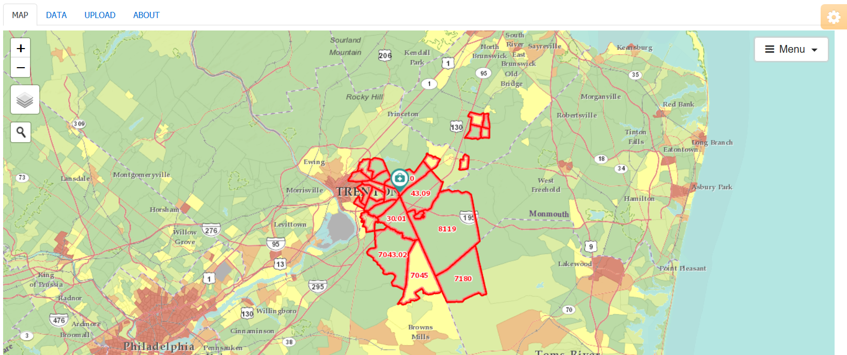
My Community
What you can do using My Community:
View community characteristics
View your clinic’s service area
View how your clinic’s service area relates to community characteristics
Download community characteristics

Slide 12
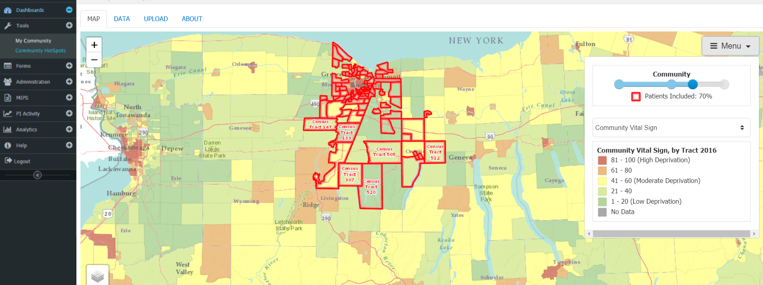
Community HotSpots
Notes:
To access My Community, select the option on the navigation menu on the left side of the screen.

Slide 13

A service area is the community or communities served by the practice
Nutting PA. Community-Oriented Primary Care: From Principle to Practice. Albuquerque, NM: University of New Mexico Press, 1990.
Notes:
A service area is the community or communities served by the clinic

Slide 14
Service area
Methods for service area definition:
  Public agencies: school districts
  Geographic borders: bodies of water
  Social or economic function: garment district
  Historical neighborhoods: Georgetown
  Geographic retrofitting: the geographies where most of the practice patients live
Nutting PA. Community-Oriented Primary Care: From Principle to Practice. Albuquerque, NM: University of New Mexico Press, 1990.
Notes:
Community is more than just the people living in a geography and includes bricks and mortar, power structures, historical traditions, social values and customs, and a myriad of unquantifiable and undefinable essential features.
There are numerous methods for defining a service area, including using existing boundaries devised from public agencies, geographic borders, geographies with a shared social or economic function, historical neighborhoods, and geographic retrofitting (or the process of using patient addresses to identify the geographies where most patients live).

Slide 15
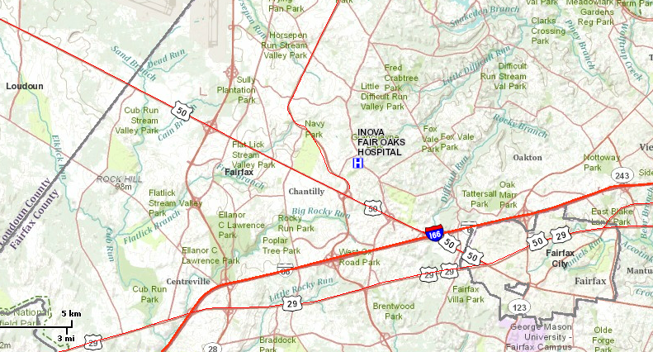
Service area
Using geographic boundaries
Notes:
Imagine that your clinic is right next to Fair Oaks Hospital. You can use existing geographic boundaries to define your service area. In Fairfax, you could pick four streams that could be used as borders. This makes more sense in rural areas where there are important geographic landmarks. In a mountainous area, for example, your service area could be everyone living in a particular valley.

Slide 16
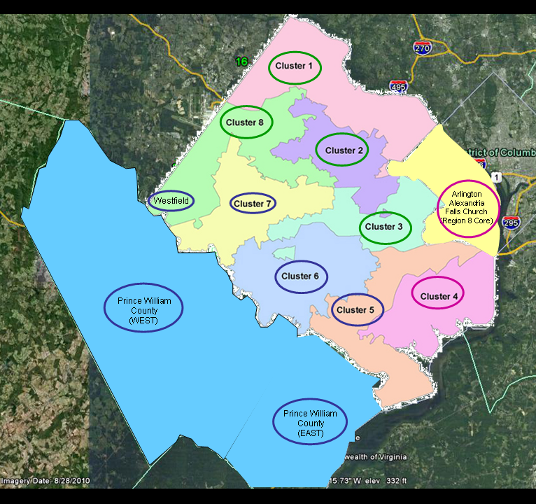
Service area
Using predefined boundaries
Notes:
Using school districts, you could choose three of the nearby high school pyramids to be your clinic’s community.

Slide 17
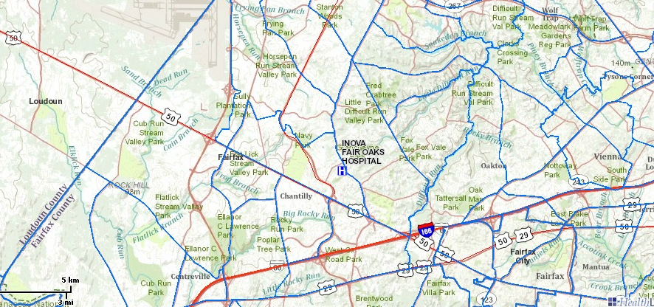
Service area
Geographic retrofitting
Notes:
Finally, you could use census tracts. These census tracts represent the geographies where 80% of the clinic’s patients live.

Slide 18
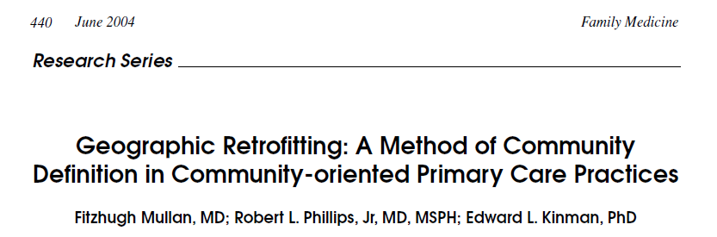
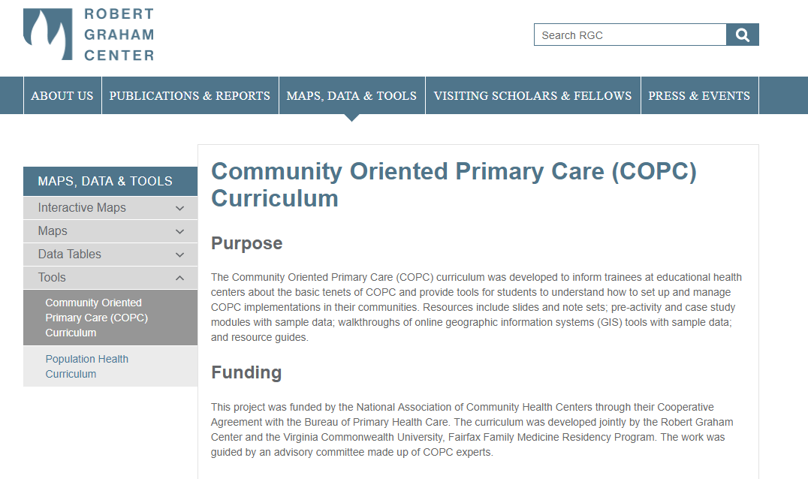
Geographic Retrofitting
Community-Oriented Primary Care
Notes:
To learn more about geographic retrofitting, please refer to this article in Family Medicine.
To learn more about defining a community, please refer to the Graham Center’s Community-Oriented Primary Care curriculum.

Slide 19
Why is the service area important?
Better delivery of care
Payment is increasingly tied to the health of populations
  Accountable care organizations
  Accountable health communities
  Identifying and treating those at risk for poor health
Notes:
Understanding one’s service area is a critical step towards improving the health of populations. In a fee-for-service system, providers have little incentive to seek out those who need care, and instead, care for those with adequate resources.
Other systems, like in Australia, fund primary care clinics through population-based funding where providers are responsible for delivering care to communities.
To improve quality and reduce costs, the US is transitioning to payment tied to the health of populations. Payment models like accountable care organizations and accountable health communities reward systems that address populations and upstream factors. Increasingly, practices are rewarded for not just conducting visits but also identifying and treating those at risk for poor health.

Slide 20
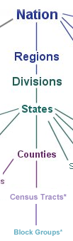
Census Geography
Census Tracts
  Primary purpose is to provide a stable set of geographic units for the presentation of statistical data
  Population size between 1,200 and 8,000 people, with an optimum size of 4,000 people
  Usually covers a contiguous area, but area varies widely
  Boundaries are delineated with the intention of being maintained over a long time so that longitudinal comparisons can be made
  Occasionally are split due to population growth or merged as a result of substantial population decline
  Boundaries generally follow visible and identifiable features
Notes:
My Community uses geographic retrofitting to create a service area. To understand this process, you first need to understand geographic units.
Census tracts are a stable, sub-county geographic unit, designed with the intent of maintaining them over a long time. Also their boundaries generally follow visible and identifiable features.
Between 1200 and 8000 people are in each census tract with an optimal size of 4000.
To learn more about census tracts, check out Module 2 (Geographic Concepts Important for Population Health) in our Population Health Curriculum:
http://www.graham-center.org/rgc/maps-data-tools/tools/pop-health.html

Slide 21
What is a service area?
Census tract | # pts | Cum. %
A | 432 | 10.3%
B | 380 | 19.5%
C | 349 | 27.8%
D | 312 | 35.3%
E | 301 | 42.5%
F | 263 | 48.8%
G | 251 | 54.8%
H | 233 | 60.4%
I | 208 | 65.4%
J | 199 | 70.1%
K | 181 | 74.5%
Census tract | # pts | Cum. %
L | 167 | 78.5%
M | 146 | 82.0%
N | 135 | 85.2%
O | 120 | 88.1%
P | 0 | --
Q | 0 | --
R | 99 | 90.5%
S | 96 | 92.8%
T | 90 | 94.9%
U | 0 | --
V | 89 | 97.1%
Census tract | # pts | Cum. %
W | 0 | --
X | 60 | 98.5%
Y | 0 | --
Z | 0 | --
AA | 27 | 99.1%
BB | 21 | 99.6%
CC | 15 | 100%
DD | 0 | --
EE | 0 | --
FF | 0 | --
TOTAL | 4,174 | 100%
Notes:
As previously mentioned, the My Community tool allows you to view your service area in relationship to community characteristics.
To generate the 70% service area, PHATE geocodes (attaches a latitude and longitude) the patient addresses and links them to their commensurate census tracts. PHATE adds up the number of patients per census tract and then rank orders census tracts from most to least patients.
All of the census tracts comprising 70% of the patients make up the 70% service area (census tracts A through J).
For an 80% service area, we would add census tracts K and L.
To create a 100% service area, PHATE includes all of the census tracts where patients live

Slide 22
What is a service area?
Service area = based on the number of patients per area; include the ones with the most patients first
70% service area
100% service area
AA
T
S
R
Q
P
BB
CC
Z
U
G
F
A
B
O
DD
Y
V
H
E
D
C
N
EE
X
W
I
J
K
L
M
FF
Notes:
And that is what this map shows. The dark green boxes would constitute the 70% service area while the light and dark green boxes combined make up the 100% service area.

Slide 23
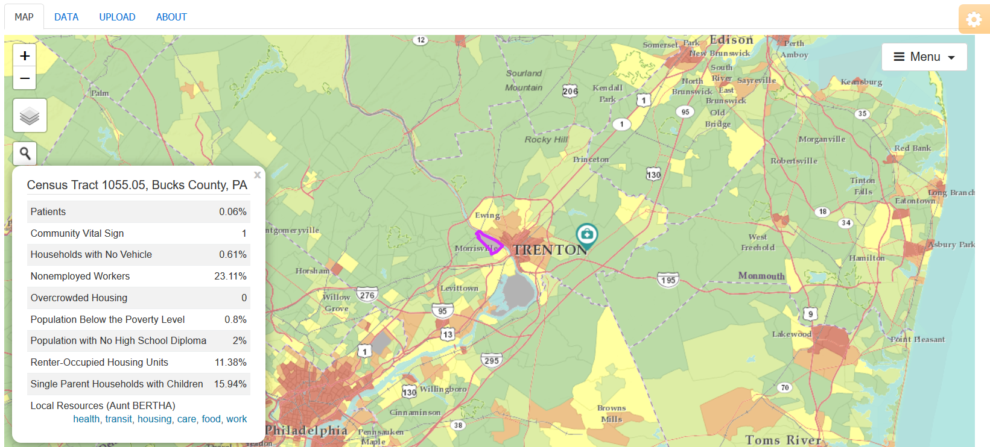
Community & Service Area
Notes:
Each geographic unit you see on the map is a census tract
If you click on a census tract, additional information about that census tract appears, including the census tract number, county, and neighborhood characteristics.
Click on the X in the top right corner of the call-out box to close information about census tract.

Slide 24
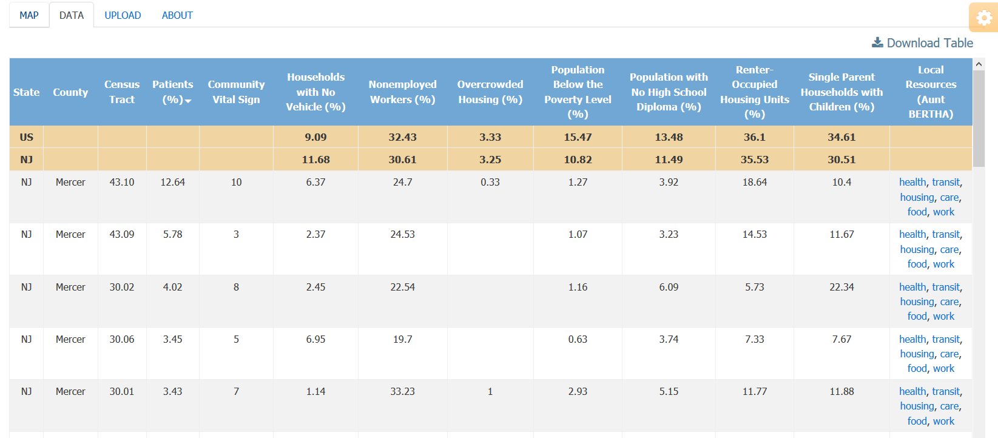
My Community
Notes:
Depending on the social determinant data selected and service area percentage, the underlying data can be viewed by selecting the “Data” tab.
The “Patient (%)” column is the percentage of the clinic’s patients living in that census tract.
This view allows you to compare social determinant data for your community against state and national averages (the top two rows).
The table can be exported to a spreadsheet (click on the “Download Table” icon).

Slide 25
Community Resources
Notes:
Under Local Resources, PHATE provides links to Aunt Bertha, a website that collates community resources in your community.
PHATE links the census tract to its commensurate zip code and allows you to search across six domains (health, transit, housing, care, food, and work). Clicking on the links takes you the Aunt Bertha page for that zip code and domain.

Slide 26
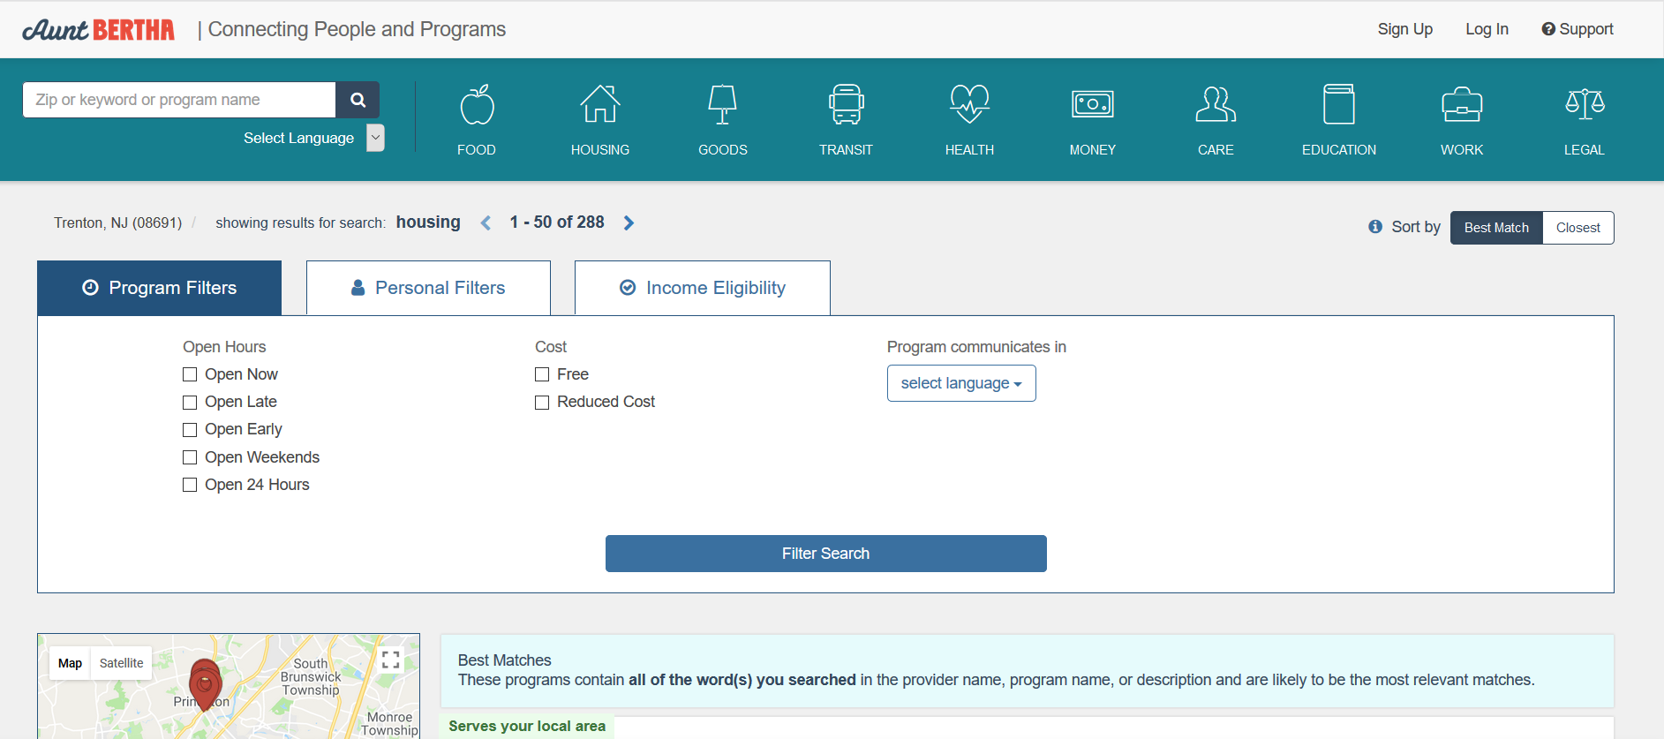
Community Resources
Notes:
Clicking on “housing” for census tract 43.10 in Mercer County takes you to this Aunt Bertha page which provides information for housing resources in this zip code.

Slide 27
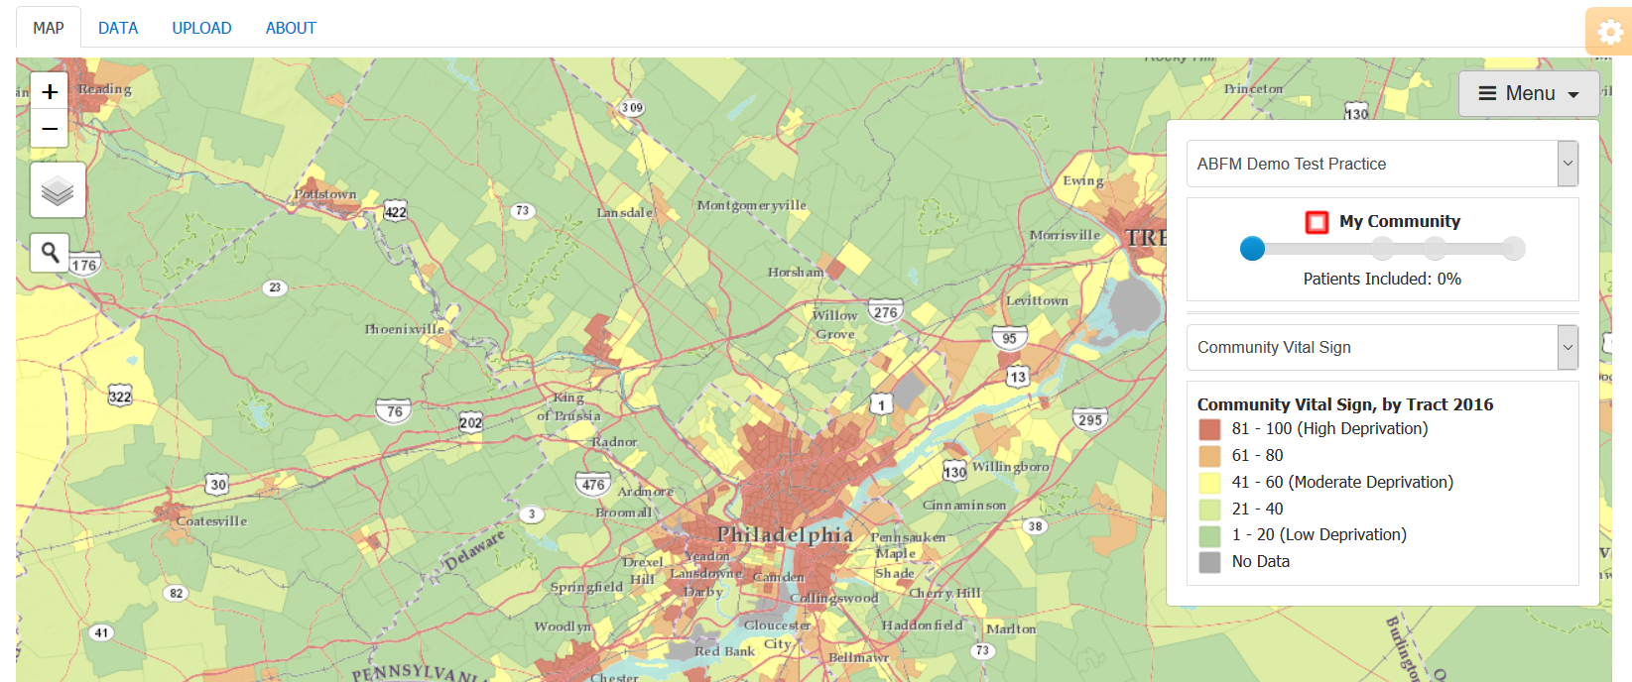
Menu
Notes:
If you click on Menu, a drop down menu appears.
Here, you can do several things:
Select amount of census tracts to include in your service area (more on this later)
Change the neighborhood data displayed

Slide 28
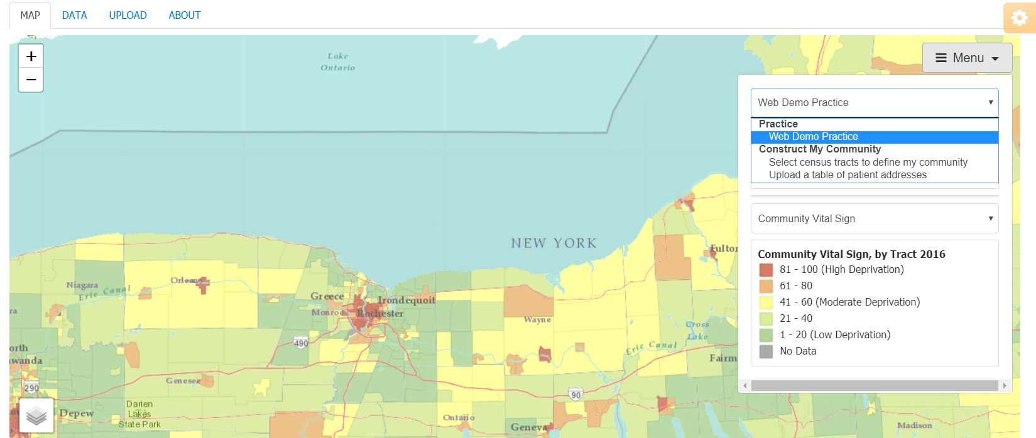
Menu
Notes:
If you click on the first drop down menu, you will see three options for identifying your service area:
Using PRIME Registry data
Selecting census tracts
Uploading addresses

Slide 29
Three ways to create service area maps
Users | Service area can be viewed automatically in PHATE | Service area can be selected by the user | Service area can be viewed by uploading addresses
Connected to the PRIME Registry | Yes | Yes | Yes (but PHATE automatically does this for you)
Not connected to PRIME and have addresses | No | Yes | Yes
Not connected to PRIME and do not have addresses | No | Yes | No
Notes:
You can use these ways for creating service areas depending on whether you have access to the PRIME Registry and/or patient addresses.

Slide 30
CREATING YOUR SERVICE AREA MAP
USING PRIME REGISTRY DATA
BEGINNER 04

Slide 31
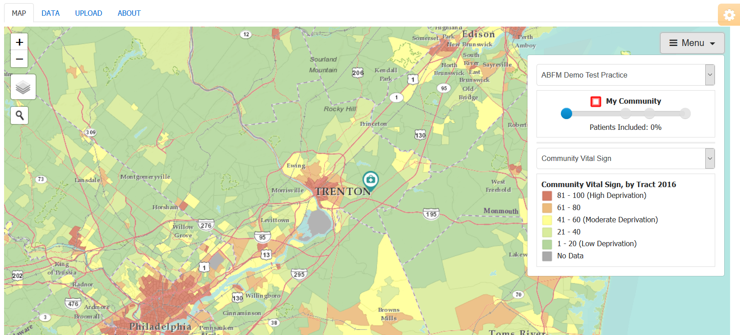
Community & Service Area
Notes:
PHATE calculates the service area for you.
Here, the slider is at 0%; therefore, no census tracts are displayed.

Slide 32
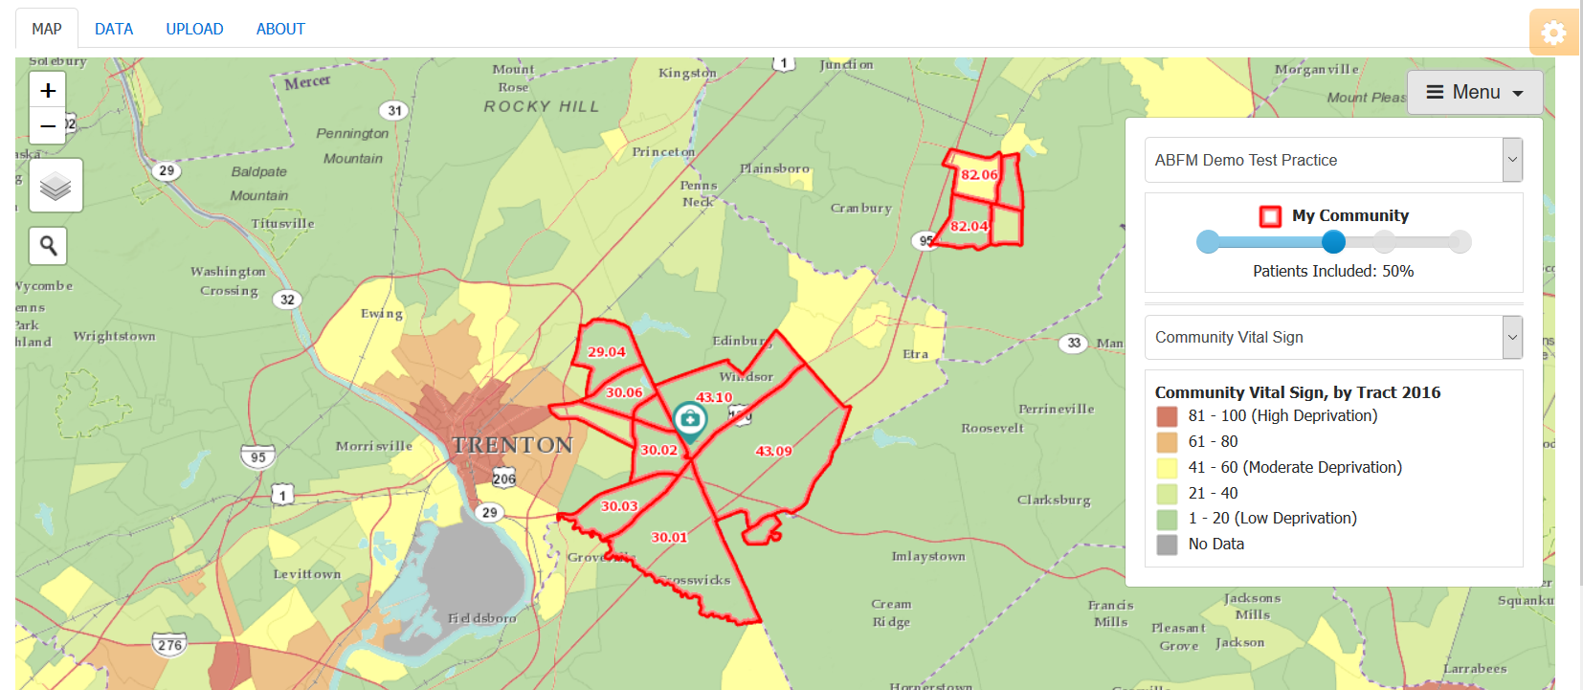
Community & Service Area
Notes:
Now, we are at a 50% service area

Slide 33
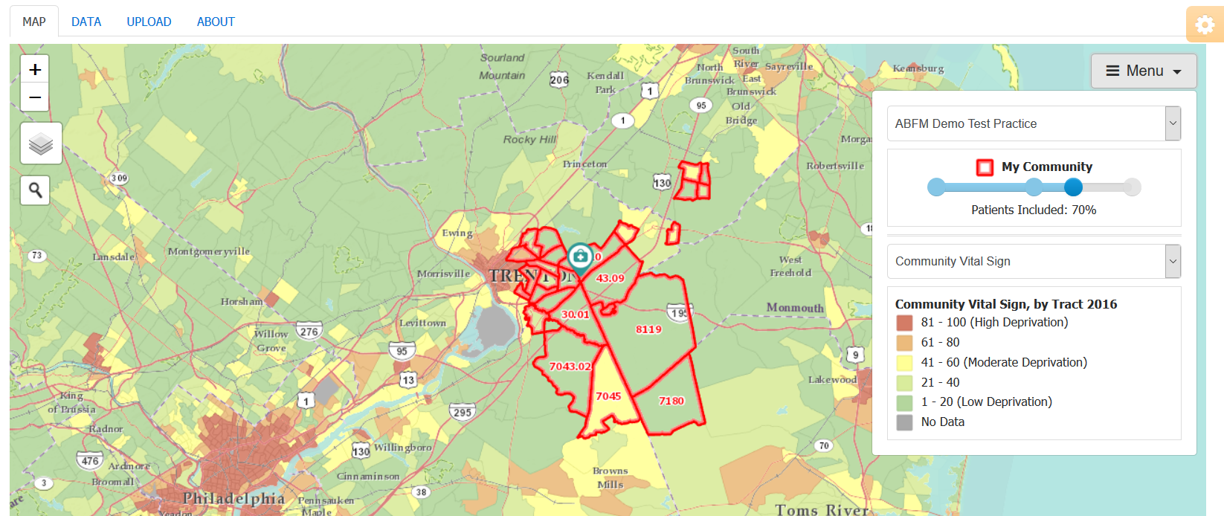
Community & Service Area
Notes:
This is a 70% service area. Notice how additional census tracts have appeared.

Slide 34
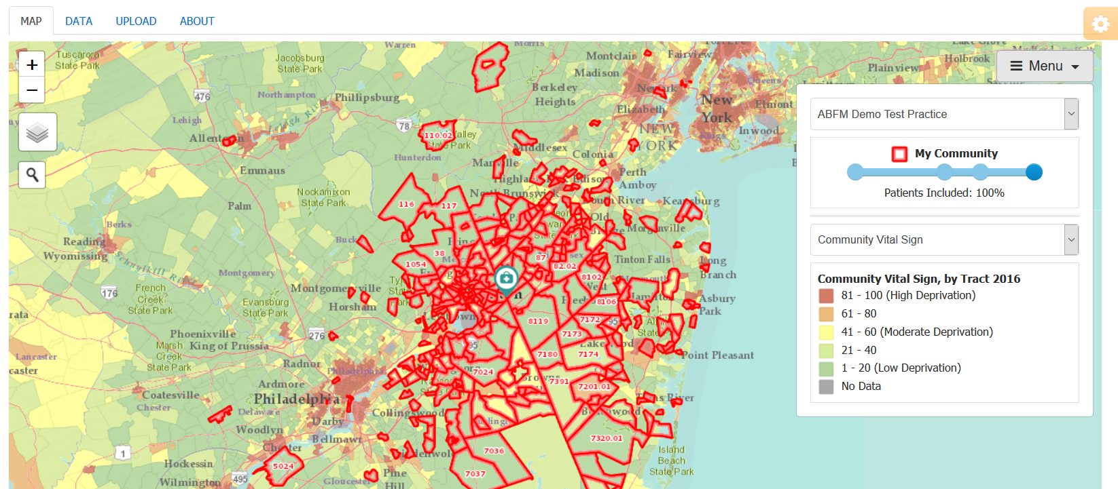
Community & Service Area
Notes:
This is a 100% service area. Notice how distant census tracts now appear.
This slider can be moved to select any service area percentage you choose. For example, you could map an 86% service area.
The business literature suggests that this core service area should include between 70-80% of your patients. The Bureau of Primary Health Care uses 75% for the UDS Mapper.

Slide 35

Community Variables
Notes:
Currently, we have mapped the social deprivation index, which is also known as the Community Vital Sign within PHATE.
As a note, some of the data are suppressed by the US Census Bureau if the number of positive responses falls below a certain threshold or if the margin of error is too wide.

Slide 36
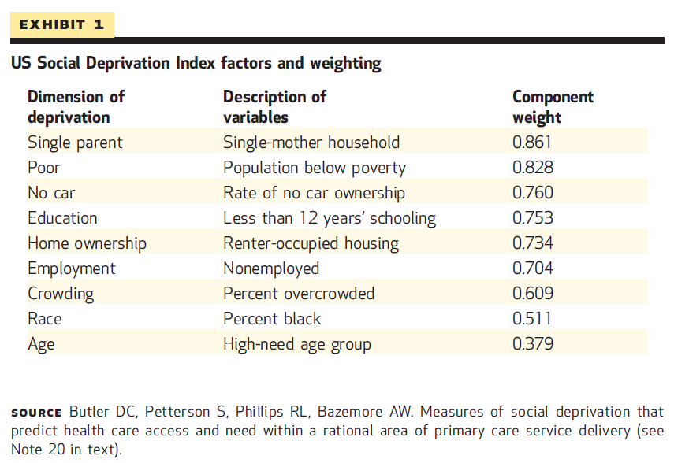
Social deprivation index
Phillips RL, Liaw W, Crampton P, et al. How Other Countries Use Deprivation Indices--And Why The United States Desperately Needs One. Health Aff (Millwood). 2016;35(11):1991-1998. doi:10.1377/hlthaff.2016.0709.
Notes:
These dimensions are the ones included in the US-based social deprivation index, which was developed by the Robert Graham Center.
Given the multitude of available community measures, communities often have difficulty agreeing on which measures to use to identify resource poor communities. One way to find a common language is to use deprivation indices. Other countries, such as the United Kingdom and New Zealand, have looked to deprivation indices to solve this problem.

Slide 37
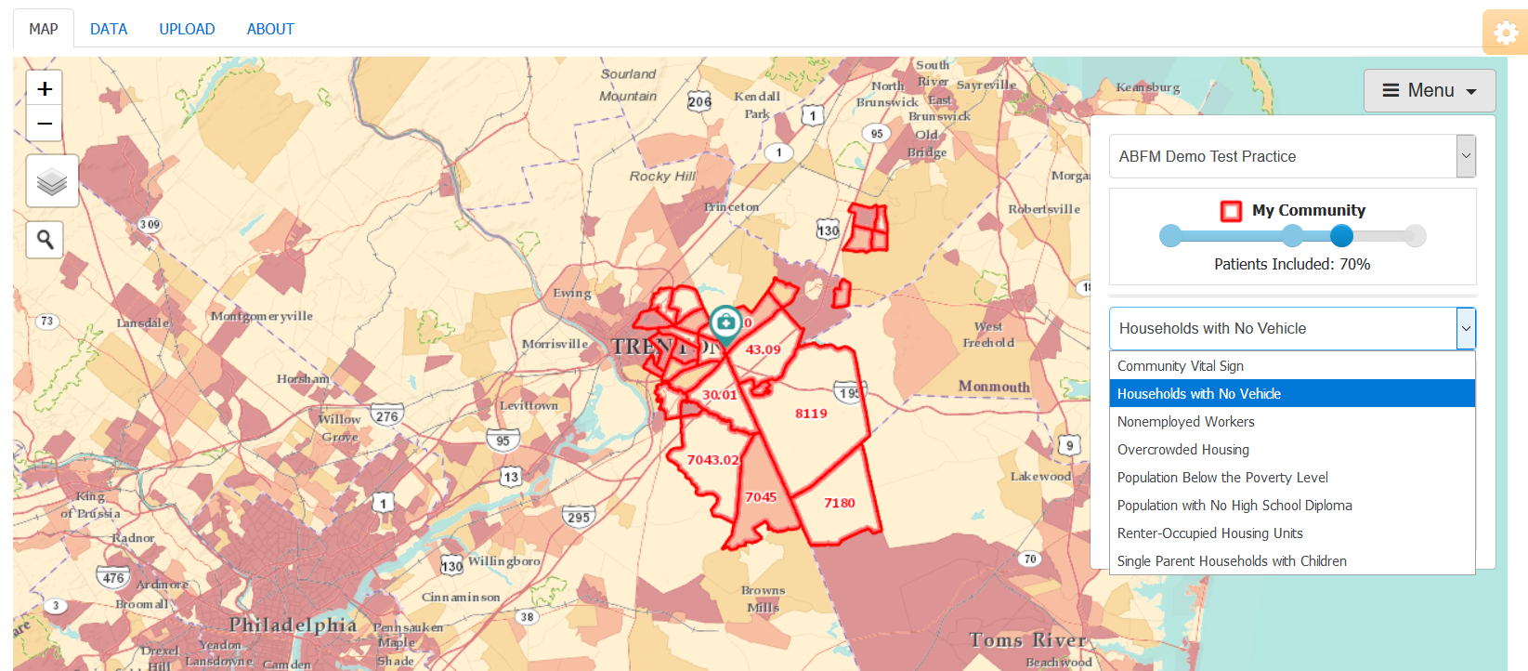
Community Variables
Notes:
If you click on the up/down arrow by the social determinant dimension, a drop down menu appears with additional options.
In this map, PHATE is displaying the % of the census tract with households with no vehicles.

Slide 38
CREATING YOUR SERVICE AREA MAP
SELECTING CENSUS TRACTS
BEGINNER 04

Slide 39
What do you know about where your patients live?
Think about…
Where they seek care
The stories they told you
Where they work or go to school
The pharmacies they used
Any administrative data you have seen
Notes:
If you are going through this module on your own, write your answer.
If you are going through this module with others, turn to your colleague and discuss your answer.

Slide 40
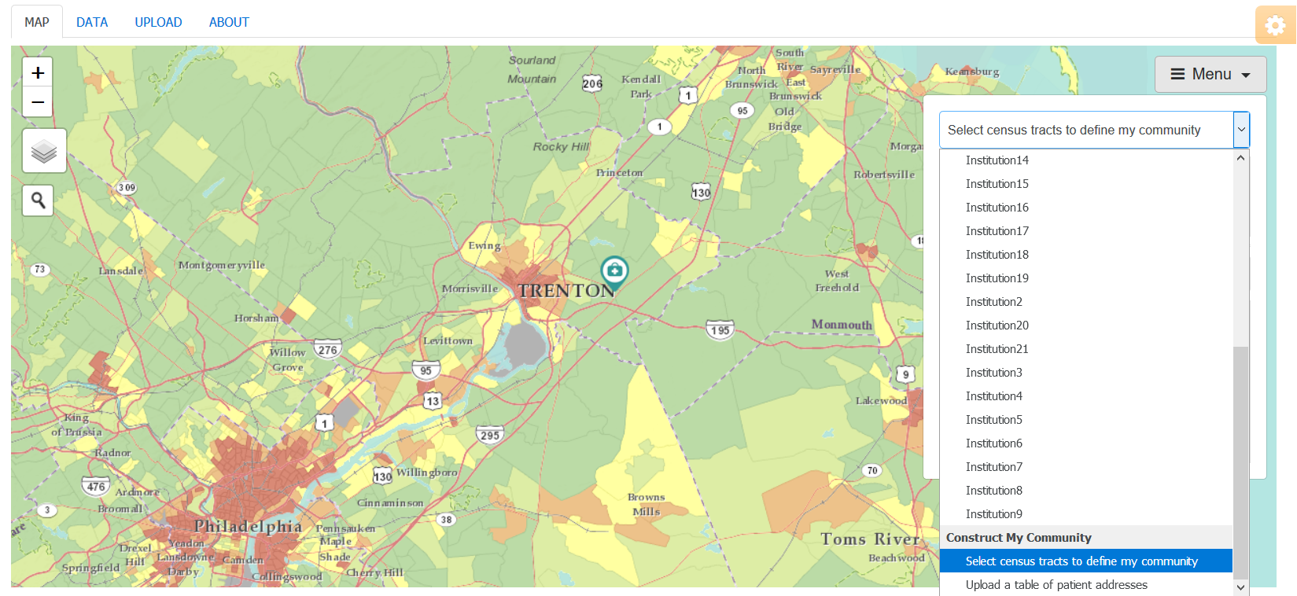
Selecting Census Tracts
Notes:
To select census tracts to define your service area, first click on “Select census tracts to define my community” under the first drop down menu.

Slide 41
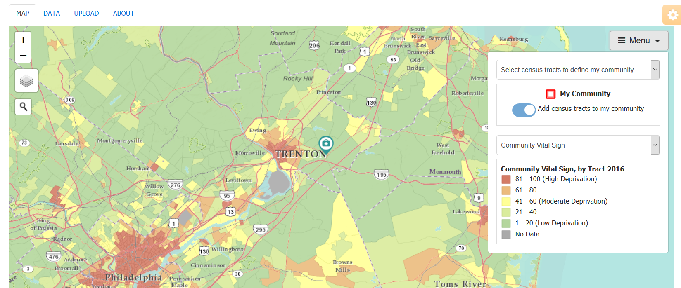
Selecting Census Tracts
Notes:
Ensure that the “Add census tracts to my community” button is highlighted.
Click on the census tracts that you think are in your clinic’s service area.
Clicking on the census tract a second time de-selects the census tract in case you wanted to change the census tracts in your service area.

Slide 42
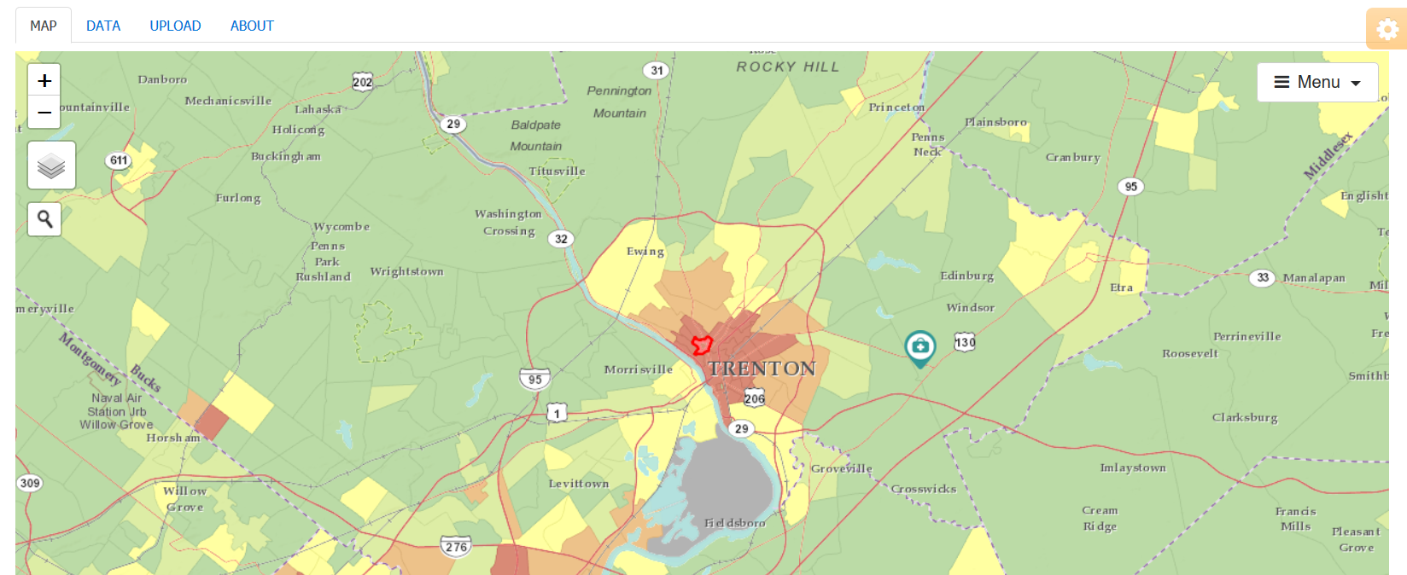
Selecting Census Tracts
Notes:
Ensure that the “Add census tracts to my community” button is highlighted.
Click on the census tracts that you think are in your clinic’s service area.
Clicking on the census tract a second time de-selects the census tract in case you wanted to change the census tracts in your service area.

Slide 43
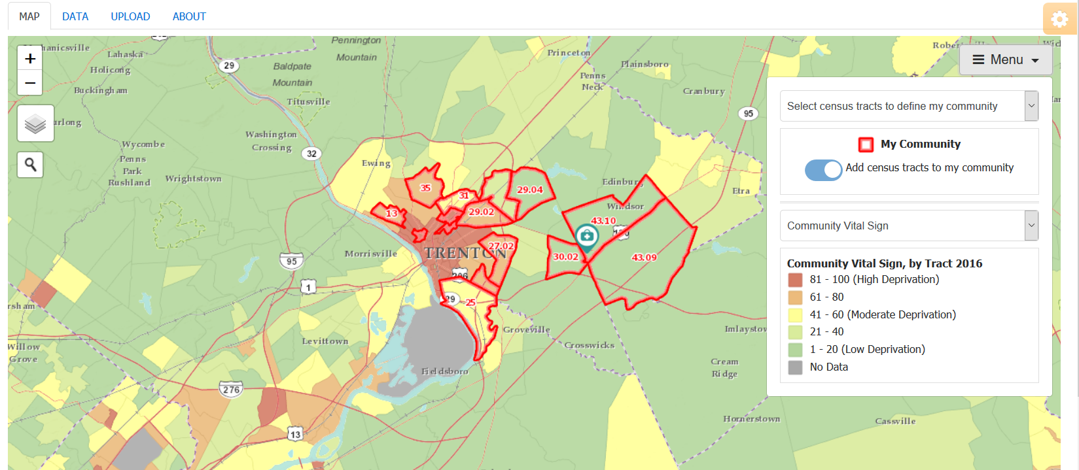
Selecting Census Tracts
Notes:
Here, we have added additional census tracts that we have defined as the clinic’s service area.

Slide 44
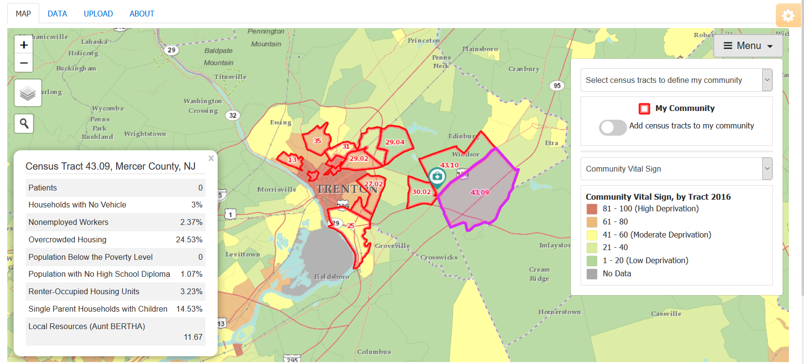
Selecting Census Tracts
Notes:
If you de-select the “Add census tracts to the my community” button, then you can click on a census tract and see additional information about it.

Slide 45
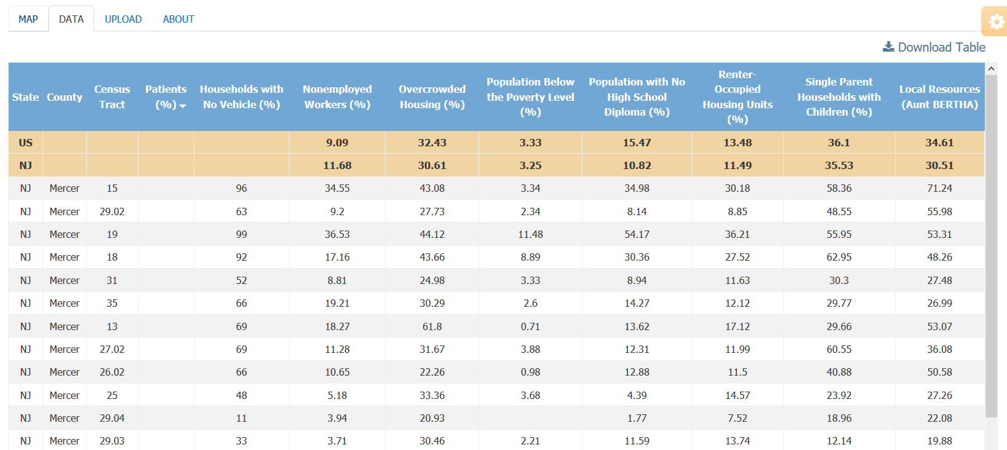
Selecting Census Tracts
Notes:
The census tracts in the data tab are those that we selected.

Slide 46
CREATING YOUR SERVICE AREA MAP
UPLOADING ADDRESSES
BEGINNER 04

Slide 47
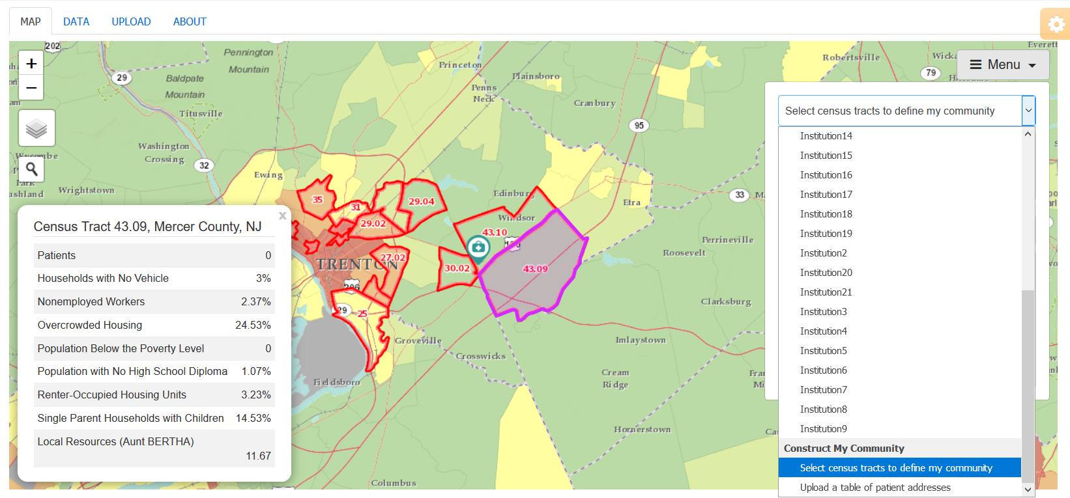
Menu
Notes:
The final method for mapping your service area is uploading patient addresses.

Slide 48
Creating your service area map using addresses
Obtain a list of patient addresses
Insert them into a properly formatted spreadsheet
Upload the addresses into PHATE
View your service area map
Notes:
There are four steps for uploading addresses to create a service area map.

Slide 49
Step 1: Obtain a list of patient addresses
Notes:
You will need to work with your practice administrator and / or your information technology staff to obtain a list of patient addresses.
Depending on your interests, you will need to provide direction regarding which people to include.
For example, you will need to determine:
Patient ages to include
Whether or not, you want to select based on patient visits
If so, how many visits
What years to include
An example of a query would be:
Include patients of all ages who have been seen once in our clinic over the past 5 years

Slide 50
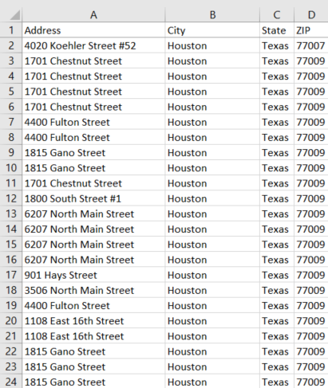
Step 2: Insert them into a properly formatted spreadsheet
Column labels:
Address
City
State
Zip
Notes:
Once you have the list of patients, you will need to insert them into the spreadsheet with the following column labels:
Address
City
State
Zip

Slide 51
Health Insurance Portability and Accountability Act of 1996
The spreadsheet should not include:
  Patient medical record numbers
  Names
  Birthdates
  Social security numbers
  Health information
For more information about HIPAA, please consult this document: https://www.hhs.gov/sites/default/files/privacysummary.pdf
Notes:
Because of HIPAA (Health Insurance Portability and Accountability Act of 1996), the spreadsheet should not include patient medical record numbers, names, birthdates, social security numbers, or health information.
For more information about HIPAA, please consult this document: https://www.hhs.gov/sites/default/files/privacysummary.pdf

Slide 52
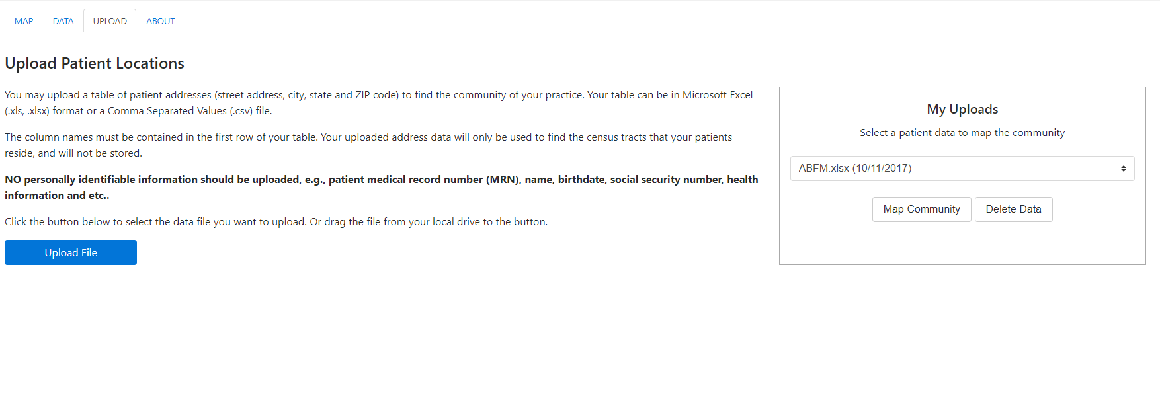
Step 3: Upload the addresses into PHATE
Notes:
To upload data, click on the “Upload tab”. On this screen, click on “Upload File”.
When prompted, upload the desired file.

Slide 53
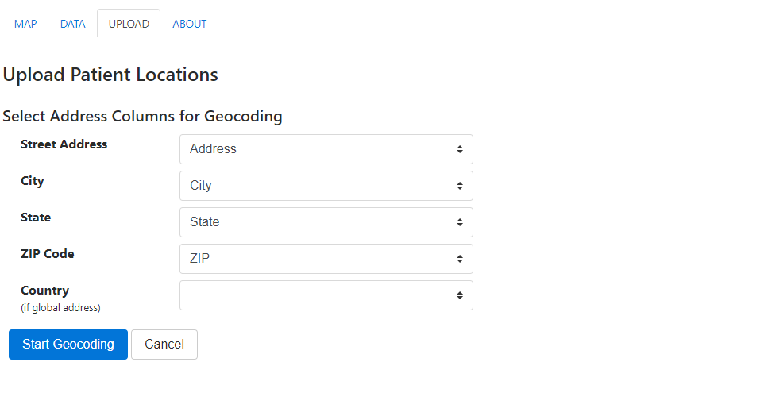
Step 3: Upload the addresses into PHATE
Notes:
Once uploaded, PHATE asks you to match the column labels with the address, city, state, and ZIP Code

Slide 54
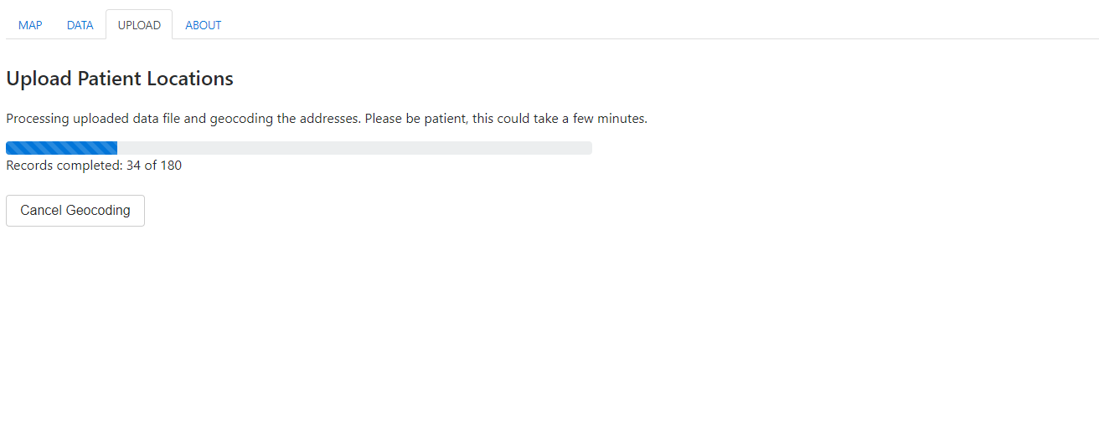
Step 3: Upload the addresses into PHATE
Notes:
You should see a screen that looks like this. Geocoding refers to attaching a latitude and longitude to an address. Once obtained, the location can be mapped to a census tract.

Slide 55
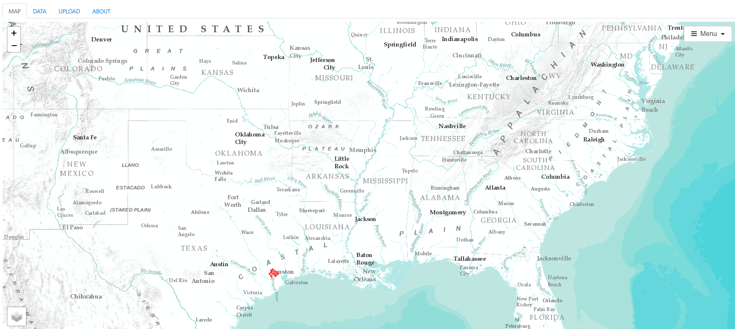
Step 4: View your service area map
Notes:
Once geocoded, you will see the red outline of your service area. You may need to zoom in.

Slide 56
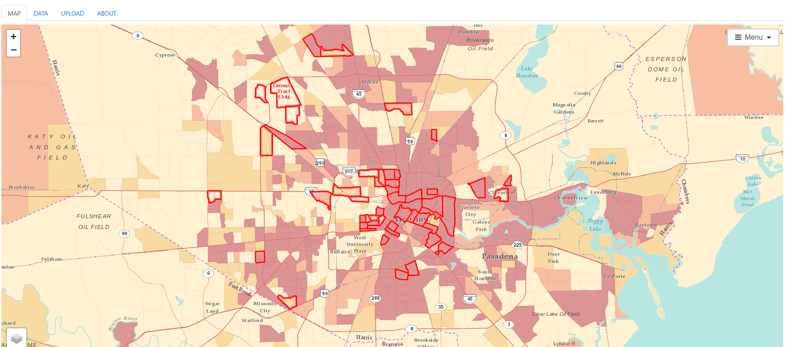
Step 4: View your service area map
Notes:
Once geocoded, you will see the red outline of your service area. You may need to zoom in.

Slide 57
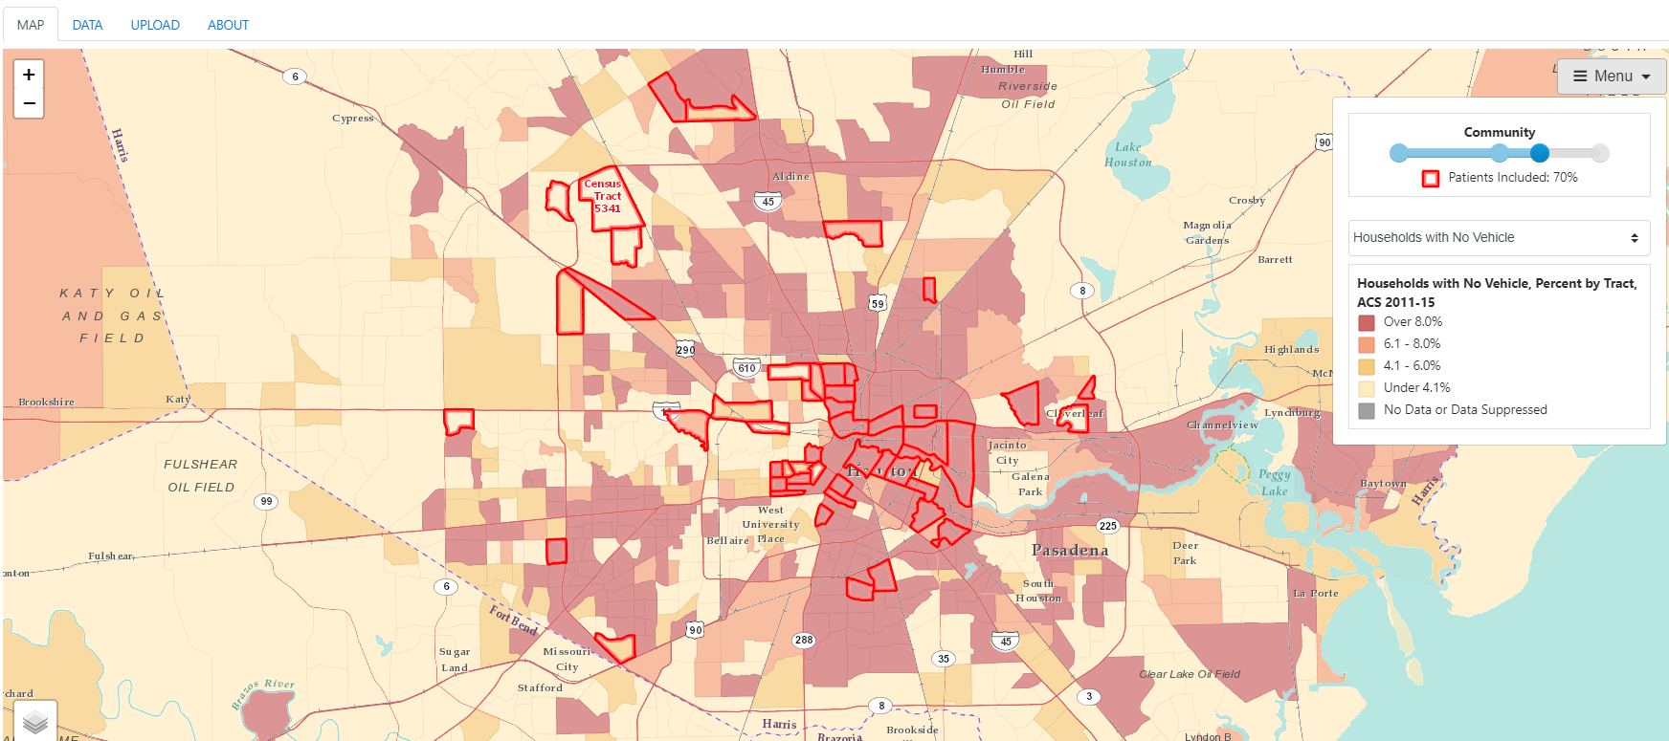
Step 4: View your service area map
Notes:
When you click on “Menu”, notice that the controls are similar to what you encountered during Tutorial 1.
Slide the “Community” indicator from left to right, what happens when you include fewer patients? More patients?

Slide 58
Take Home Points
You can learn about your community and your practice’s service area by using the My Community tool
There are three ways to create your service area:
  Using PRIME Registry data
  Selecting census tracts
  Uploading addresses

Slide 59
Nuts and Bolts 04: How to use My Community
Learning Objectives
Define service area
Demonstrate competency in creating a service area map
Demonstrate competency in creating a spreadsheet that can be uploaded into PHATE

Slide 60
Relevant family medicine milestones
Notes:
After completing this module, we hope that family medicine residents will be able to meet these milestones.
https://www.acgme.org/Portals/0/PDFs/Milestones/FamilyMedicineMilestones.pdf

Slide 61
Relevant nurse practitioner competencies
Notes:
After completing this module, we hope that nurse practitioner trainees will be able to address these competencies.
http://www.aacn.nche.edu/dnp/Essentials.pdf
https://c.ymcdn.com/sites/nonpf.site-ym.com/resource/resmgr/Competencies/NPCoreCompsContentFinalNov20.pdf

