Slide 1
Population Health Curriculum Advisory Committee Meeting
In partnership with :
Health Resources and Services Administration
Community Health Center, Inc.
American Board of Family Medicine
February 21, 2017
Notes:
My name is Winston Liaw, and I am a family physician and the Medical Director at the Graham Center
I wanted to express my gratitude for your attendance today and your participation in the Advisory Committee
We are very excited about building this curriculum and supporting the tool being developed by the American Board of Family Medicine
I also wanted to take this opportunity to thank Roberta Wilson, Lorlita Alexander, Meg Coffman, Denise Koo, and Virginia Watson for helping to organize this meeting
I also wanted to acknowledge our partners: Health Resources and Services Administration, Community Health Center, Inc, and the American Board of Family Medicine

Slide 2
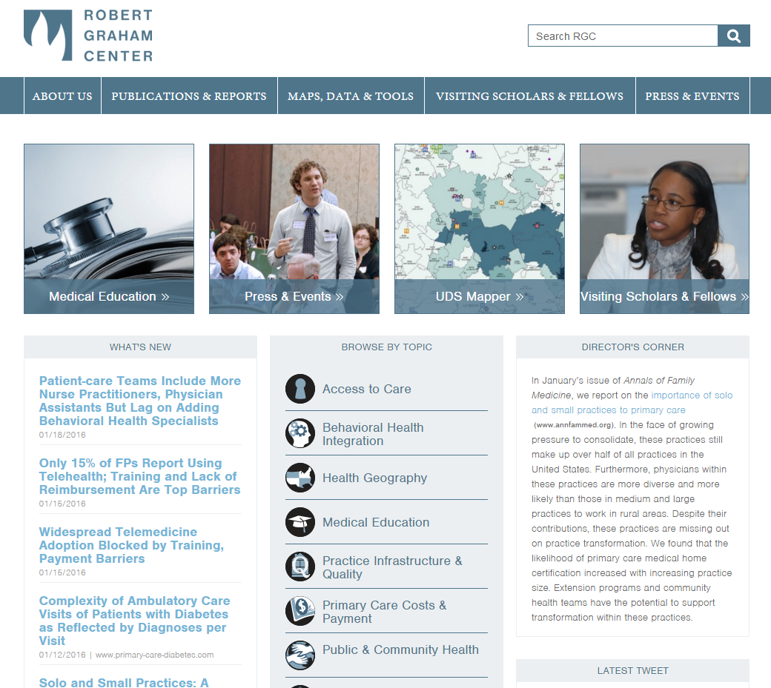
Notes:
Andrew’s remarks

Slide 3
Agenda
Introductions
Population Health Curriculum Background
Prioritization of milestones and competencies
Developing use cases
Meeting wrap up
Notes:
To get you oriented, here is a high level overview of the day

Slide 4
Introductions
Name
Affiliation; Area of Expertise (if applicable)
What do you find most exciting about population health?
Notes:
To get you familiar of the other participants, we wanted to do introductions
Please state your name and affiliation
If you have an area of expertise, you are welcome to share that as well
And let us know what you find most exciting about population health right now.

Slide 5
Ground Rules
We are interested in learning from all of you
Everyone gets a chance to contribute
There are no right or wrong answers
If people talk about personal experiences, please respect their privacy and do not repeat this information outside this room
Notes:
We want to thank you all for being here and for contributing
What you have personally experienced with population health will contribute to our conversation
Think about your own experiences, the stories you have heard about the experiences of others, and any research you have consumed

Slide 6
Project Background

Slide 7
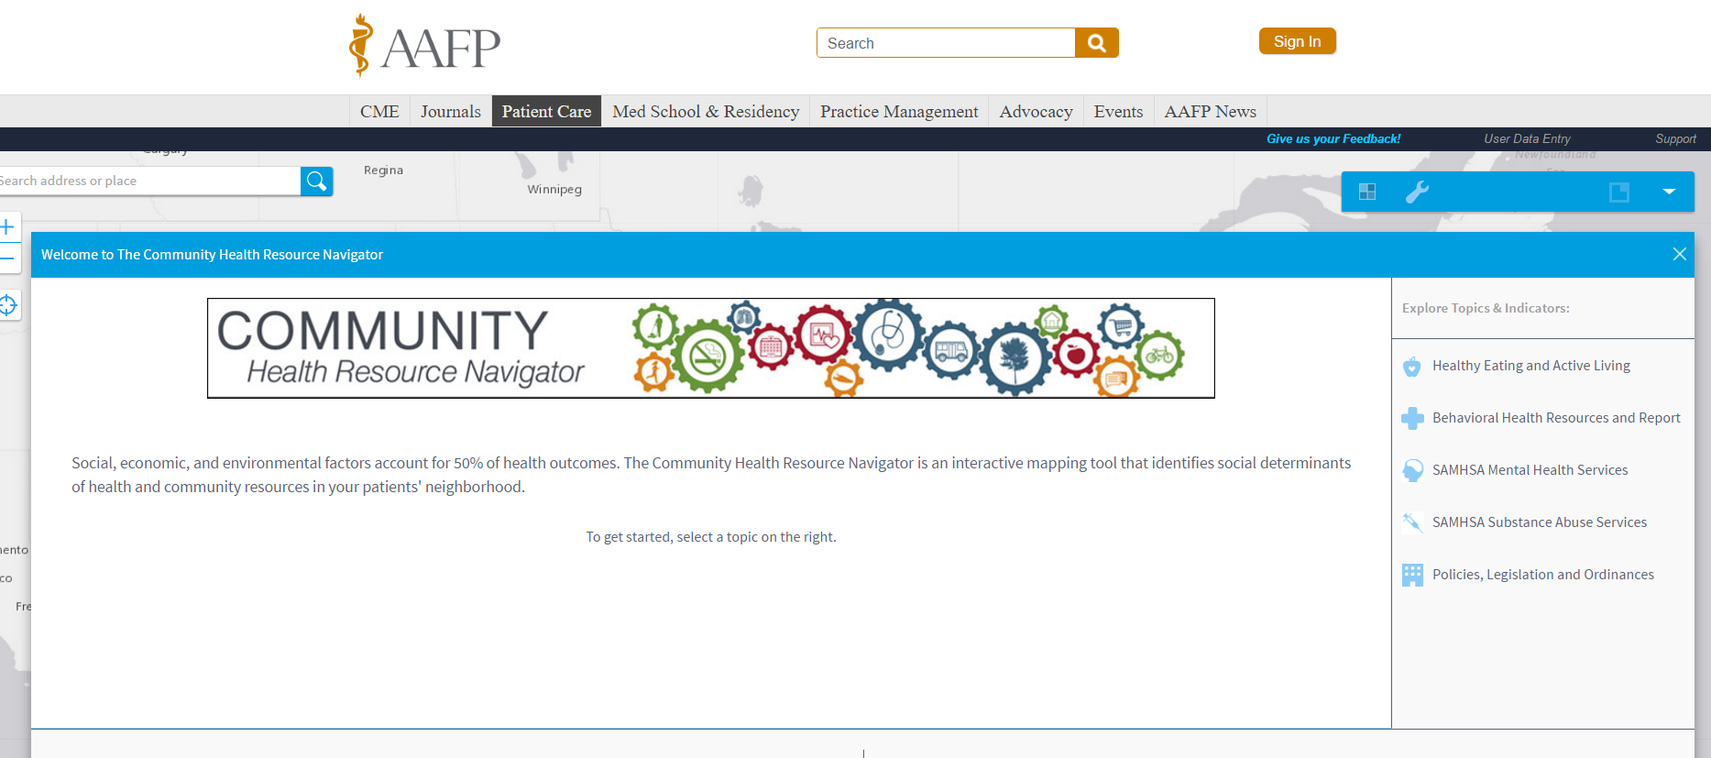
Notes:
Some of you have asked me questions about this tool
I think that this video is an appropriate response
The tool has not yet been built and remains a twinkle in Bob’s eye
Building an airplane in flight

Slide 8
Deliverables
 | Health Resources and Services Administration Project
Pre-development | Environmental Scan
 | Advisory Committee Formation
Product development | Population Health Curriculum Development
 | Performance Improvement Activity
Testing | Pilot testing at residency programs (2)
 | Webinars (4)
Evaluation | Survey of trainees
 | Track number of institutions participating in the webinars
 | Track usage of the curriculum
Notes:
For this project, we have specific deliverables which I wanted to declare here

Slide 9
Definition
Population health
The health outcomes of a group of individuals, including the distribution of such outcomes within the group
Kindig D, Stoddart G. What is population health? Am J Public Health. 2003; 93: 380-383.

Slide 10
Definition
Performance Improvement Activity
The PIA consists of introductory materials, detailed instructions, and an interactive quality improvement (QI) development process
The QI period is a minimum of 7 days

Slide 11
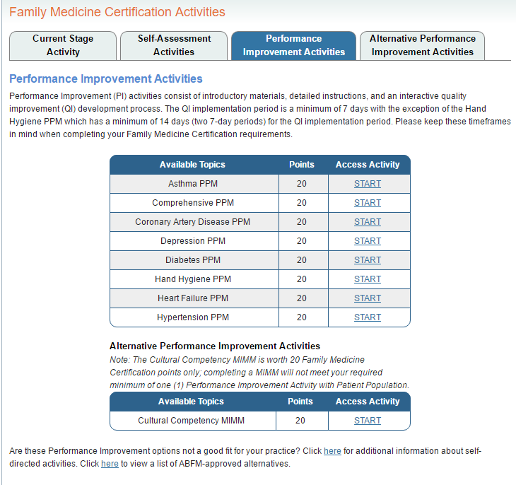

Slide 12
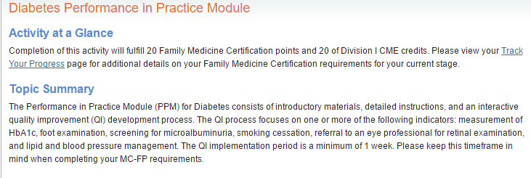

Slide 13
Goal for this Advisory Committee Meeting
To gather perspectives from a diverse group of stakeholders in order to provide direction for the population health curriculum.
Sub-goals:
Validate the target audience
Incorporate feedback regarding the population health curricular needs of providers and learners
Foster support for the curriculum from Advisory Committee members

Slide 14
User Category | Prior Population Health Experience
Practicing primary care providers (including physicians, nurse practitioners, and physician assistants) | Variable
Residents | Variable across specialties and graduates
Medical students | From the Association of American Medical Colleges: 35% (2016) of medical students had field experience providing education in the community 31.4% (2016) had experience with a community based research project 37.9% (2014) had a field experience in community health
Nurse practitioner residents | Population health is discussed in the accreditation process, but exposure is variable across programs.
Nurse practitioner students
Physician assistant students
Notes:
Our team went through the exercise of thinking about our the individuals and groups that would be going through this curriculum

Slide 15
Learner analysis
Entry behaviors: Critical thinking and technological skills
Attitudes toward content: Variable
Academic motivation: Variable with some intrinsically motivated and others only motivated by an educational or certification requirement

Slide 16
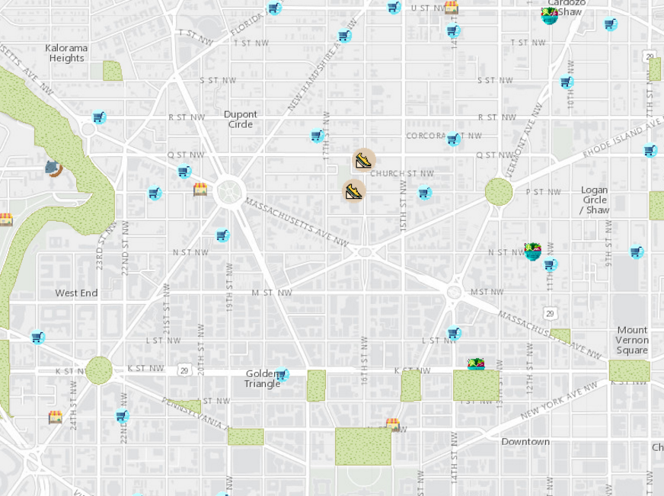
What gaps do this tool and curriculum fill?
In our environmental scan, we found lots of population health curricula.
We did not identify tools that can extract electronic health record data, merge those data with community data, and then link providers with community resources.
Notes:
However, there are tools that can do each of these steps
For instance, Julie Wood and the AAFP created the Community Health Resource Navigator Tool (CHRN) which maps community resources
Green areas are parks
Market stands are farmers markets
Fruit are markets
Shopping carts are grocery stores
Shoes are public recreation centers (like recreation centers, public tennis courts, swimming pools)

Slide 17
Bob Phillips, MD MSPH
ABFM Vice President
Research & Policy
Professor, Georgetown and Virginia Commonwealth Universities

Slide 18
MIPS
Meaningful Use
PQRS
MOC
PRIME Registry
Researchers
Measure Development
Social Determinants & Community Engagement
Notes:
Once physicians join the registry, the ABFM is looking at ways to even further add value for them—by incorporating social determinant data to get a broader view of the community in which they practice. We want to reduce the burden on you to collect the data, and then also make them more useful

Slide 19
www.primenavigator.org

Slide 20
Population Health Assesment Tool
PHAsT
Notes:
The ABFM is proposing to work with the Robert Graham Center and HealthLandscape, its sister center in the AAFP, to develop the Population Health Assessment Tool (PHAsT).
WE want to do for you what the UDSMapper did for health centers

Slide 21
What is PHAsT?
Uses EHR data to:
Map physician or clinic service area
Show clusters of disease
Show clusters of poor outcomes
Pull in social determinant data = poverty, less than high school ed., single parent household, unemployment
“Community Vital Sign”
Notes:
Family physicians enrolled in the registry would have the option of using PHAsT to
define their clinical service area,
understand which neighborhoods are most dependent on them,
look at disease and quality clusters (‘hotspots’), and to draw on social determinant data to develop community vital signs for patients, and to
look at risk of poor health across their community.

Slide 22
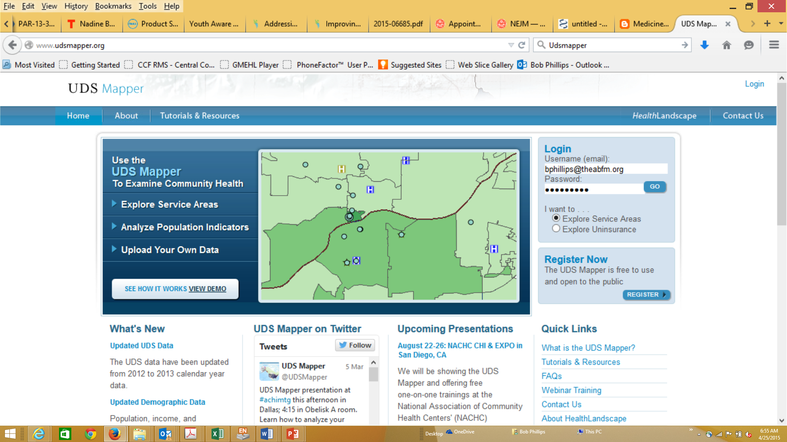
UDSMapper.org
Notes:
The Robert Graham Center built related tools for Community Health Centers all over the country.
The UDSMapper pulls on neighborhood data (Census and other sources) to help CHCs understand who they are serving and how social determinants stack up in those same neighborhoods

Slide 23
3 PHAsT Versions, one skin
Fully imbedded in PRIME, draws on patient data:
Address
Diagnoses
Quality measures
Social Determinant and Community Resource data
Drop-in Data: Address
Same Skin: All 3 look the same except the No Data and Drop-in Data users will see that they could do more with PRIME
No Data: choose census tracts

Slide 24
What can we do with it?
Help think in terms of population and community
Pull other data into understanding patients’ risks and resources
Find partners in their shared geographies of care
Become community leaders
Partner with public health
Notes:
Value-based payments mean greater accountability for population health, and most family physicians lack tools or the ability to use their data to inform this role.
Many family physicians are also frustrated by patients who cannot or won’t take their medication or change health behaviors, often because they don’t understand what is going on in their patients’ lives, or because they don’t know who to partner with in the community to help their patients.
PHAsT aims to help family physicians do population health better, and to improve understanding of community supports.
For example, PHAsT may help you recognize that most of your patients with diabetes and hemoglobin A_{1c} above 9.0 live in neighborhoods that are unsafe for exercise and lack healthy food sources. With similar information, family physicians have partnered with a local YMCA, malls and armories to develop indoor walking club, diabetes peer-support group, or farmers market—or all 3.
We know from experience that family physicians in community health centers have used these tools in clever ways, and now want all family physicians to have the same opportunity, especially when payments may soon be based on population health outcomes.

Slide 25
Environmental Scan Alyssa Shell, MD PhD

Slide 26
Environmental Scan: Methods
Primary question: What is the content, structure and effectiveness of population health curricula that have been developed for medical trainees in the United States and in global settings?
Source: PubMed
Keywords:
Population health or community health or social determinants of health
Residency or training or residents or trainees
Curriculum or education
English
Humans
Date 01/01/1980 to 11/04/2016

Slide 27
Environmental Scan: Output
Output: #794
#298 selected for abstract review based on titles
Breakdown:
#32 described a curriculum (+/- evaluation)
#68 described curricular interventions
#40 focused on evaluating curricular interventions
The remainder covered background, justification or were unrelated
Additional peer-reviewed articles considered

Slide 28
Environmental Scan: product
#32 PubMed papers read → #19 selected for annotated bibliography
Highlighted Resources
#5 papers on curricula from the PubMed search
#3 peer-reviewed papers found through alternate paths
#2 papers about a curriculum
Tabulated spreadsheets
Core domains
Evaluation methods
Time commitment
Strengths/limitations

Slide 29
Environmental Scan: Findings
Many different groups doing overlapping work
Diverse audience: MD (FM), RN, APN, Pharm, Dental, MPH/MAPH
Students, residents, fellows, and mid-career professionals
Highly variable structures and time requirements
Elective, longitudinal, episodic, classroom, practicum-based
Primary evaluation is pre- and post- satisfaction surveys

Slide 30
Environmental Scan: Findings
Core domains mentioned by >50%
Demography, epi, SDH, prevention, public health, cultural competency
Remaining domains are highly variable
Examples: biostats, study design, data collection and management, advocacy, team building, leadership, CBPR, MI, workforce, policy making, health care financing and organization
Very few attempted population health for QI or community intervention

Slide 31
Environmental Scan: Limitations
Search terms
Titles/abstracts can be misleading – we may have missed some
Still awaiting communication regarding curricular details
Grey literature

Slide 32
Environmental Scan: Moving forward
Flexibility: short segments, tiered depth, alt. delivery structures
Content: core domains, preexisting good options, determine priorities
Feasibility: flexibility, navigability, explicit materials
Evaluation: high quality short and long-term evaluation

Slide 33
Questions?
What resources have we missed?

Slide 34
10 Minute Break

Slide 35
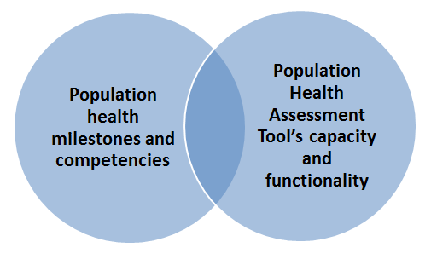
Identification of relevant milestones and competencies
1st activity: Prioritization of relevant milestones and competencies
2nd activity: Development of use cases

Slide 36
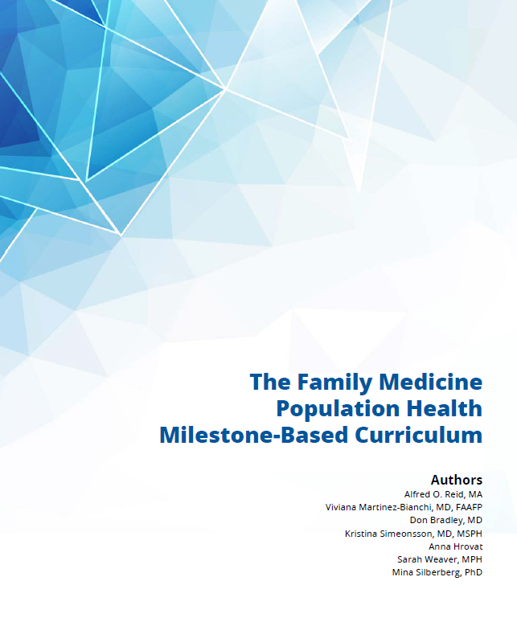
Notes:
We used competencies and milestones from three different sources:
This document which highlighted population health relevant family medicine milestones, a document which outlined NP core competencies, and a document outlined competencies for Doctor of Nursing Practice programs

Slide 37
Definition
ACGME:
Competency
The specific knowledge, skills, behaviors, and attitudes and the appropriate educational experiences required of residents to complete GME programs
Milestones
Significant points in development
Competency based developmental outcomes that can be demonstrated progressively
http://www.acgme.org/What-We-Do/Accreditation/Milestones/Overview
https://www.acgme.org/Portals/0/PDFs/ab_ACGMEglossary.pdf
Notes:
Add reference

Slide 38
Competency domains
Competencies
Milestones
Notes:
As Virginia says,
This about learning as a journey
competencies are the desired outcome or the destination
Milestones are the granular activities that the learner is doing to help them figure out where they are on the journey

Slide 39
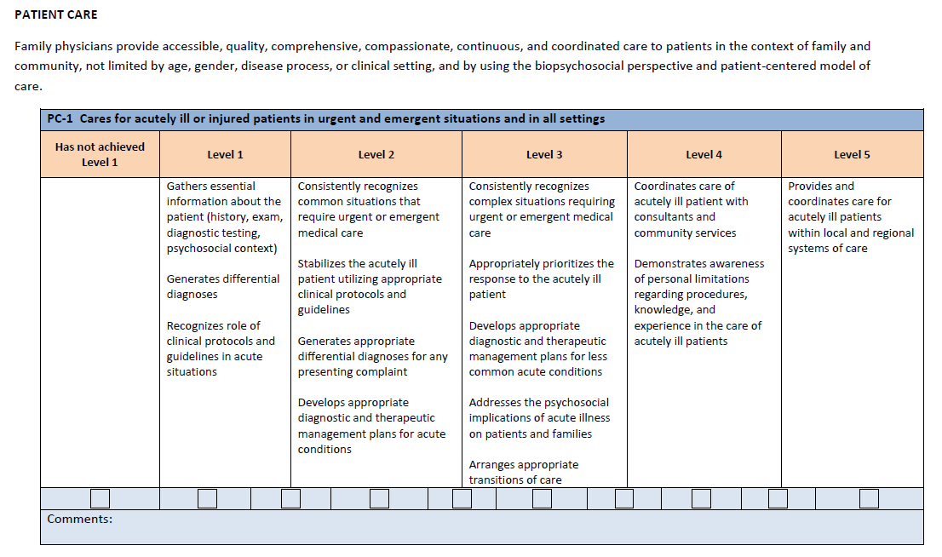
Competency domain
Competency
Milestone

Slide 40
Milestone and competency prioritization
15 minutes:
Individually, select the 6 milestones and/or competencies (3 nurse practitioner and 3 family medicine) that are the most relevant for this curriculum
Why did you select these?
30 minutes:
As a group, come to a consensus about your top 6 (3 nurse practitioner and 3 family medicine)
Why did you select these?
Notes:
[Create a worksheet]

Slide 41
Milestone and competency prioritization
15 minutes:
Report Out:
Report your top 3 family medicine and 3 nurse practitioner milestones / competencies (use the cards)
Why did you choose these?
Notes:
[Create a worksheet]
[Create 2 sets of laminated cards with each of the milestones and competencies]
[When reporting out, we can display the milestones and competencies on the wall]

Slide 42
Large group discussion (15 minutes) Reactions? What milestones and competencies resonate with you? Do any not resonate? What milestones and competencies would you have liked to have seen?
Notes:
Reactions?
What milestones and competencies resonate with you?
Do any not resonate?

Slide 43
Reactions? (15 minutes)
Vote on the 4 most relevant
2 family medicine
2 nurse practitioner

Slide 44
LUNCH

Slide 45
Identification of relevant milestones and competencies
1st activity: Prioritization of relevant milestones and competencies
2nd activity: Development of use cases
Notes:
Now that we have prioritized milestones and competencies, we would love your help thinking about how to use this tool
We have some ideas, but I’m positive there are use cases that we have never considered

Slide 46
Developing Use Cases
15 minutes
Individually, write a story about how a learner or provider uses the tool, meeting milestones and competencies in the process
Consider the who / what / where / when / why questions
Notes:
We would love to tap into your creative sides.
Specifically, we have envisioned ways of using this tool
But there are probably many uses that we have not considered

Slide 47
Developing Use Cases
15 minutes
Share your stories in your small groups
30 minutes
Combine your stories to create one story for the group
Tell a story or create a skit to describe your unifying story
Tell us which milestones and competencies you are meeting
The group that meets the most milestones and competencies wins a prize
Notes:
[6 Graham Center Flash drives and mugs]

Slide 48
10 Minute Snack Break

Slide 49
STORIES & SKITS
Tell us which milestones / competencies you are meeting
Notes:
[30 Minutes]

Slide 50
Large group discussion (15 minutes)
Notes:
Reactions?
Did seeing ideas from other groups generate any new ideas?

Slide 51
Final Thoughts
What advice do you have for us?
Consider…
Curriculum development
Performance improvement activity development
Dissemination
Notes:
You all bring a unique perspective. As our team moves forward to create the curriculum and the performance improvement activity, what advice would you give us?

Slide 52
Wrap Up
Receipts
Next steps
Questions
Thanks!
Notes:
We will email out the form and you will submit receipts
We will be setting up a call

