Slide 1

Population Health Assessment Engine

Slide 2
Population Health Assessment Engine Curriculum
01
02
BACKGROUND
Introduction to
Population Health
Introduction to
Geospatial Concepts
BEGINNER
03
04
05
Introduction to the Population Health Assessment Engine
How to use My Community
How to use Community HotSpots
06
07
ADVANCED
Getting the Most out of My Community
Getting the Most out of Community Hotspots
Notes:
This curriculum consists of 2 background modules that will introduce you to population health and geospatial concepts. The next three modules will describe how to use the Population Health Assessment Engine (PHATE) and the two tools embedded within PHATE: My Community and Community HotSpots. The final two modules will help you learn how to integrate PHATE into your clinic.

Slide 3
Overall goal for the PHATE Curriculum
To integrate community data, clinical data, and community resources in order to address social determinants of health and improve the health of patients and populations.
Notes:
Through the modules, case studies, and performance improvement activity, we hope that you will be able to integrate community data, clinical data, and community resources in order to address social determinants of health and improve the health of patients and populations.

Slide 4
Target audience
Anyone interested in learning about improving the health of populations
  Providers
  Staff
  Learners
    Residents
    Medical students

Slide 5
Abbreviations
PHATE: Population Health Assessment Engine

Slide 6
GETTING THE MOST OUT OF MY COMMUNITY
ADVANCED 06

Slide 7
Next Level Stuff 06: Getting the Most out of My Community
Learning Objectives
List two strengths of your community
List two health issues important to your community
Demonstrate how to select your own service area
Describe how to use PHATE to collaborate with community organizations

Slide 8
Relevant family medicine milestones
Notes:
After completing this module, we hope that family medicine residents will be able to meet these milestones.
https://www.acgme.org/Portals/0/PDFs/Milestones/FamilyMedicineMilestones.pdf

Slide 9
Relevant nurse practitioner competencies
Notes:
After completing this module, we hope that nurse practitioner trainees will be able to address these competencies.
http://www.aacn.nche.edu/dnp/Essentials.pdf
https://c.ymcdn.com/sites/nonpf.site-ym.com/resource/resmgr/Competencies/NPCoreCompsContentFinalNov20.pdf

Slide 10
Next Level Stuff 06: Getting the Most out of My Community
Outline
What is a service area?
Activity 1: Learning about your service area
Activity 2: Identifying your service area
Activity 3: Comparing your service area

Slide 11
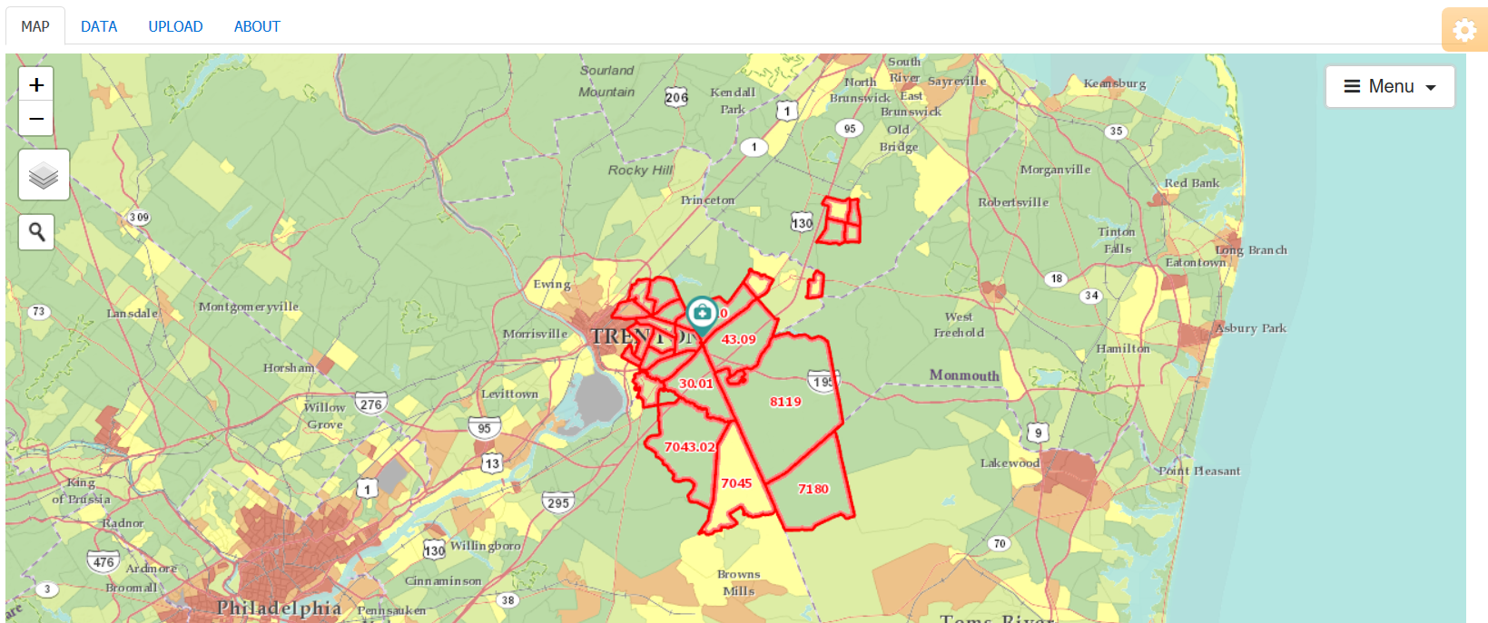
My Community
What you can do using My Community:
View community characteristics
View your clinic’s service area
View how your clinic’s service area relates to community characteristics
Download community characteristics

Slide 12

A service area is the community or communities served by the practice
Nutting PA. Community-Oriented Primary Care: From Principle to Practice. Albuquerque, NM: University of New Mexico Press, 1990.
Notes:
A service area is the community or communities served by the clinic

Slide 13
What is a service area?
Census tract | # pts | Cum. %
A | 432 | 10.3%
B | 380 | 19.5%
C | 349 | 27.8%
D | 312 | 35.3%
E | 301 | 42.5%
F | 263 | 48.8%
G | 251 | 54.8%
H | 233 | 60.4%
I | 208 | 65.4%
J | 199 | 70.1%
K | 181 | 74.5%
Census tract | # pts | Cum. %
L | 167 | 78.5%
M | 146 | 82.0%
N | 135 | 85.2%
O | 120 | 88.1%
P | 0 | --
Q | 0 | --
R | 99 | 90.5%
S | 96 | 92.8%
T | 90 | 94.9%
U | 0 | --
V | 89 | 97.1%
Census tract | # pts | Cum. %
W | 0 | --
X | 60 | 98.5%
Y | 0 | --
Z | 0 | --
AA | 27 | 99.1%
BB | 21 | 99.6%
CC | 15 | 100%
DD | 0 | --
EE | 0 | --
FF | 0 | --
TOTAL | 4,174 | 100%
Notes:
As mentioned in Tutorial 1, the My Community tool allows you to view your service area in relationship to community characteristics.
To generate the 70% service area, PHATE geocodes (attaches a latitude and longitude) the patient addresses and links them to their commensurate census tracts. PHATE adds up the number of patients per census tract and then rank orders census tracts from most to least patients.
All of the census tracts comprising 70% of the patients make up the 70% service area (census tracts A through J).
For an 80% service area, we would add census tracts K and L.
To create a 100% service area, PHATE includes all of the census tracts where patients live (IS THIS RIGHT? DO WE SUPPRESS ANY SMALL NUMBER CENSUS TRACTS?)

Slide 14
What is a service area?
Service area = based on the number of patients per area; include the ones with the most patients first
70% service area
100% service area
AA
T
S
R
Q
P
BB
CC
Z
U
G
F
A
B
O
DD
Y
V
H
E
D
C
N
EE
X
W
I
J
K
L
M
FF
Notes:
And that is what this map shows. The dark green boxes would constitute the 70% service area while the light and dark green boxes combined make up the 100% service area.

Slide 15
Three ways to create service area maps
Users | Service area can be viewed automatically in PHATE | Service area can be selected by the user | Service area can be viewed by uploading addresses
Connected to the PRIME Registry | Yes | Yes | Yes (but PHATE automatically does this for you)
Not connected to PRIME and have addresses | No | Yes | Yes
Not connected to PRIME and do not have addresses | No | Yes | No
Notes:
You can use these ways for creating service areas depending on whether you have access to the PRIME Registry and/or patient addresses.

Slide 16
Learning about your service area
Activity #1
For this activity, you will need to view your clinic’s service area.
To learn how to do this, please consult:
  “Nuts and Bolts 05: My Community”
If you neither are linked to the PRIME registry nor have access to patient addresses, please proceed to the next step

Slide 17
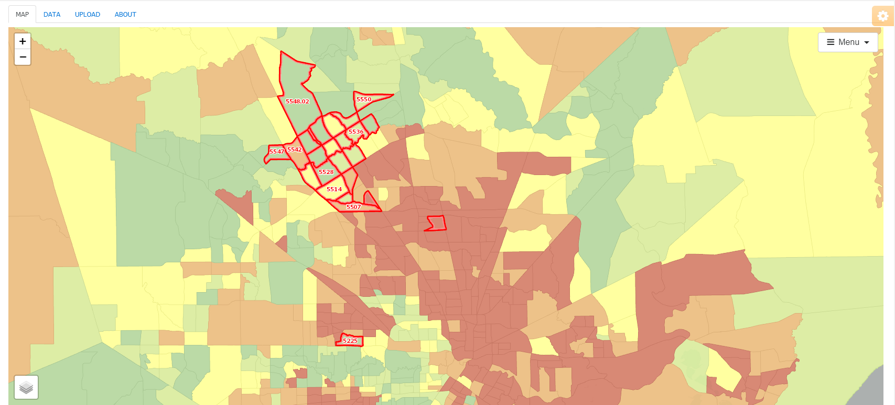

Learning about your service area
Activity #1
Arrange the map so that you can see all of the census tracts included in your 70% service area
Notes:
Arrange the map so that you can see all of the census tracts included in your clinic’s 70% service area.
If you neither have access to the PRIME registry nor patient addresses, arrange the map so that you can view the census tracts you think are in your 70% service area.
Make sure the Community Vital Sign option is selected by hovering over the layer icon in the bottom left of the screen.

Slide 18
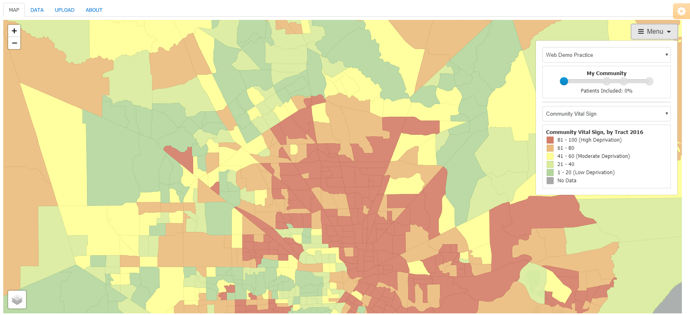
Learning about your service area
Activity #1
If your service area is visible, click on “Menu” and move the slider so that 0% of the patients are included

Slide 19
Learning about your service area
Activity #1
If your service area is visible, click on “Menu” and move the slider so that 0% of the patients are included
Under the drop down menu, select Community Vital Sign

Slide 20
What patterns do you observe?
Notes:
If you are going through this module on your own, write your answer.
If you are going through this module with others, turn to your colleague and discuss your answer.

Slide 21
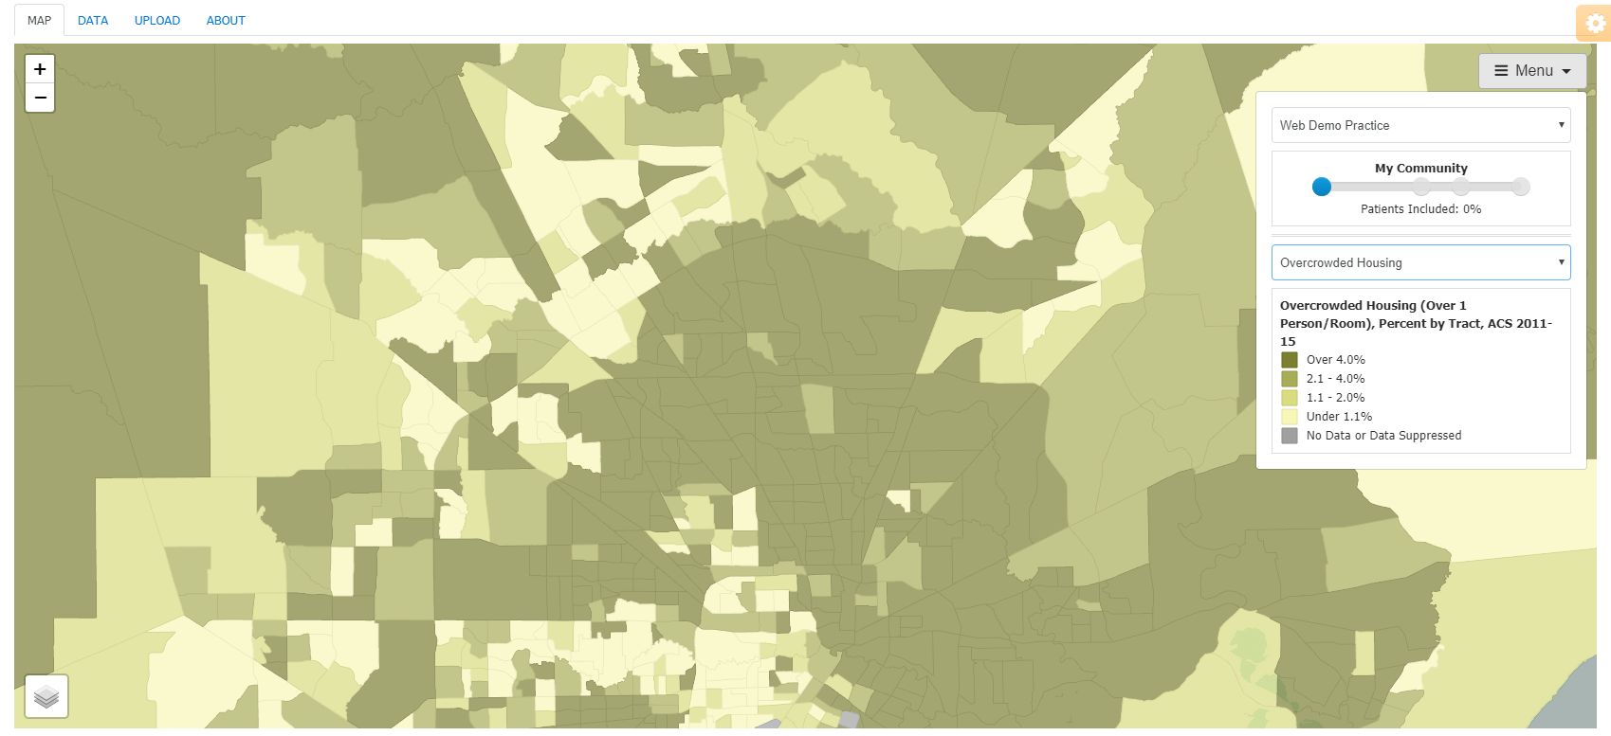
Learning about your service area
Activity #1
Select two additional community variables

Slide 22
When you change the variables mapped, does the pattern change?
Is this similar or different than what you expected?
Notes:
If you are going through this module on your own, write your answer.
If you are going through this module with others, turn to your colleague and discuss your answer.

Slide 23
What do you think accounts for these patterns?
Notes:
If you are going through this module on your own, write your answer.
If you are going through this module with others, turn to your colleague and discuss your answer.

Slide 24
What makes you most proud of your community?
What do you believe are the 3 most important issues that must be addressed to improve health and quality of life in your community?
Notes:
If you are going through this module on your own, write your answer.
If you are going through this module with others, turn to your colleague and discuss your answer.

Slide 25
What are ways that you can learn about your community?
Notes:
If you are going through this module on your own, write your answer.
If you are going through this module with others, turn to your colleague and discuss your answer.

Slide 26
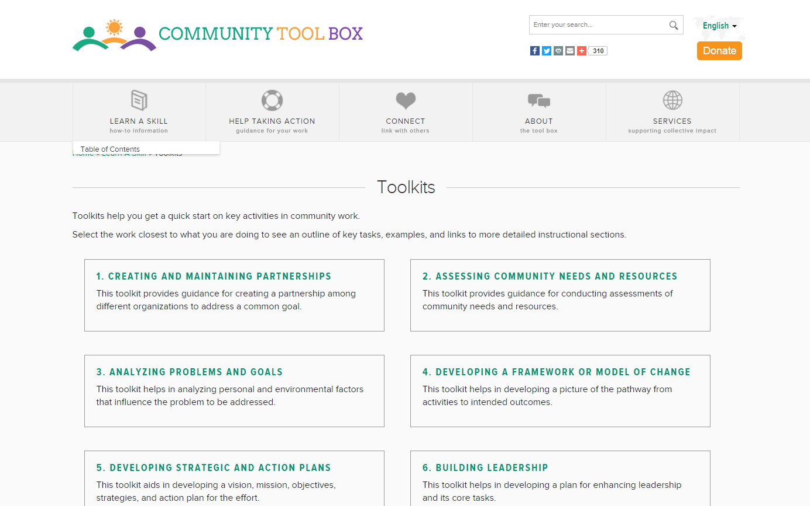
For more information about assessing community needs, check out the Community Tool Box
Notes:
Answering these questions and studying your community is just one step in a much larger community needs assessment analysis. If you are interested in learning more, there are numerous resources online, including the Community Tool Box.
The Community Tool Box has guides for additional methods for learning about your community, including conducting focus groups, disseminating surveys, leading community dialogues, using photovoice, and conducting windshield and walking surveys.

Slide 27
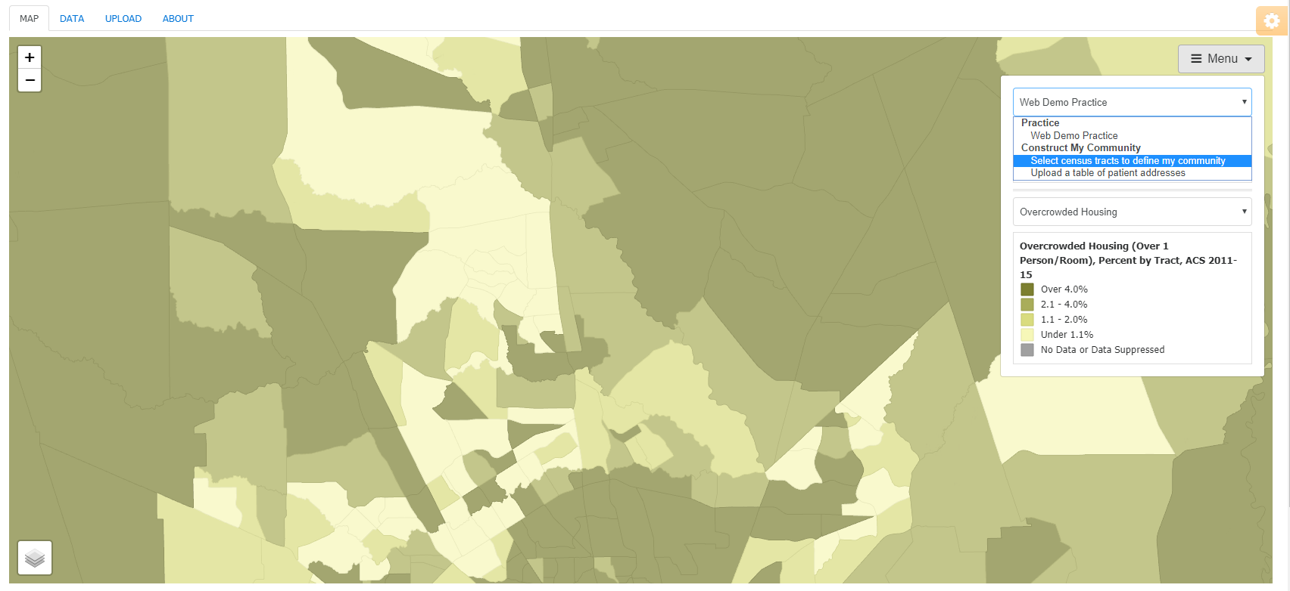
Identifying Your Service Area
Activity #2
Notes:
For this next activity, click on “Menu,” and then under the first drop down menu, select “Select census tracts to define my community”

Slide 28
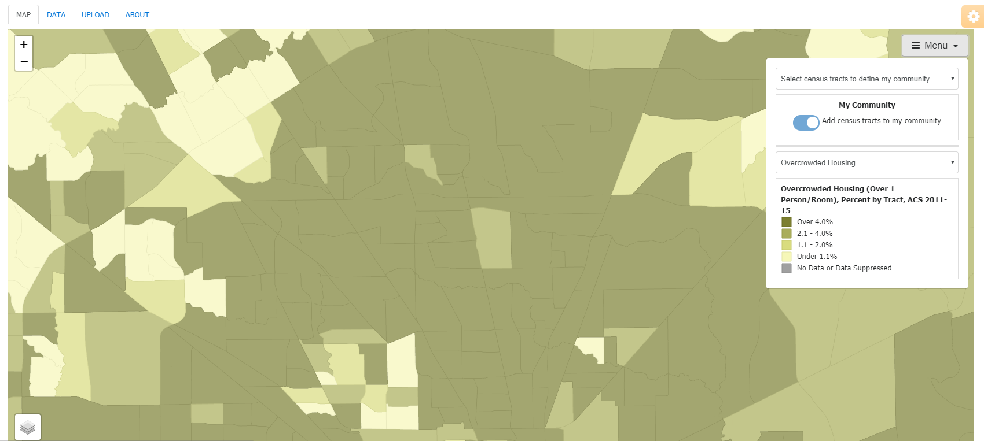
Identifying Your Service Area
Activity #2
Notes:
Make sure that the “Add census tracts to my community” button is activated.

Slide 29
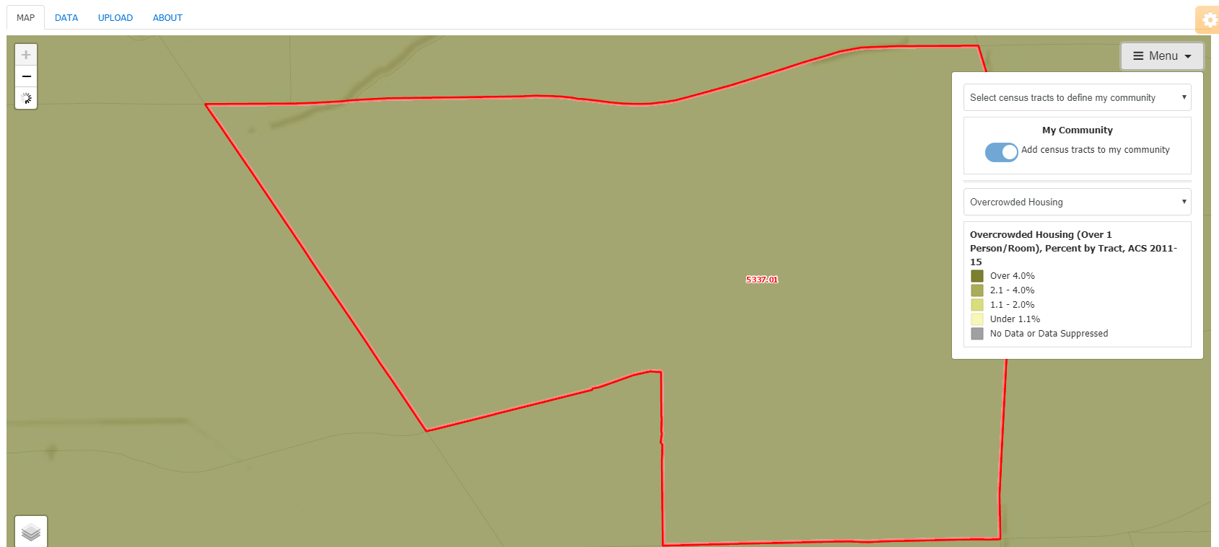
Identifying Your Service Area
Activity #2
Notes:
Select the census tracts that you think are in your 70% service area. When you click on a census tract, PHATE will zoom to that geography. As you click on additional tracts, the tool will zoom out. To remove census tracts from your service area, click on the census tract again.

Slide 30
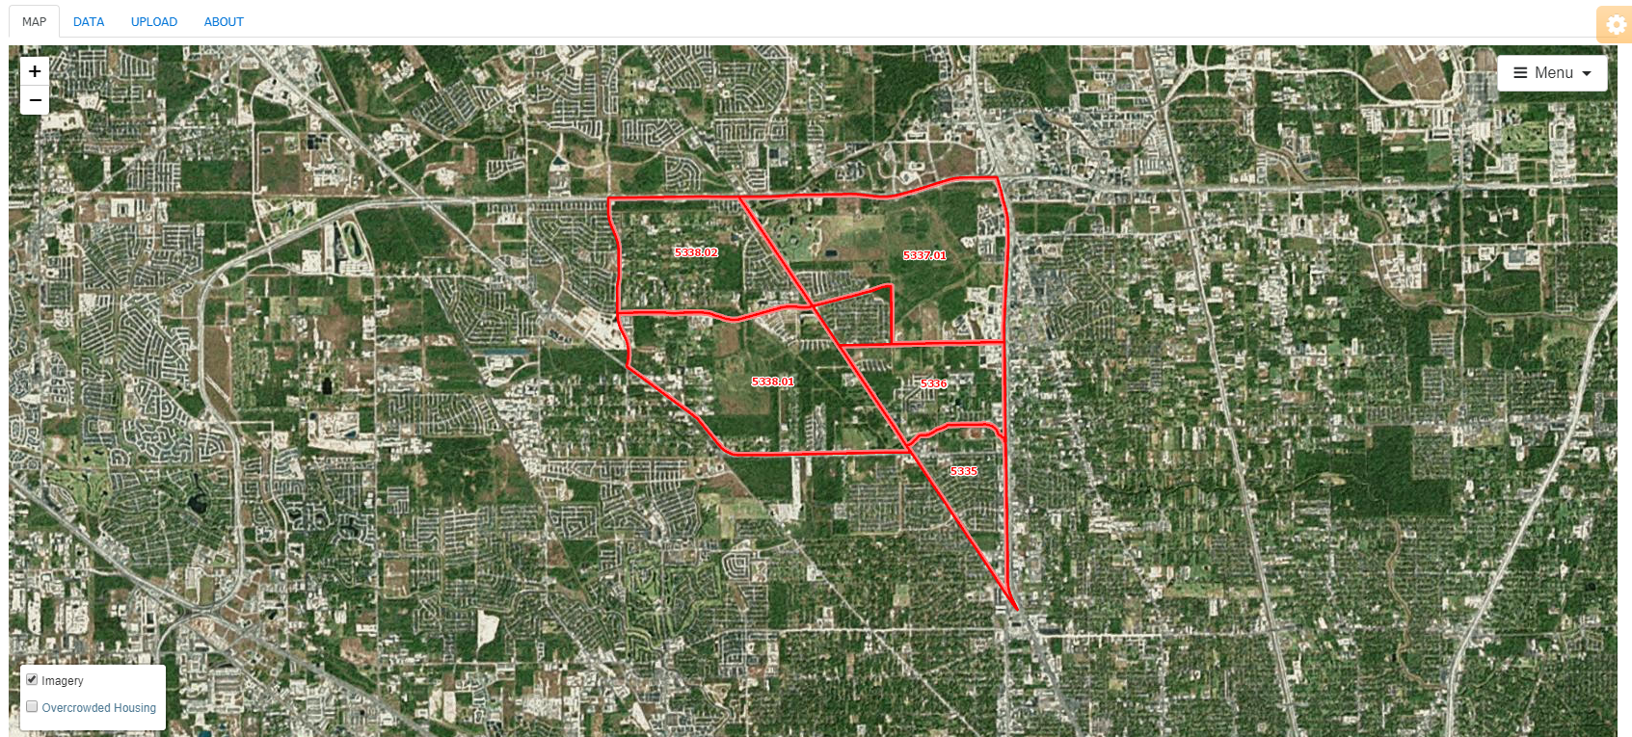
Identifying Your Service Area
Activity #2
Notes:
To orient yourself, you may need to hover over the layer icon, deselect the community variable, and select “Imagery”. The base map also has major streets and can be used for orientation.

Slide 31
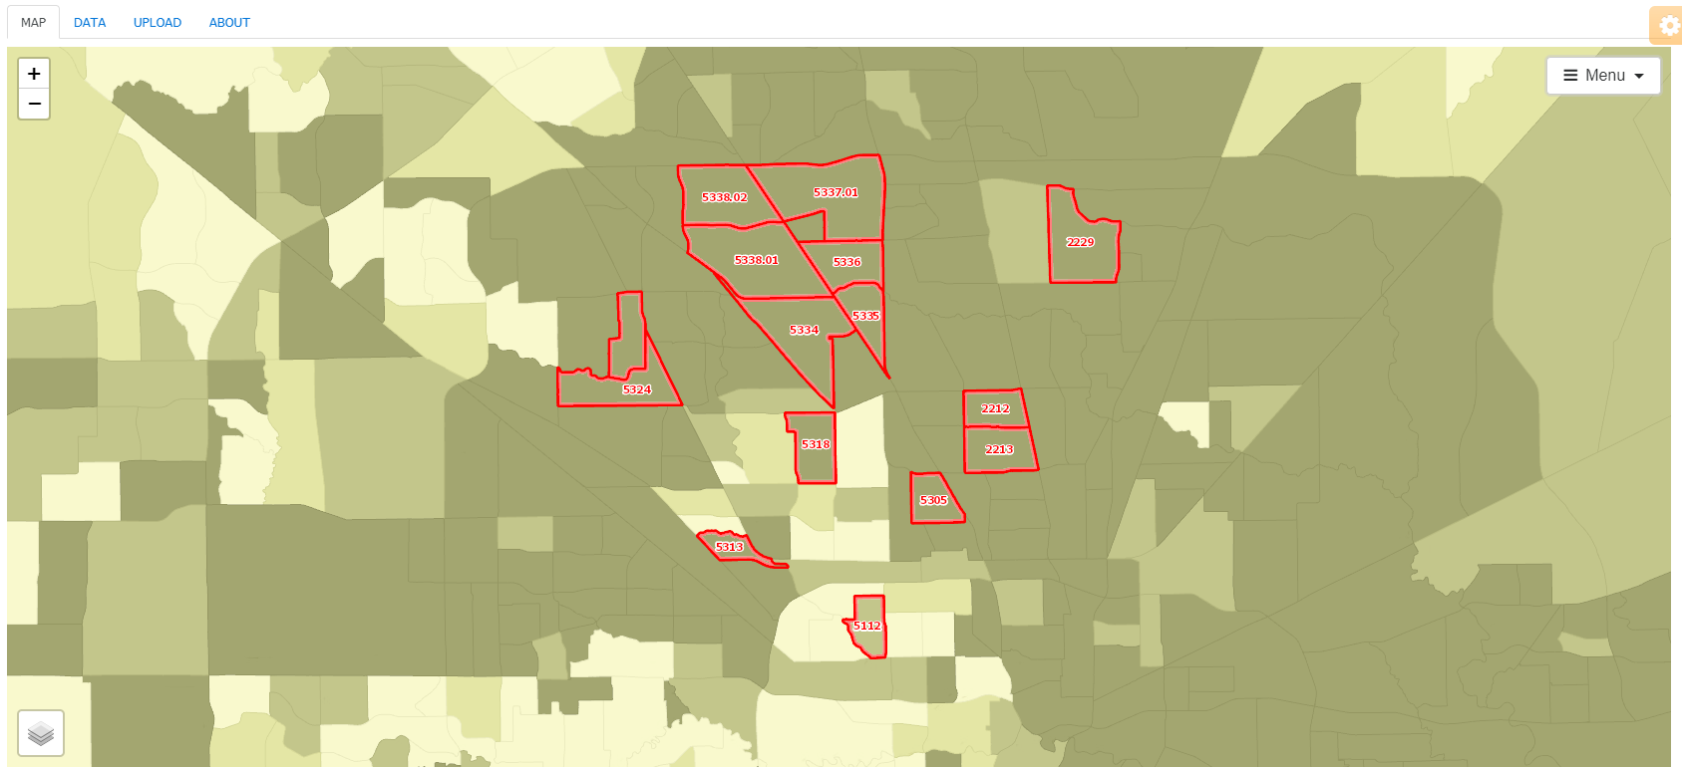
Identifying Your Service Area
Activity #2
Notes:
Once you are done, view the 70% service area map you created.

Slide 32
Turn to a colleague, how are your maps similar? How are they different?
Notes:
If you are going through this module on your own, proceed to the next slide.
If you are going through this module with others, turn to your colleague and discuss your answer.

Slide 33
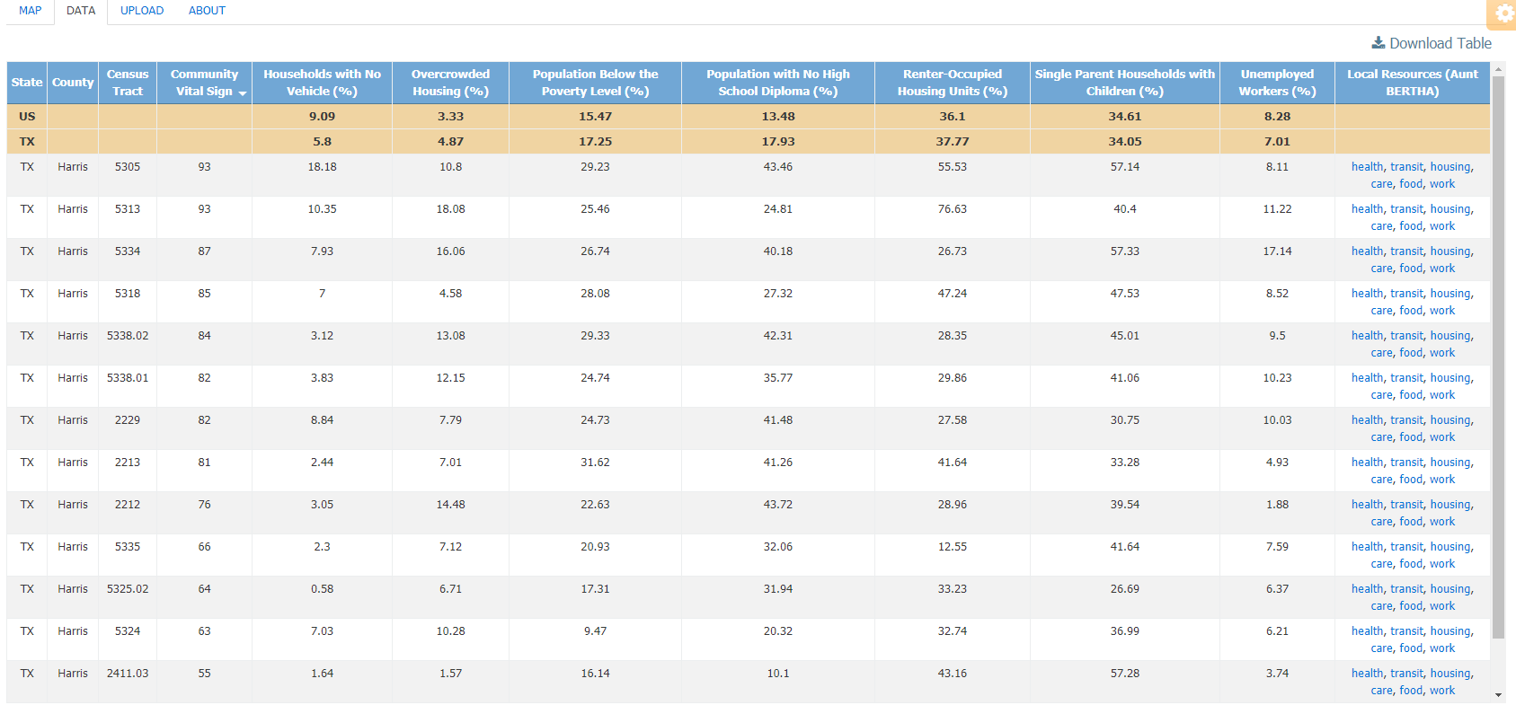
Identifying Your Service Area
Activity #2
Notes:
Click on the data tab. These are the census tracts that you selected.

Slide 34
Identifying Your Service Area
Activity #2
Go back to your response for this question and select one of the issues you identified:
  What do you believe are the 3 most important issues that must be addressed to improve the health and quality of life in your community?

Slide 35
Identifying Your Service Area
Activity #2
Notes:
Notice that the last column links to an external website, Aunt Bertha. This website lists community resources by geography in various domains, including health, transportation, housing, food, and employment. Clicking on the link takes you to Aunt Bertha, searches for that specific domain, and provides a list of resources around the zip code associated with the census tract of interest.
Identify one organization that could partner with your clinic to address the issue you identified.

Slide 36
What is one thing your clinic could do to partner with this community organization to address this issue?
Notes:
If you are going through this module on your own, write your answer.
If you are going through this module with others, turn to your colleague and discuss your answer.

Slide 37
Comparing Your Service Area
Activity #3
If you neither have access to the PRIME Registry nor patient addresses, then you have completed this module. Please proceed to the end.
If you do have access to the PRIME Registry or patient addresses, please proceed to the next slide.
Notes:
Once you are done, view your 70% service area map.

Slide 38
Comparing Your Service Area
Activity #3
Open up a new browser window or tab as you will need to compare the service area you just created with your actual service area
In your new window, map your service area.
If you need assistance, please consult:
  “Nuts and Bolts 05: My Community”

Slide 39
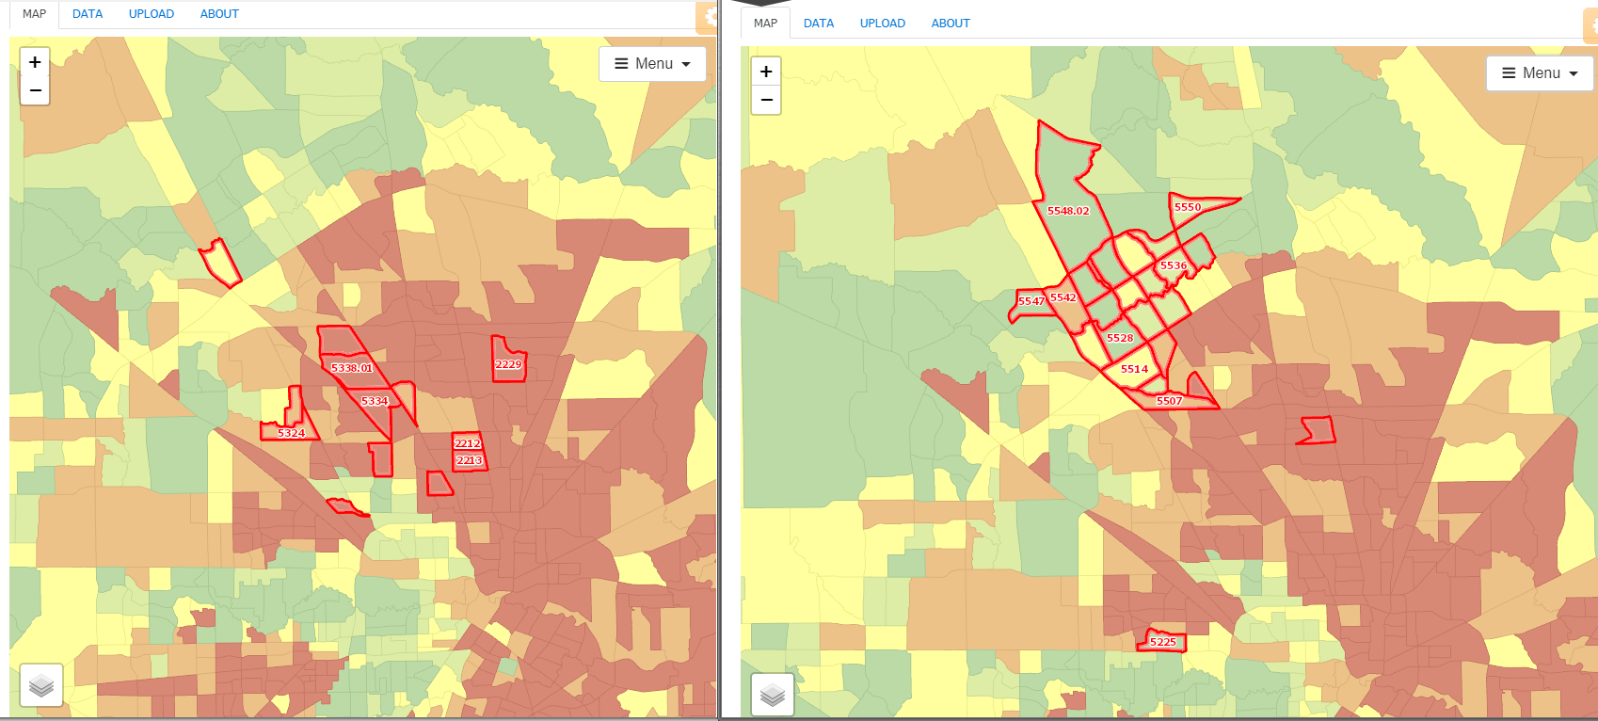
Comparing Your Service Area
Activity #3
USER DEFINED
ACTUAL
Notes:
View the two service area maps (the actual service area and the one census tracts that you selected) side by side.

Slide 40
How are these two maps similar?
How are they different?
What accounts for the differences?
Notes:
If you are going through this module on your own, write your answer.
If you are going through this module with others, turn to your colleague and discuss your answer.

Slide 41
Take home points
My Community can be used to learn about your community and service area
Aunt Bertha can be used to learn about potential community partners

Slide 42
Next Level Stuff 06: Getting the Most out of My Community
Learning Objectives
List two strengths of your community
List two health issues important to your community
Demonstrate how to select your own service area
Describe how to use PHATE to collaborate with community organizations

Slide 43
Relevant family medicine milestones
Notes:
After completing this module, we hope that family medicine residents will be able to meet these milestones.
https://www.acgme.org/Portals/0/PDFs/Milestones/FamilyMedicineMilestones.pdf

Slide 44
Relevant nurse practitioner competencies
Notes:
After completing this module, we hope that nurse practitioner trainees will be able to address these competencies.
http://www.aacn.nche.edu/dnp/Essentials.pdf
https://c.ymcdn.com/sites/nonpf.site-ym.com/resource/resmgr/Competencies/NPCoreCompsContentFinalNov20.pdf

