Slide 1

Population Health Assessment Engine

Slide 2
Population Health Assessment Engine Curriculum
01
02
BACKGROUND
Introduction to
Population Health
Introduction to
Geospatial Concepts
BEGINNER
03
04
05
Introduction to the Population Health Assessment Engine
How to use My Community
How to use Community HotSpots
06
07
ADVANCED
Getting the Most out of My Community
Getting the Most out of Community Hotspots
Notes:
This curriculum consists of 2 background modules that will introduce you to population health and geospatial concepts. The next three modules will describe how to use the Population Health Assessment Engine (PHATE) and the two tools embedded within PHATE: My Community and Community HotSpots. The final two modules will help you learn how to integrate PHATE into your clinic.

Slide 3
Overall goal for the PHATE Curriculum
To integrate community data, clinical data, and community resources in order to address social determinants of health and improve the health of patients and populations.
Notes:
Through the modules, case studies, and performance improvement activity, we hope that you will be able to integrate community data, clinical data, and community resources in order to address social determinants of health and improve the health of patients and populations.

Slide 4
Target audience
Anyone interested in learning about improving the health of populations
  Providers
  Staff
  Learners
    Residents
    Medical students

Slide 5
Abbreviations
PHATE: Population Health Assessment Engine

Slide 6
GETTING THE MOST OUT OF COMMUNITY HOTSPOTS
ADVANCED 07

Slide 7
Next Level Stuff 07: Getting the Most out of Community HotSpots
Learning Objectives
List three hot spot census tracts
Describe how hot spots relate to community characteristics
List three ways to address hot spots

Slide 8
Relevant family medicine milestones
Notes:
After completing this module, we hope that family medicine residents will be able to meet these milestones.
https://www.acgme.org/Portals/0/PDFs/Milestones/FamilyMedicineMilestones.pdf

Slide 9
Relevant nurse practitioner competencies
Notes:
After completing this module, we hope that nurse practitioner trainees will be able to address these competencies.
http://www.aacn.nche.edu/dnp/Essentials.pdf
https://c.ymcdn.com/sites/nonpf.site-ym.com/resource/resmgr/Competencies/NPCoreCompsContentFinalNov20.pdf

Slide 10
Next Level Stuff 07: Getting the Most out of Community HotSpots
Outline
Learning about hot spots
Integrating My Community and Community HotSpots
What can be done about hot spots?

Slide 11
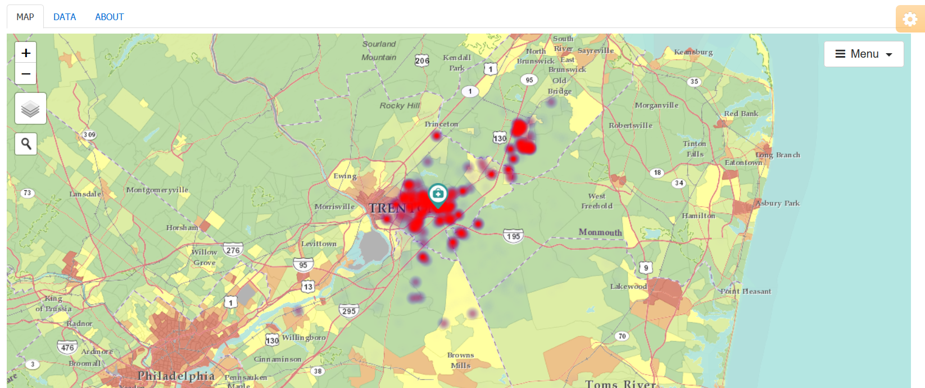
Community HotSpots
What you can do using Community HotSpots:
View community characteristics
View hot spots (clusters of poor disease control or gaps in quality) from your electronic health record data
View how hot spots relate to community characteristics
Download community characteristics

Slide 12

Hotspotting
The use of data to reallocate resources to a small subset of high-need, high-cost patients
Notes:
Today, innovators are experimenting with new ways of linking health to place and have, in the process, added new terms to the population health lexicon. As recalled in the 2011 Atul Gawande New Yorker article, Jeffrey Brenner, a family physician, pioneered the hotspotting playbook. Serving as a citizen member of a Camden police reform commission, Brenner learned about community policing. One strategy was crime hotspotting, or the process of mapping crime and focusing resources on high crime neighborhoods. He applied similar techniques using health care data, identifying and treating patients and buildings responsible for significant costs. Check out the Brenner’s Camden Coalition website for more information about hotspotting.

Slide 13
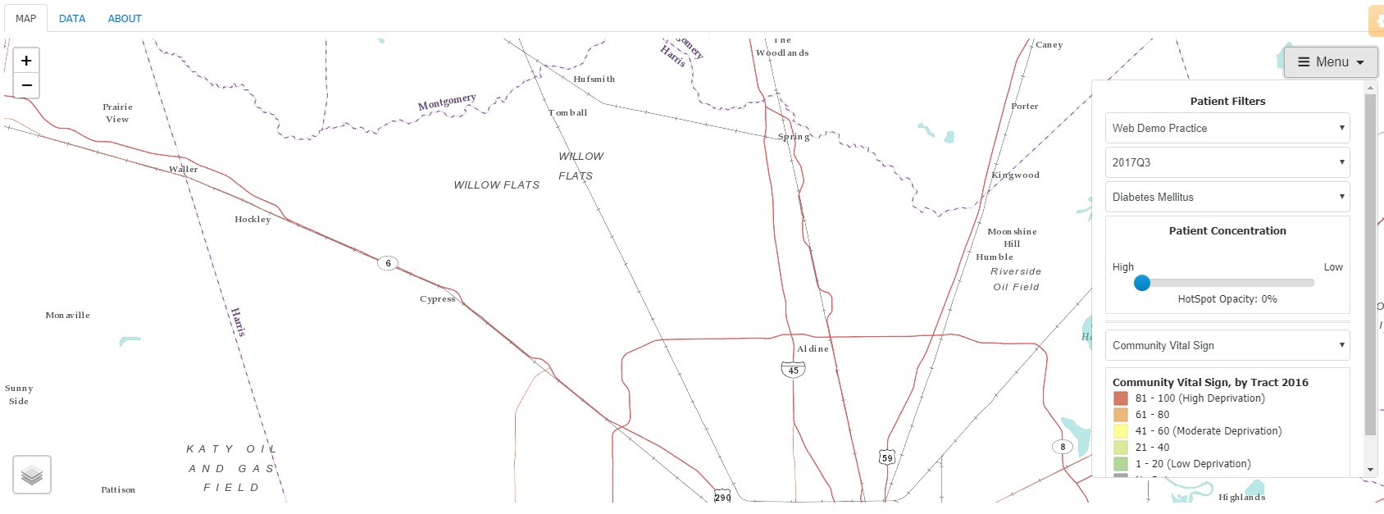

Identifying Hot Spots
Activity #1
Write down three census tracts where you think patients with poorly controlled diabetes will be located
Notes:
For the first activity, select your practice under the first drop down menu.
Under the second drop down menu, select the most recent quarter.
Under the third drop down menu, select the quality measure for poorly controlled diabetics.
Under “Patient Concentration”, move the slider to 0% opacity so that you cannot view the hot spots.
Hover over the layer icon in the bottom left corner of the screen, and deselect “Imagery” and “Community Vital Sign”
Write down three census tracts where you think patients with poorly controlled diabetes will be located

Slide 14
Why did you select these census tracts?
What do you know about these neighborhoods?
Notes:
If you are going through this module on your own, write your answer.
If you are going through this module with others, turn to your colleague and discuss your answer.

Slide 15
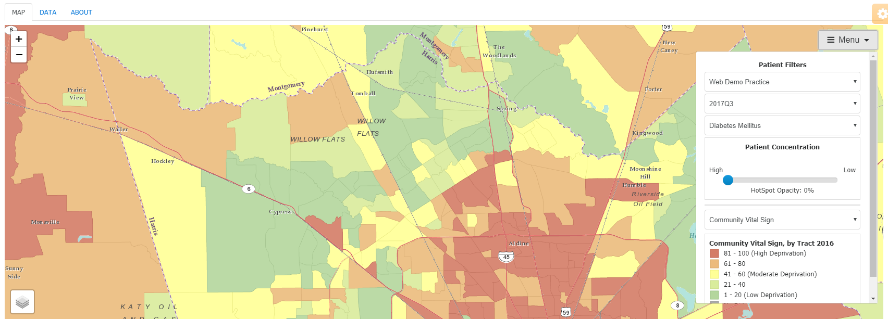

Identifying Hot Spots
Activity #1
Notes:
Now, hover over the layer icon in the bottom left corner and select “Community Vital Sign”.
Under the Menu, select Community Vital Sign.
Remember that the community vital sign is a composite measure of the deprivation in a census tract.

Slide 16
Consider the census tracts that you wrote down. Does having the additional neighborhood data change your prediction about where the hot spots will be located?
If so, how did your prediction change?
If not, why did it not change?
Notes:
If you are going through this module on your own, write your answer.
If you are going through this module with others, turn to your colleague and discuss your answer.

Slide 17
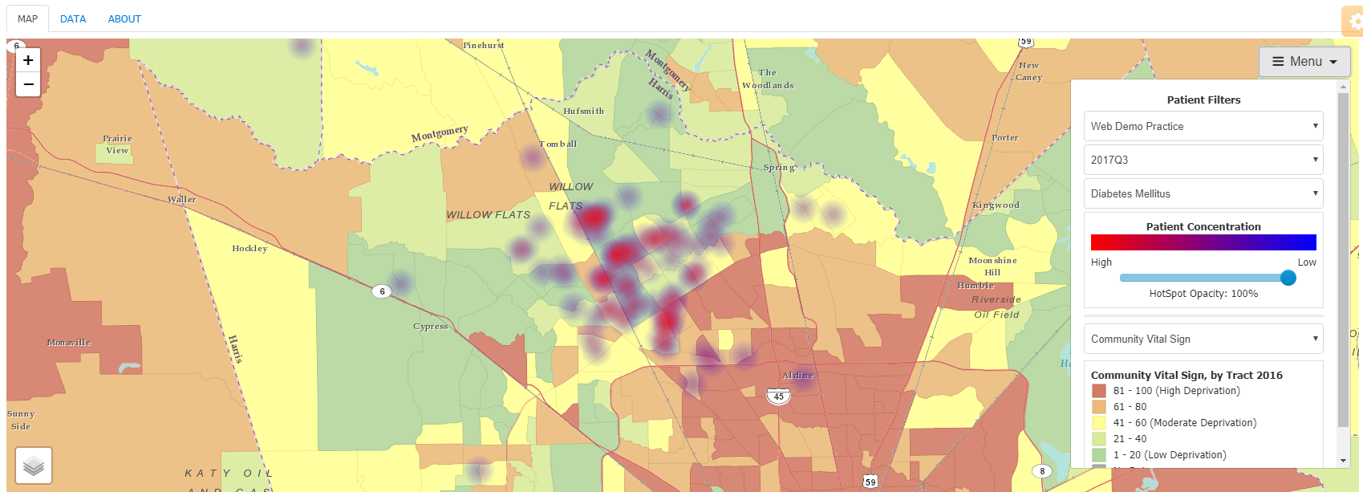
Identifying Hot Spots
Activity #1
Notes:
Under the Menu, change the opacity to 100% or to a level where you can view the hot spots.
Look at the four darkest spots and write down census tract numbers.

Slide 18
Compare your predicted list of hot spot census tracts with the actual census tracts.
To what extent are they similar and different?
Notes:
If you are going through this module on your own, write your answer.
If you are going through this module with others, turn to your colleague and discuss your answer.

Slide 19
Identifying Hot Spots
Activity #1
Notes:
Under the third drop down menu, select blood pressure control.

Slide 20
Identifying Hot Spots
Activity #1
Notes:
Select one additional quality measure.

Slide 21
How did the map change?
What accounts for any differences?
Notes:
If you are going through this module on your own, write your answer.
If you are going through this module with others, turn to your colleague and discuss your answer.

Slide 22
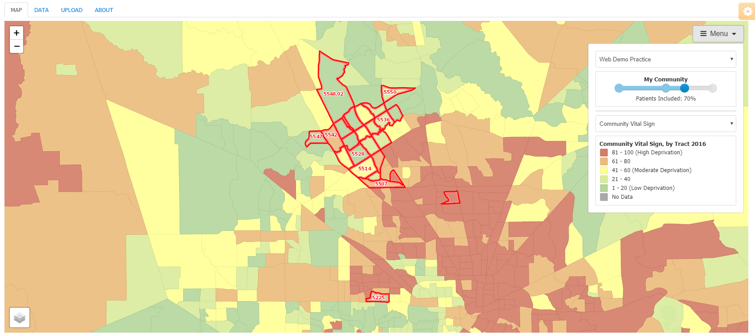
Integrating My Community and Community HotSpots
Activity #2
Notes:
Switch to the My Community Tool.
Move the slider so that 70% of the patients are included in the service area.

Slide 23
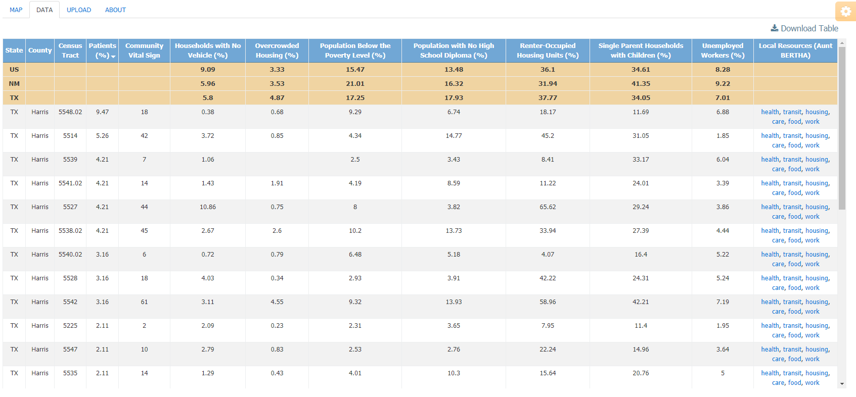
Integrating My Community and Community HotSpots
Activity #2
Notes:
Now, select the “Data” tab.
The census tracts listed are all of the census tracts in the 70% service area.
This table also includes the percentage of the patients coming to the clinic from this census tracts and community data about each census tract including composite deprivation, households with no vehicles, overcrowded housing, poverty, low education, renter-occupied housing units, single parent households, and unemployed workers. Similar to My Community, you can find community resources through Aunt Bertha. These are matched to the zip code linked to the census tract.
Also note that the state and national averages for these characteristics are listed at the top of the table.
Download this table, by clicking on the “Download Table” icon.

Slide 24
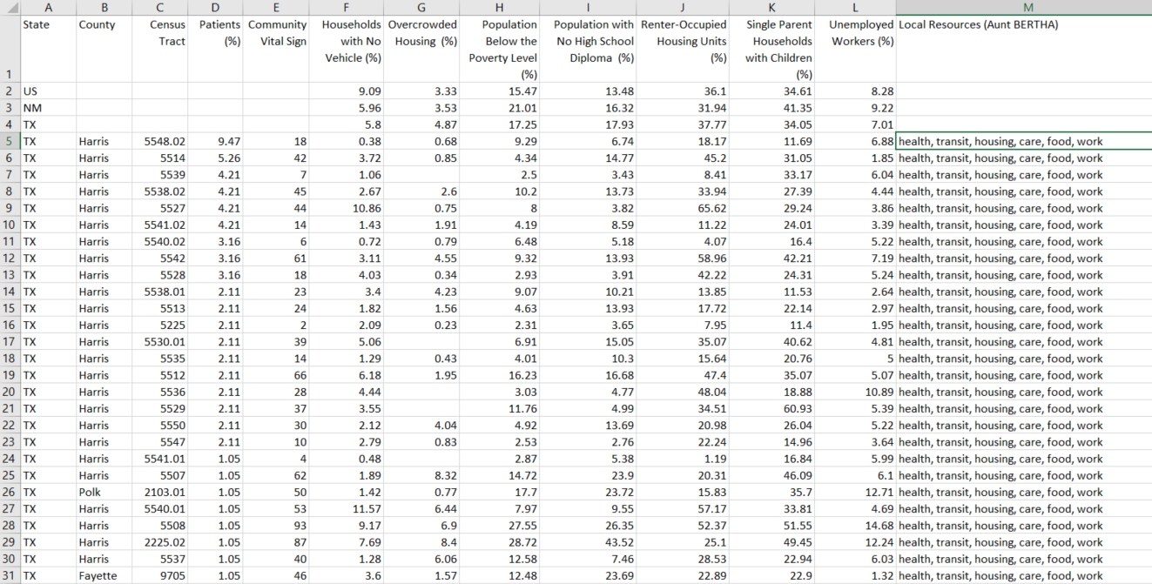
Integrating My Community and Community HotSpots
Activity #2
Notes:
You can either print this table or view it in a separate window.

Slide 25
Integrating My Community and Community HotSpots
Activity #2
Notes:
Switch back to Community HotSpots.
Select poorly controlled diabetes under the third drop down menu.
Write down the four darkest hot spots.

Slide 26
Integrating My Community and Community HotSpots
Activity #2
Notes:
Select a different quality measure under the third drop down menu.
Write down the four darkest hot spots.

Slide 27
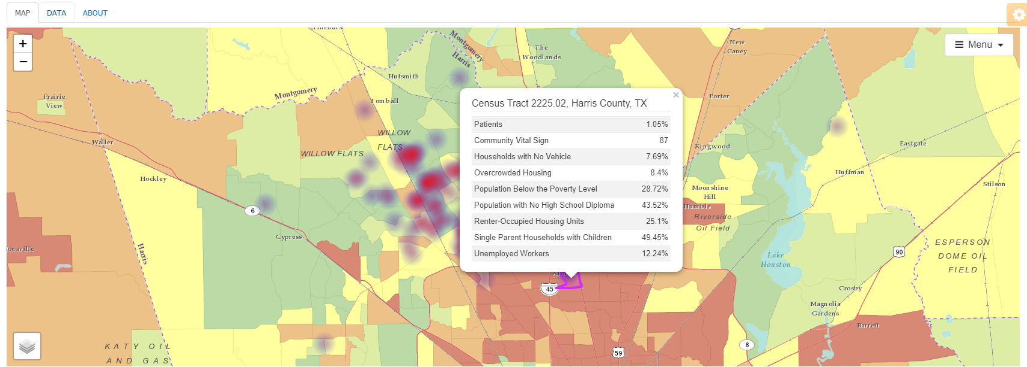
Integrating My Community and Community HotSpots
Activity #2
Notes:
Compare the census tracts you wrote down to the census tracts in your practice’s 70% service area.
If a census tract is not listed in the 70% service area, then click on the census tract.
When you click on it, you will see a pop up screen that will provide characteristics of that census tract.
Add these figures to your excel spreadsheet or print out.

Slide 28
What do you know about these neighborhoods?
Notes:
If you are going through this module on your own, write your answer.
If you are going through this module with others, turn to your colleague and discuss your answer.

Slide 29
Compare the community characteristics of the hot spot census tracts with the other census tracts in the 70% service area.
How are they similar? How are they different?
Notes:
If you are going through this module on your own, write your answer.
If you are going through this module with others, turn to your colleague and discuss your answer.

Slide 30
Compare the community characteristics of the hot spot census tracts with state and national averages.
How are they similar? How are they different?
Notes:
If you are going through this module on your own, write your answer.
If you are going through this module with others, turn to your colleague and discuss your answer.

Slide 31
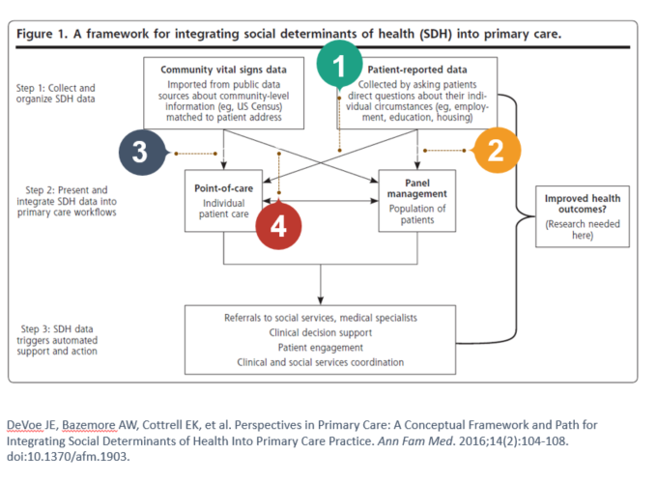
What can be done about hot spots?
Activity #3
Notes:
In Background 01: Introduction to Population Health, we talked about different approaches to using community and individual data to influence care.
In path 1, individual social determinants of health information is assessed and addressed for an individual patient
In path 2, individual social determinants of health information is aggregated and addressed at the community-level
In path 3, community determinants of health information is assessed and applied to an individual patient
In path 4, community determinants of health information is assessed and applied at the community-level

Slide 32
What can be done about hot spots?
Activity #3
What are three ways you can change delivery to address hot spots?
Notes:
If you are going through this module on your own, write your answer.
If you are going through this module with others, turn to your colleague and discuss your answer.

Slide 33
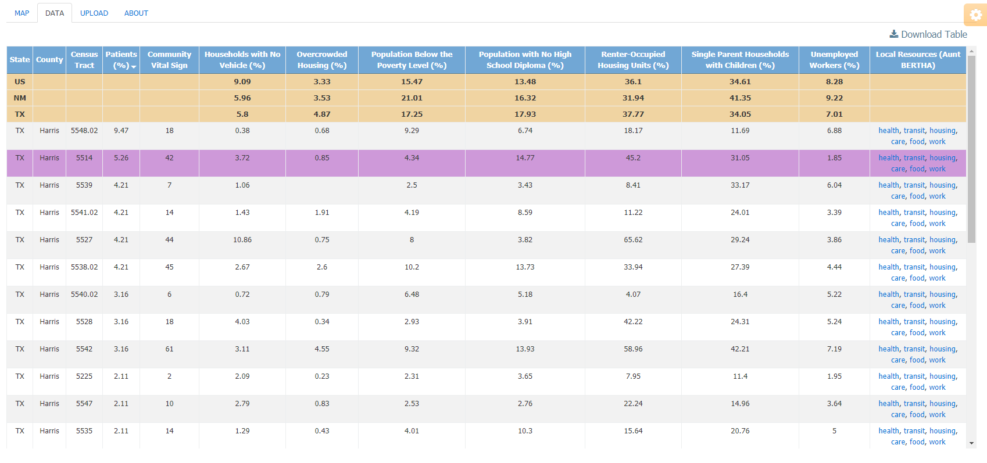
What can be done about hot spots?
Activity #3
Notes:
Take your list of hot spot census tracts in Activity #2, select one of them.
Select the “Data” tab.
Identify the row of the selected census tract and explore the resources available through Aunt Bertha.
Identify one community resource with which you could collaborate to address patients living in the hot spot census tract.

Slide 34
Which community resource did you select?
How would you partner with this organization to change delivery?
Notes:
If you are going through this module on your own, write your answer.
If you are going through this module with others, turn to your colleague and discuss your answer.

Slide 35
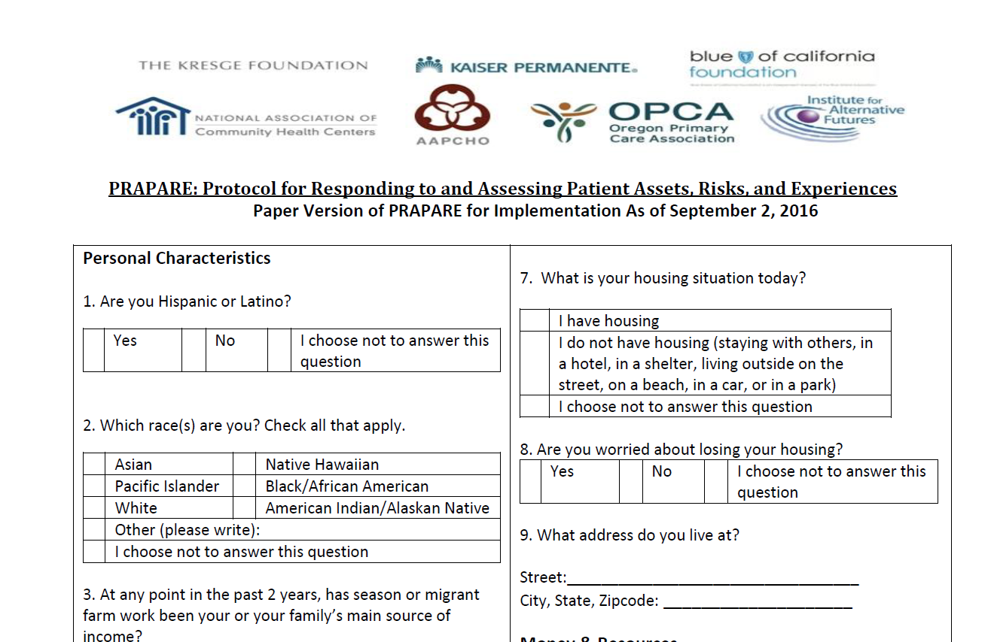
What can be done about hot spots?
Activity #3
EXAMPLE 1
Use patient-reported data to better understand the unmet social needs of those living in hot spots
Notes:
In Background 01: Introduction to Population Health, we talked about the PRAPARE instrument which can be used to better understand the unmet social needs of those living in hot spots. Identifying and addressing these unmet social needs is one strategy for controlling disease or improving quality gaps.

Slide 36
What can be done about hot spots?
Activity #3
EXAMPLE 2
Allocate a case manager, care coordinator, social worker, or community health worker for those patients living in hot spots

Slide 37
What can be done about hot spots?
Activity #3
EXAMPLE 3
Build a team around a neighborhood
  Cincinnati Children’s Hospital Medical Center
  A multi-disciplinary team of physicians, nurses, social workers, and community engagement consultants receive an alert when children from two high risk neighborhoods are hospitalized. The team reviews the charts, meets with the family at the bedside, and deliver home and community-based care.

Slide 38
What can be done about hot spots?
Activity #3
Hot Spotting Resources
  Association of American Medical Colleges Hotspotting Collaborative
  Camden Coalition Hotspotting Data Toolkit
  National Center for Complex Health and Social Needs

Slide 39
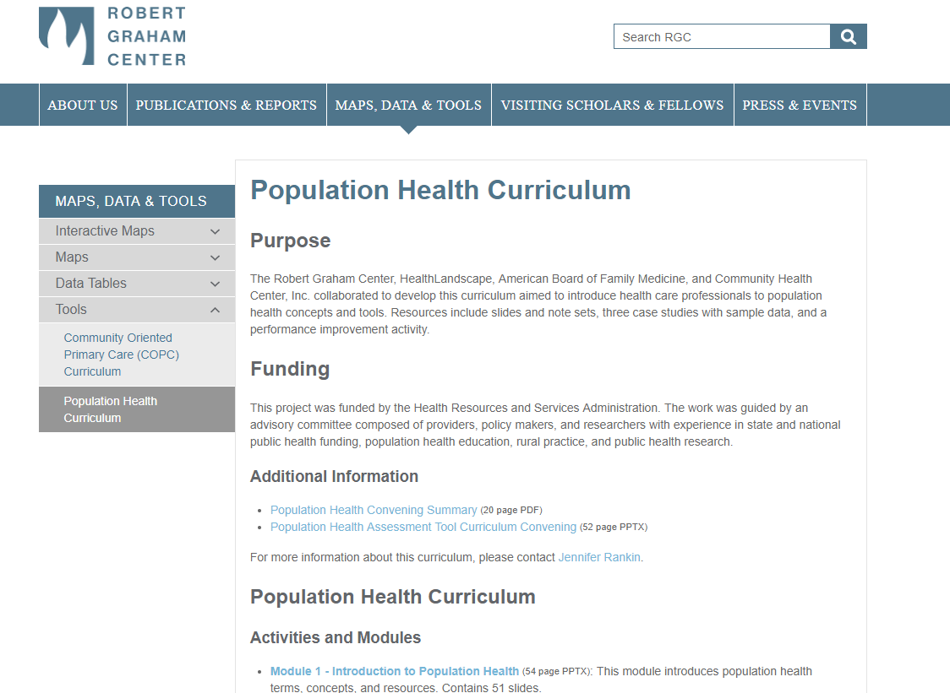
Tell us about how you are using PHATE
Share your story on our website

Slide 40
Take Home Points
PHATE can be used to:
  Identify hot spots
  Integrate clinical and community data
  Connect your practice with community resources

Slide 41
Next Level Stuff 07: Getting the Most out of Community HotSpots
Learning Objectives
List three hot spot census tracts
Describe how hot spots relate to community characteristics
List three ways to address hot spots

Slide 42
Relevant family medicine milestones
Notes:
After completing this module, we hope that family medicine residents will be able to meet these milestones.
https://www.acgme.org/Portals/0/PDFs/Milestones/FamilyMedicineMilestones.pdf

Slide 43
Relevant nurse practitioner competencies
Notes:
After completing this module, we hope that nurse practitioner trainees will be able to address these competencies.
http://www.aacn.nche.edu/dnp/Essentials.pdf
https://c.ymcdn.com/sites/nonpf.site-ym.com/resource/resmgr/Competencies/NPCoreCompsContentFinalNov20.pdf

