Slide 1

Population Health Assessment Engine

Slide 2
Population Health Assessment Engine Curriculum
01
02
BACKGROUND
Introduction to
Population Health
Introduction to
Geospatial Concepts
BEGINNER
03
04
05
Introduction to the Population Health Assessment Engine
How to use My Community
How to use Community HotSpots
06
07
ADVANCED
Getting the Most out of My Community
Getting the Most out of Community Hotspots
Notes:
This curriculum consists of 2 background modules that will introduce you to population health and geospatial concepts. The next three modules will describe how to use the Population Health Assessment Engine (PHATE) and the two tools embedded within PHATE: My Community and Community HotSpots. The final two modules will help you learn how to integrate PHATE into your clinic.

Slide 3
Overall goal for the PHATE Curriculum
To integrate community data, clinical data, and community resources in order to address social determinants of health and improve the health of patients and populations.
Notes:
Through the modules, case studies, and performance improvement activity, we hope that you will be able to integrate community data, clinical data, and community resources in order to address social determinants of health and improve the health of patients and populations.

Slide 4
Target audience
Anyone interested in learning about improving the health of populations
  Providers
  Staff
  Learners
    Residents
    Medical students

Slide 5
INTRODUCTION TO POPULATION HEALTH
BACKGROUND 01

Slide 6
Background 01: Introduction to Population Health
Learning Objectives
List two social determinants of health
Describe the impact of social determinants on health
Define community-oriented primary care
Define hotspotting and coldspotting
List two ways that individual and community social determinants of health data can be used to improve health
Notes:
By the end of this module, we hope that you will be able to:
List two social determinants of health
Describe the impact of social determinants on health
Define community-oriented primary care
Define hotspotting and coldspotting
List two ways that individual and community social needs data can be used to improve health

Slide 7
Relevant family medicine milestones
Notes:
After completing this module, we hope that family medicine residents will be able to meet these milestones.
https://www.acgme.org/Portals/0/PDFs/Milestones/FamilyMedicineMilestones.pdf

Slide 8
Relevant nurse practitioner competencies
Notes:
After completing this module, we hope that nurse practitioner trainees will be able to address these competencies.
http://www.aacn.nche.edu/dnp/Essentials.pdf
https://c.ymcdn.com/sites/nonpf.site-ym.com/resource/resmgr/Competencies/NPCoreCompsContentFinalNov20.pdf

Slide 9
Background 01: Introduction to Population Health
Outline
Definitions
Evidence Base
Concepts & Frameworks
Practical Tools & Action

Slide 10
I. DEFINITIONS
BACKGROUND 01

Slide 11
How would you define population health?
Notes:
If you are going through this module on your own, write down your definition for population health. If you are in a group, turn to the person next to you and discuss your answer. There are no wrong answers.

Slide 12
How would you define social determinants of health?
Notes:
If you are going through this module on your own, write down your definition for social determinants of health. If you are in a group, turn to the person next to you and discuss your answer. There are no wrong answers.

Slide 13
How are population health and social determinants related?
Notes:
If you are going through this module on your own, write down how these two terms are related. If you are in a group, turn to the person next to you and discuss your answer. There are no wrong answers.

Slide 14
Meet “Mary”
Female in her 40s with anxiety, depression, obesity, fibromyalgia, migraines, polycystic ovary syndrome, and hypertension
Notes:
Numerous organizations, from the Centers for Disease Control and Prevention to the National Academy of Medicine to the World Health Organization, have extolled the importance of addressing social determinants of health. But what does that mean practices?
Before we answer that question, let’s look at a case. Mary is a female in her 40s with anxiety, depression, obesity, fibromyalgia, migraines, polycystic ovary syndrome, and hypertension. Periodically, we will come back to Mary to see how social determinants affect her.

Slide 15

Population Health:
    The health outcomes of a group of individuals, including the distribution of such outcomes within the group
Kindig D, Stoddart G. What is population health? Am J Public Health. 2003; 93: 380-383.
Notes:
If you are like me, then you have many patients like Mary. All of the patients you see in your clinic comprise your patient panel – which is one method for defining a population. The term population health means different things to different people. For the purposes of this curriculum, we will be using the definition put forth by Kindig and Stoddart, who defined population health as the health outcomes of a group of individuals, including the distribution of such outcomes within the group.

Slide 16
Types of Populations
Community
Clinic
Panel
Subgroups within these populations (e.g. diabetics)
Notes:
You can identify these groups by sampling from three different levels of populations: your panel, your clinic, and those living in the community served by your clinic. Often, you may be looking at subgroups within these populations, such as only diabetics or only those eligible for cervical cancer screening. For decades, fee-for-service has incentivized us to only consider the needs of the patients sitting in front of us. Delivering care to populations is fundamentally different. Reducing the incidence of colon cancer in your panel will require you to discuss prevention during acute care visits and deliver care outside of encounters. Reducing this incidence at the community level will require you to deliver care to not only those coming to your clinic but also those your clinic has never treated. These activities are often not reimbursed in fee-for-service.

Slide 17
Determinants of Population Health
Genes and Biology
Health Behaviors
Social Characteristics
Medical Care
Annals of the New York Academy of Sciences
Volume 896, Issue 1, pages 281-293, 6 FEB 2006 DOI: 10.1111/j.1749-6632.1999.tb08123.x
http://onlinelibrary.wiley.com/doi/10.1111/j.1749-6632.1999.tb08123.x/full#f1
Notes:
The determinants of population health are well categorized by the physician Alvin Tarlov.
He describes four categories of determinants of health:
1) Genes and biology: Your patient has Huntington’s because of his genes.
2) Medical care: Your patient has end stage renal disease because she was unable to get insulin.
3) Health related behavior: Your patient has bladder cancer because he smoked.
4) Social characteristics
Most of us have spent the majority of our training learning about genes and biology, health behaviors, and medical care. But if we only focus on those three determinants and ignore the social determinants, we will be missing factors that have a significant impact on the health of our patients.

Slide 18

Social Determinants of Health:
Conditions in which people are born, grow, live, work, and age.
http://www.who.int/social_determinants/en/
Notes:
According to the World Health Organization, the social determinants of health are the conditions in which people are born, grow, live, work, and age. Addressing social determinants is an important strategy for improving population health.

Slide 19
II. EVIDENCE BASE
BACKGROUND 01

Slide 20
“Mary”
Mary’s zip code: 22041
36% earning less than 200% of the Federal Poverty Level
Notes:
These statistics are certainly true for Mary.
She moved to northern Virginia from the Midwest. The cost of living in northern Virginia is much higher than the Midwest. Therefore, she could only afford to live in less desirable areas, where the rent was more affordable. Her apartment building is located in a high crime area, is not near parks, and is older, with numerous structural issues. Many of her neighbors are unemployed and unable to find work. Her zip code has one of the highest poverty rates in the county.

Slide 21
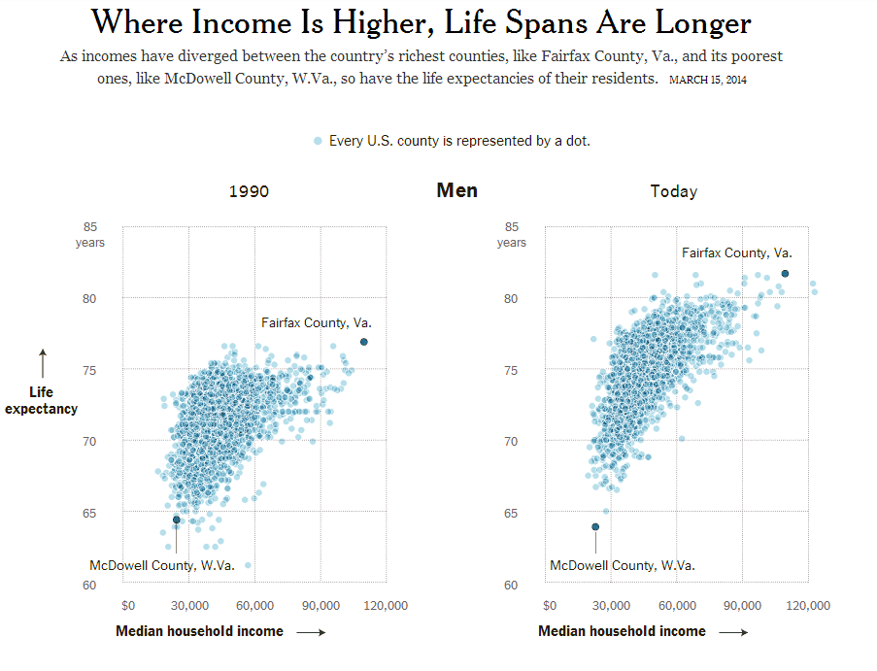
Your zip code is more important than your genetic code
82 years
18 year difference
64 years
Lowrey A. Income Gap, Meet the Longevity Gap. New York Times. 2014.
Notes:
Remember that social characteristics have a greater impact on health than genes and biology. Therefore, when it comes to health, your zip code is more important than your genetic code. McDowell County, West Virginia and Fairfax County, Virginia are separated by 350 miles, yet they might as well be in different countries.
McDowell has been affected by the decline coal. Unemployment and drug use are high. In contrast, Fairfax County is supported by government contracts and a growing technology sector.
On this graph, each point is a county. On the x axis, we have median household income. On the y axis, we have life expectancy. As you can see, men in Fairfax County live around 82 years, which is about the same as Sweden. Those in McDowell County live around 64 years, which is about the same as Iraq. That’s an 18 year difference.

Slide 22
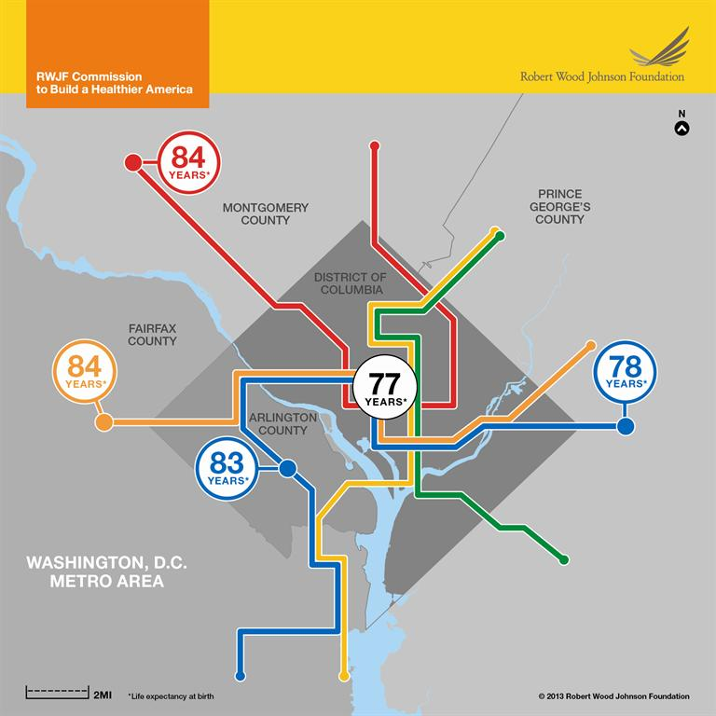
http://www.societyhealth.vcu.edu/work/products/
Notes:
Washington, DC is one of the nation’s most affluent regions. Yet, within DC, there is variation. Life expectancy varies by 7 years, depending on your subway stop.

Slide 23
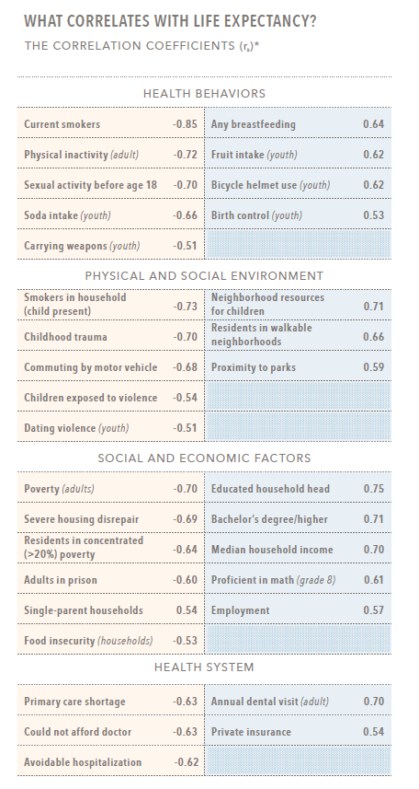
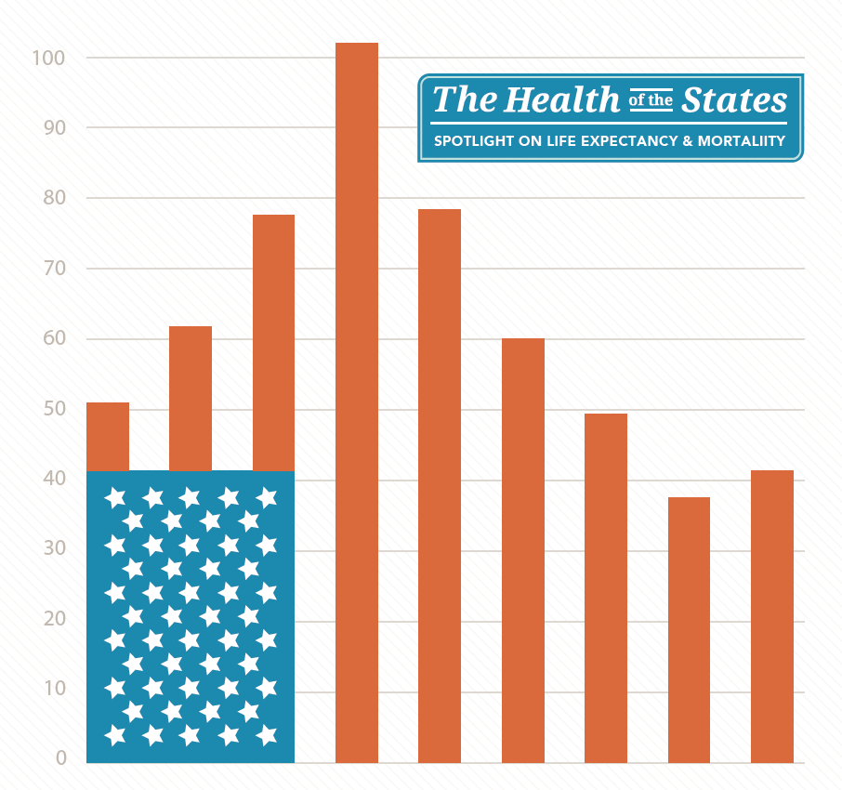
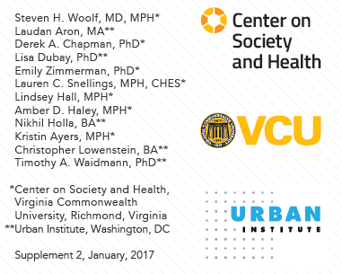
Notes:
Many have sought to explain the reasons behind this variation and have identified numerous factors related to life expectancy. For example, this report at the state level found that smoking, physician inactivity, soft drink intake, childhood trauma, community violence, and poverty were correlated with lower life expectancy while breastfeeding, fruit intake, walkable neighborhoods, parks, and education were protective.

Slide 24
Social Determinants of Health
Whitehall study
18,000 male civil servants
Marmot’s cohort study looking at risk factors for death (hypertension, diabetes, smoking)
Assigned to one of four employment grades:
  Administrative
  Professional and executive
  Clerical
  Other (messengers and manual laborers)
Outcomes: mortality rates
Marmot et al. Employment Grade and CHD Death in British Civil Servants.
J Epidemiol and Community Health. 1978;32:244-9.
Notes:
Dr. Michael Marmot conducted one of the seminal works on social determinants. In the Whitehall study, he captured the complexities of the relationship between work and health. Whitehall is a street in London where many of the British civil service work. He performed a fascinating prospective cohort study in the 1960s looking at various risk factors for death. He followed 18,000 civil servants aged 40-69. The risk factors included hyperlipidemia, hypertension, glucose intolerance, diabetes, and smoking. He stratified people according to their job within the hierarchy of the British civil service. Administrative is the top level then professional / executive then clerical then other which includes messengers and manual laborers. He was interested in mortality rates across the groups.

Slide 25
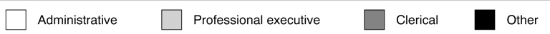
Social Determinants of Health - Work
Rossum et al. Employment Grade Differences in cause specific mortality. A 25 year Follow up of civil servants from the first Whitehall study. J. Epidemiol Community Health 2000;54:178-184.
Notes:
This is what he found. The y axis is the mortality rate, and you are looking at 0-9 years, 10-19 years, and 20+ years of follow up. These data are stratified based on employment grade. Remember that administrative (white bars) is the highest grade while other (manual labor / black bars) is the lowest grade. Over a ten year period, Marmot found that workers in the lowest grade had a mortality rate 3 times higher than the mortality rate of the highest grade.

Slide 26
Why treat people and send them back to the conditions that make them sick?
Michael Marmot
Notes:
Marmot’s findings prompted him to ask…

Slide 27
III. CONCEPTS & FRAMEWORKS
BACKGROUND 01

Slide 28
“Mary”
On disability
1 daughter with autism
1 son who has had multiple hospitalizations for asthma
Notes:
We know that Mary’s neighborhood affects her health. Her individual poverty has also impacted her health.
Due to her worsening medical conditions, she was unable to work and ultimately was placed on disability. Furthermore, she has 1 daughter with autism and 1 son with multiple hospitalizations for asthma. While caring for her children is rewarding, coordinating and paying for their care is stressful and isolating. She is grateful for the disability payments, but the medical expenses make it difficult for her to pay for other living expenses. After paying for medical care, she said “there’s nothing left over for food.” She feels shame that she cannot provide her family with the healthy foods she knows they need.

Slide 29
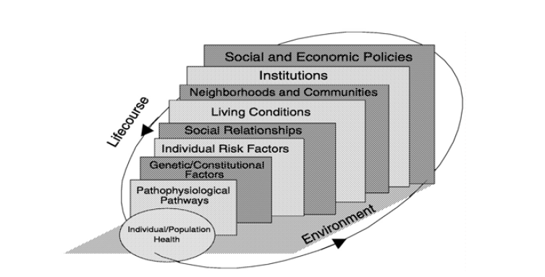
Multilevel approach to health
Smedley B. Promoting Health: Intervention Strategies from Social and Behavioral Research. Washington (DC): National Academy Press; 2000.
Notes:
The work of Marmot and others led us to widen our lens and think more broadly about what affects health. These large gradients in health challenge our model of what it means to be healthy. Genomics and biomedicine alone cannot explain all of the variation. This model was presented in a National Academy of Medicine report on social determinants and provides a useful framework for thinking about how social determinants relates to other health determinants. With Mary, this is certainly true, where individual, family, and neighborhood factors interact and contribute to her current state of health.

Slide 30
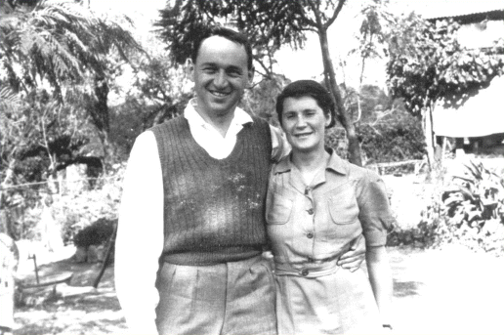
Community-Oriented Primary Care
Sidney and Emily Kark
Sidney Kark: 1911-1998
Ran the Pholela Health Center in South Africa
Coined the term – “Community-oriented primary health care” (now community-oriented primary care (COPC))
Longlett SK, Kruse JE, Wesley RM. Community-oriented primary care: Historical perspective. J Am Board Fam Pract 2001; 14(1): 54-63.
Notes:
Linking social determinants to health care is not a new idea. In the 1940s, Sidney and Emily Kark were charged with delivering both curative and preventive services at the Pholela Health Center in South Africa. To care for the population, the Karks emphasized research methods, tried to understand local concepts of disease, focused on community diagnosis, and relied on team approaches. In their assessments and interventions, they used epidemiology, social psychology, basic sciences, geography, and primary care. They trained community health workers to complete needs assessments, survey each individual within their defined community, and implement interventions. Their first project report focused on social determinants such as the need for basic sanitation, the prevention of soil erosion, and improvements in nutrition. During the 1950s, the infant mortality rate of their community decreased from 275 deaths per 1000 live births to 100. Similar declines did not occur outside of their service area. They named their process, community-oriented primary care, or COPC.

Slide 31
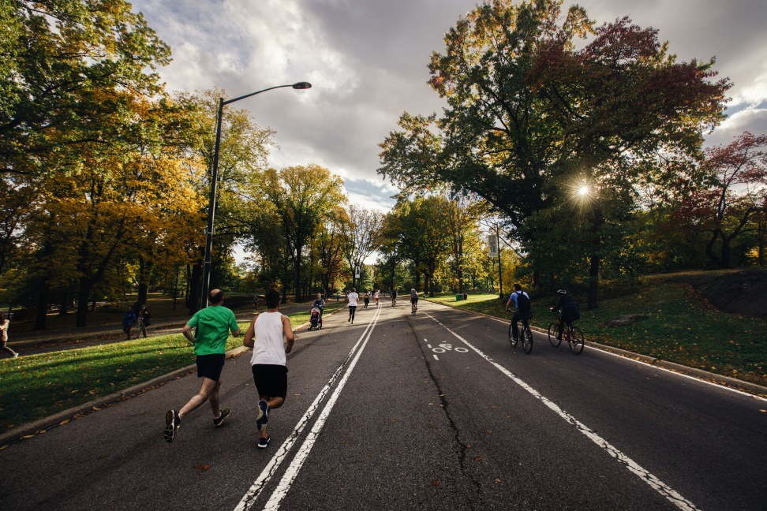
Community-Oriented Primary Care
A continuous process by which primary health care is provided to a defined community on the basis of its assessed health needs by the planned integration of public health with primary care
Mullan F, Epstein L. Community-oriented primary care: New relevance in a changing world. Am J Public Health 2002; 92(11): 1748-55.
Notes:
COPC is defined as a continuous process by which primary health care is provided to a defined community on the basis of its assessed health needs by the planned integration of public health with primary care. Within this definition, I want to direct your attention to “health” and “defined community”. First, since we are talking about health, we are not talking about just drugs, tests, and procedures. And second, the target of COPC is a defined community; therefore, this does not just refer to the patient in front of you or even just the patients coming to your office.

Slide 32
COPC Steps
Four process steps:
1) Define the community of interest
2) Identify the health problem
3) Develop and implement interventions
4) Conduct ongoing evaluation
COMMUNITY INVOLVEMENT IS CRITICAL TO EACH STEP
Community-oriented primary care: A practical assessment. Institute of Medicine. Washington, DC: National Academy Press; 1984.
Notes:
There are four steps in the COPC process. The first step is defining the community of interest. The next step is identifying health problems. The third step is developing and implementing interventions. The final step is conducting an ongoing evaluation. Hopefully, by the end of the module, you will come to appreciate that community involvement is critical to each step.

Slide 33

COPC – The Birth of Health Centers
H. Jack Geiger
“A central tenet [of COPC] is that primary care should be rooted in communities, for communities, and with communities”
Director of the Mound Bayou Community Health Center
Longlett SK, Kruse JE, Wesley RM. Community-oriented primary care: Historical perspective. J Am Board Fam Pract 2001; 14(1): 54-63.
Geiger HJ. Community-oriented primary care: The legacy of Sidney Kark. Am J Public Health 1993; 83(7): 946-7.
Notes:
Eventually, COPC spread to the United States. In the 1960s, Congress established Medicare, Medicaid, and the Office of Economic Opportunity (OEO) and mandated that each eliminate poverty. The grant to start the first health centers was awarded by the OEO to Tufts where H. Jack Geiger was faculty. Geiger had been active in civil rights since college. In medical school, he struggled with integrating his interest in social justice and medicine. Ultimately, he realized that he could combine his interests by studying the social causes of ill health. He spent time in South Africa with the Karks and was instantly drawn to their approach. Following this formative experience, Geiger employed COPC techniques and concepts when he became the Director of the Mound Bayou Health Center in the Mississippi delta – one of the two first health centers in the US. COPC was prominent in the application for the first health center, and the intention was for all health centers to employ COPC principles.

Slide 34
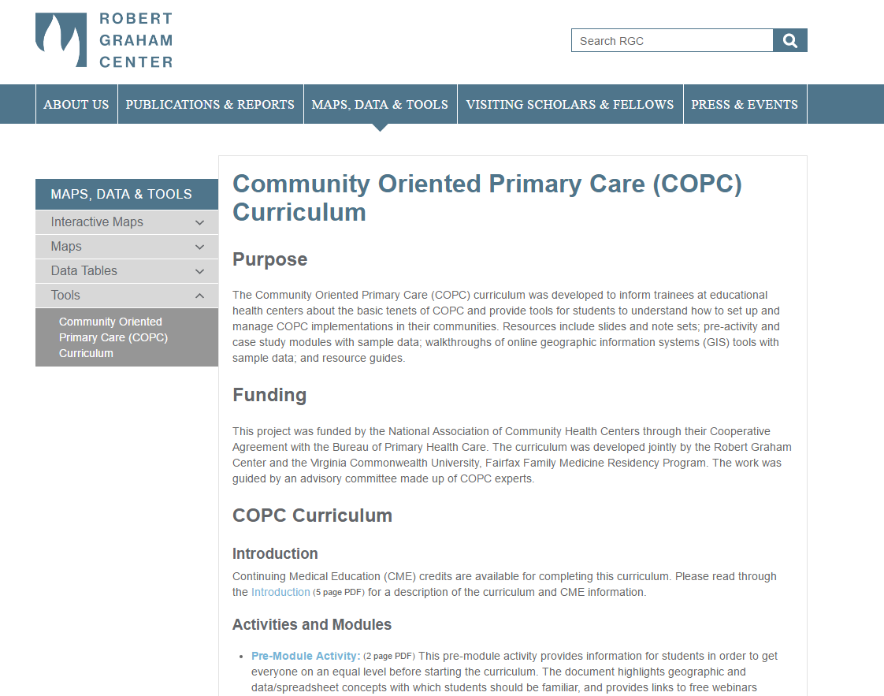
COPC Curriculum
http://www.graham-center.org/rgc/maps-data-tools/tools/copc.html
Notes:
If you are interested in learning more about COPC, please check out the free, online curriculum that we developed in conjunction with the National Association of Community Health Centers

Slide 35
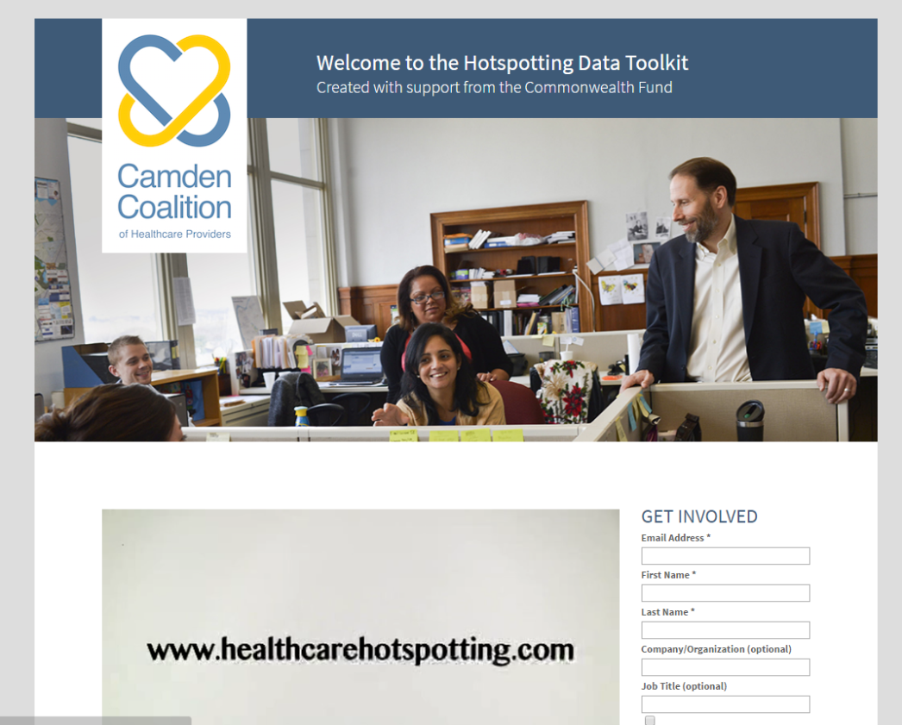
Hotspotting
The use of data to reallocate resources to a small subset of high-need, high-cost patients
Notes:
Today, innovators have experimented with new ways of linking health to place and have, in the process, added new terms to the population health lexicon. As recalled in the 2011 Atul Gawande New Yorker article, Jeffrey Brenner, a family physician, pioneered the hotspotting playbook. Serving as a citizen member of a Camden police reform commission, Brenner learned about community policing. One strategy was crime hotspotting, or the process of mapping crime and focusing resources on high crime neighborhoods. He applied similar techniques using health care data, identifying and treating patients and buildings responsible for significant costs. Check out the Brenner’s Camden Coalition website for more information about hotspotting.

Slide 36
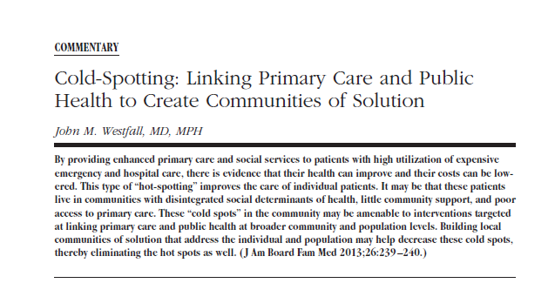
Coldspotting
Finding communities that lack the essential opportunities for health
Notes:
Jack Westfall, a family physician at the University of Colorado, proposed another concept, which he called coldspotting. Instead of concentrating resources on a small number of patients, he proposes investing resource poor communities. These are communities that do not provide the essential opportunities for health. For example, they lack good air quality, grocery stores, and opportunities for employment and education.

Slide 37
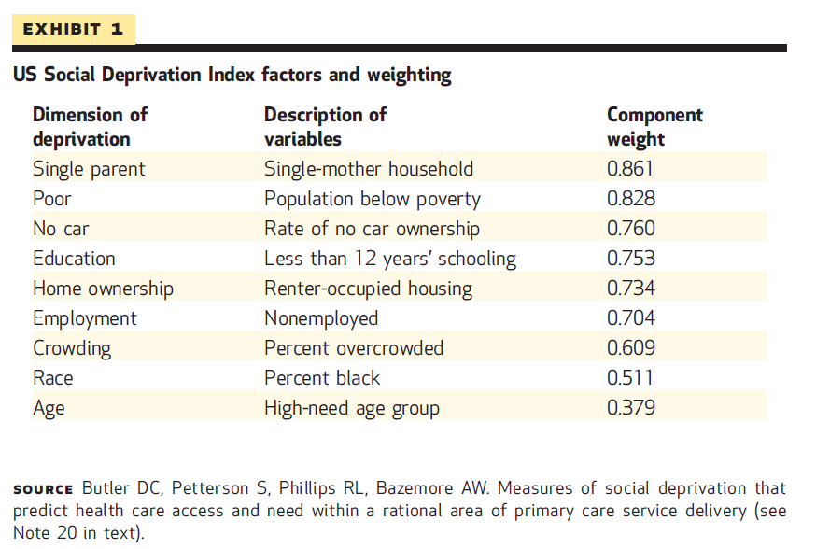
Social deprivation index
Phillips RL, Liaw W, Crampton P, et al. How Other Countries Use Deprivation Indices--And Why The United States Desperately Needs One. Health Aff (Millwood). 2016;35(11):1991-1998. doi:10.1377/hlthaff.2016.0709.
Notes:
Given the multitude of available community measures, communities often have difficulty agreeing on which measures to use to identify cold spots. One way to find a common language is to use deprivation indices. Other countries, such as the United Kingdom and New Zealand, have looked to deprivation indices to solve this problem. The Robert Graham Center has developed a US based social deprivation index, which is composed of the dimensions listed in the table above.

Slide 38
Growth in value-based payment
% Medicare payment tied to quality or value
Notes:
Why do you need to know any of this? In addition to allowing you to address roots causes and upstream factors that affect health, addressing social determinants and improving population health may become an integral part of your job. In 2015, former Health and Human Services Secretary Sylvia Burwell set a goal of tying 90% of Medicare payments to value (reduced costs, improved quality) by the end of 2018. The Medicare Access and CHIP Reauthorization Act (MACRA) accelerates this transition by encouraging providers to participate in alternative payments models, which are also tied to value.
http://www.hhs.gov/about/news/2015/01/26/better-smarter-healthier-in-historic-announcement-hhs-sets-clear-goals-and-timeline-for-shifting-medicare-reimbursements-from-volume-to-value.html
Graph from http://www.commonwealthfund.org/publications/issue-briefs/2015/jun/medicare-payment-reform-aligning-incentives

Slide 39
Payment and measurement may soon be adjusted for social risks
A 2016 Health and Human Services Report found that:
  Beneficiaries with social risk factors had worse quality
  Providers disproportionately serving beneficiaries with social risk factors had worse quality
  Outlined methods for adjusting payment and measurement for social risks
Assistant Secretary for Planning and Evaluation. Social Risk Factors and Performance Under Medicare’s Value-Based Purchasing Programs.; 2016. https://aspe.hhs.gov/system/files/pdf/253971/ASPESESRTCfull.pdf.
Notes:
Furthermore, the IMPACT Act of 2014 asked the Assistant Secretary for Planning and Evaluation to study the effect of individuals’ socioeconomic status on quality measures. This has led to a lot of conversation about whether or not payment and quality measurement should be adjusted to account for social risk factors. If so, how should payment and measurement be adjusted?
There are two main findings of this report:
Beneficiaries with social risk factors had worse outcomes on many quality measures, regardless of the providers they saw, and dual enrollment status was the most powerful predictor of poor outcomes. Dually enrolled beneficiaries had poorer outcomes on process measures (such as cancer screening), clinical outcome measures (such as diabetes control), safety (such as infection rates), and patient-experience measures. They also had higher resource use (such as higher spending per hospitalization).
Providers that disproportionately served beneficiaries with social risk factors tended to have worse performance on quality measures. As a result, safety net providers were more likely to face financial penalties in most of the value based purchasing programs. Nevertheless, there were some providers serving a high proportion of beneficiaries with social risk factors that achieved high performance levels – indicating that high performance is feasible.
The report outlines three key strategies as CMS considers the options:
Measuring and reporting quality for beneficiaries with social risk factors
Setting high, fair quality standards for all beneficiaries
Provision of targeted rewards and supports for better outcomes for beneficiaries with social risk factors

Slide 40
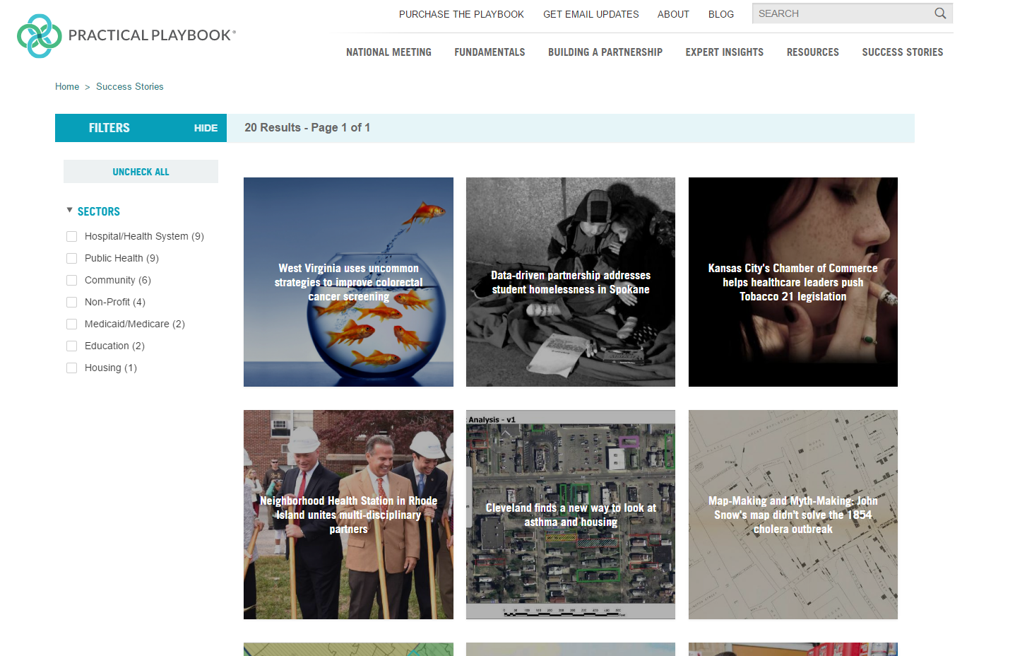
Brightspotting
Notes:
All over the country, organizations are trying to better address social determinants of health. This is from the Practical Playbook, a book and an online community of practitioners sharing and learning from existing community solutions.

Slide 41
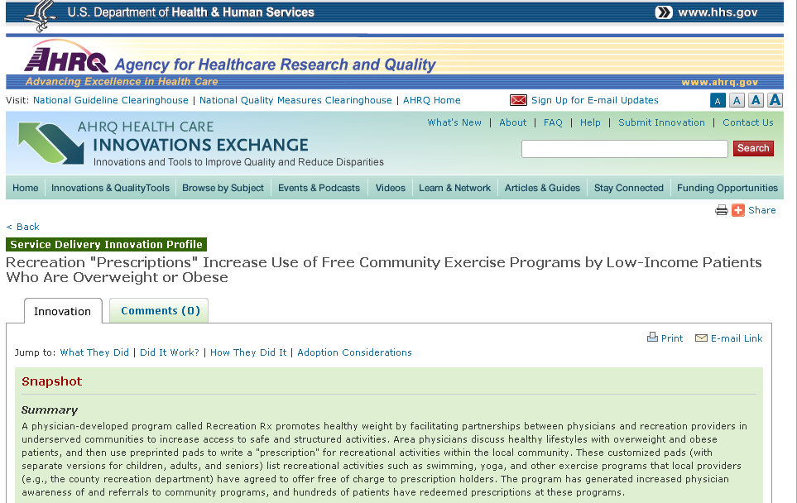
Brightspotting
Notes:
The Agency for Healthcare Research and Quality has a repository of interventions and brief information about their effectiveness. In this example, the providers write a prescription for recreational activities within the community such as passes for swimming pools, yoga classes, and exercise programs. Local providers such as the county recreation departments have agreed to offer the activities free of charge to prescription holders.

Slide 42

Brightspotting
Notes:
The Community Tool Box has amazing resources and examples. It’s a great place for additional curricula around community needs assessment and engagement.

Slide 43
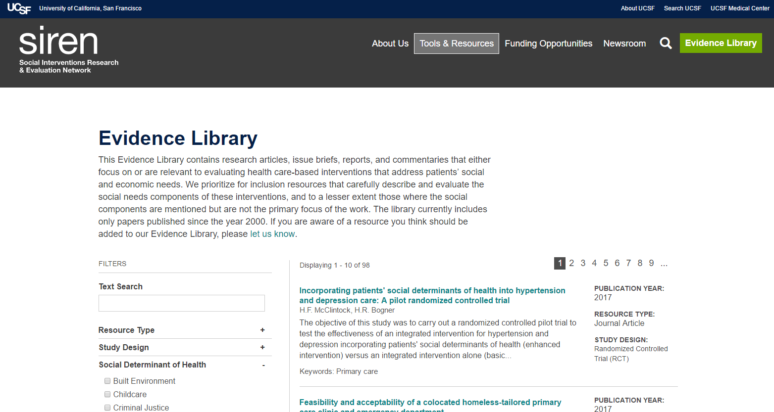
Brightspotting
Notes:
Finally, the Social Interventions Research & Evaluation Network is an evidence library created by the University of California, San Francisco, with articles specifically about social intervention research. It is updated regularly in order to incorporate the most up to date literature.

Slide 44
IV. PRACTICAL TOOLS & ACTION
BACKGROUND 01

Slide 45
“Mary”
Body mass index: 56
On 22 medications
2016: 25 visits
Has worsening depression
Notes:
Let’s go back to Mary. She has a body mass index of 56 and is on 22 medications. In 2016, she had 25 office visits. Despite being on several anti-depressants, her depression continues to worsen. You wonder whether there are other factors affecting her health that remain unaddressed.

Slide 46
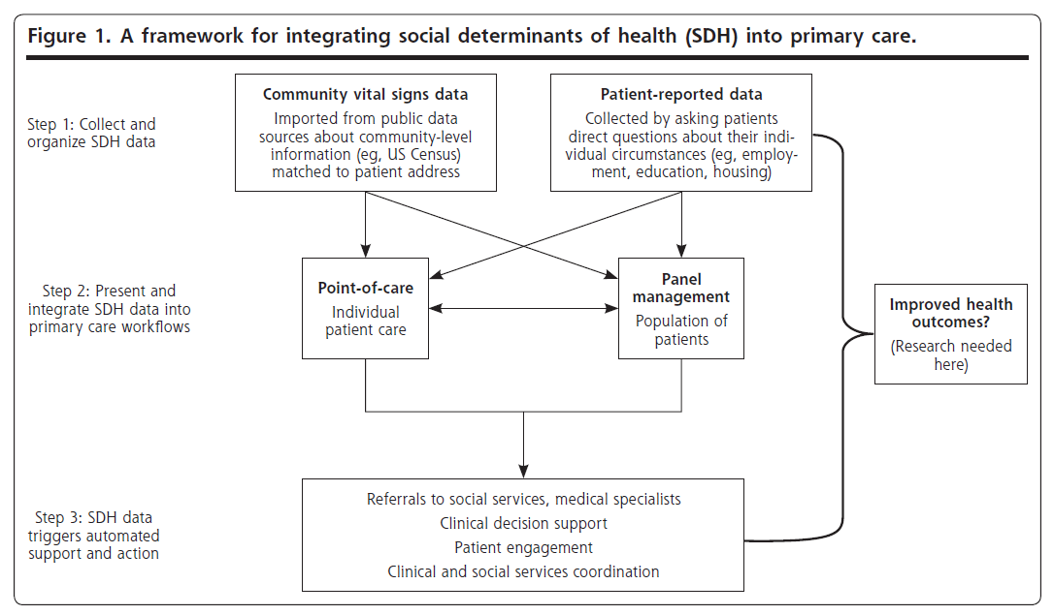
1
3
2
4
DeVoe JE, Bazemore AW, Cottrell EK, et al. Perspectives in Primary Care: A Conceptual Framework and Path for Integrating Social Determinants of Health Into Primary Care Practice. Ann Fam Med. 2016;14(2):104-108. doi:10.1370/afm.1903.
Notes:
From an ecological perspective, we know that social determinants affect health. Public health has taught us that community interventions can improve community-level measures. But does addressing social determinants at the individual level improve health? Do community-interventions improve health at the individual level? How do we integrate this information into clinical practice?
Drs. Devoe and Bazemore created this framework for categorizing interventions that address social determinants:
In path 1, individual social determinants of health information is assessed and addressed for an individual patient
In path 2, individual social determinants of health information is aggregated and addressed at the community-level
In path 3, community determinants of health information is assessed and applied to an individual patient
In path 4, community determinants of health information is assessed and applied at the community-level
Let’s evaluate each of these pathways individually.

Slide 47
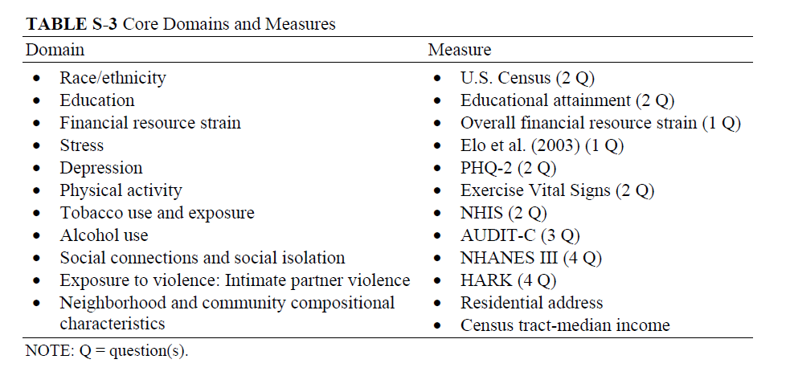
Using patient-reported data at the point of care
1
Notes:
Path one is probably the most straightforward: Using patient-reported data at the point of care. The National Academy of Medicine has declared social and behavioral measures that should be incorporated into electronic health records.

Slide 48
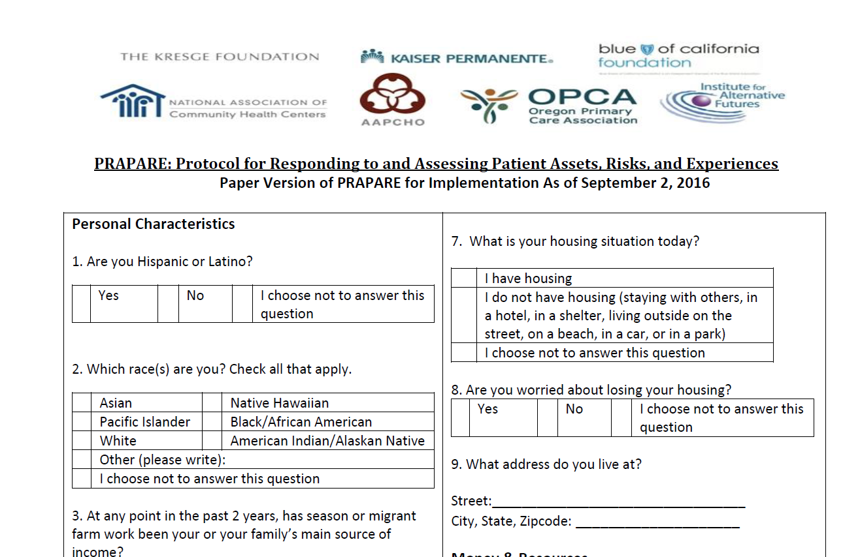
Using patient-reported data at the point of care
1
Notes:
There are numerous tools that can be used to assess individual needs. This tool is called PRAPARE and was developed by the National Association of Community Health Centers.

Slide 49
Using patient-reported data at the point of care
1
Mary’s responses:
  She is worried about losing her housing
  She is receiving disability
  In the past year, she has been unable to pay for food and medicine when they were really needed
  Lack of transportation has kept her from medical appointments and from getting her medications
Notes:
You ask Mary to complete the PRAPARE tool and find out that:
1) She is worried about losing her housing
2) She is receiving disability
3) In the past year, she has been unable to pay for food and medicine when they were really needed
4) Lack of transportation has kept her from medical appointments and from getting her medications
The tool opens the door to a conversation about how her impending bankruptcy is underlying her worsening depression. Therapy and medication can potentially help her deal with this stress but will not address the underlying issue. Her son has had multiple hospitalizations over the past two years, and she has trouble paying the subsequent bills. Having this information allows you to connect Mary with existing community resources to help with financial, legal, housing, and transportation assistance.

Slide 50
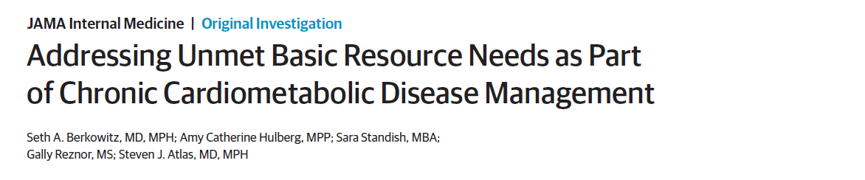
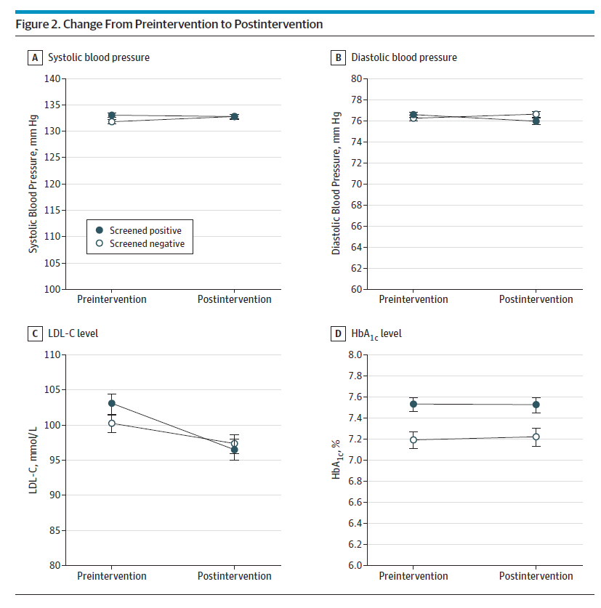
1
Notes:
There is a need for more research to determine whether this strategy works. Here is one study of over 5000 patients at 3 practices in Massachusetts screened for social needs. They used the Health Leads program, where individuals complete standardized screening forms. Those reporting unmet needs were referred to the program. Advocates link patients with community resources and / or public benefits to meet the need. These researchers were interested in changes systolic and diastolic blood pressures, LDL levels, and hemoglobin A1cs. The two groups were the group with unmet needs and the group without. This was a difference in differences approach, meaning that the individuals served as their own controls. The Health Leads group had a 1 mm Hg greater reduction in systolic blood pressure and 3.7 mg/dL reduction in LDL cholesterol. While these differences are small, a 2 mm Hg reduction in systolic blood pressure is associated with a 5% reduction in relative risk for coronary disease events.

Slide 51
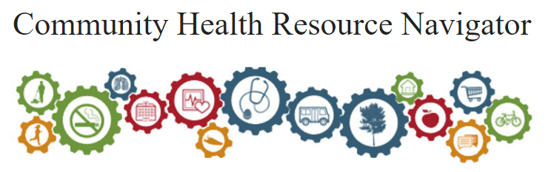
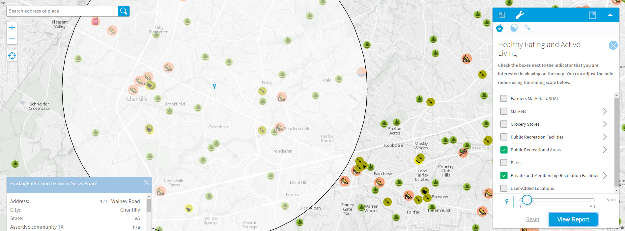
Using patient-reported data at the point of care
1
Notes:
There are a growing number of tools that allow you to better connect individuals with community resources. The American Academy of Family Physicians has developed the Community Health Resource Navigator. This tool allows you to look up the location of markets, parks, recreation facilities, mental health resources, and substance abuse resources. Here, we have found the location of the County Community Services Board, which can help link Mary to mental health resources.

Slide 52
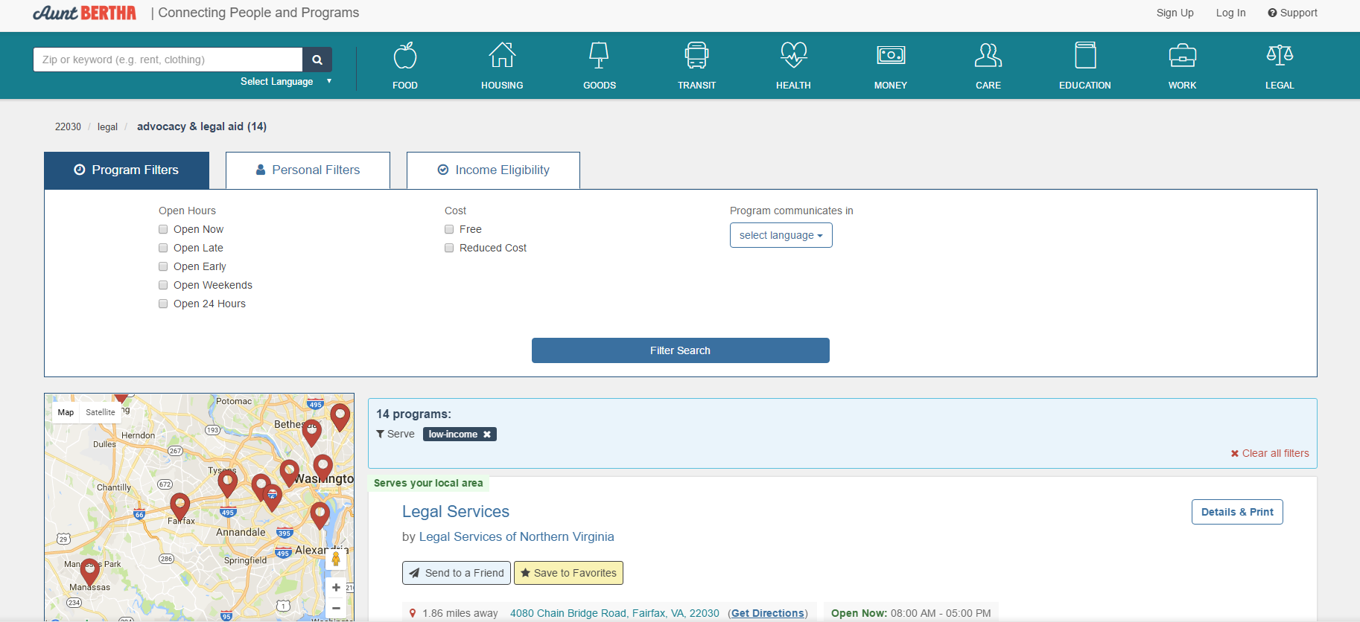
Using patient-reported data at the point of care
1
Notes:
Aunt Bertha is a free website that also links people to community resources. Here, I’ve searched for legal services for low income patients. The site can also connect you with food, housing, work, and transportation organizations.

Slide 53
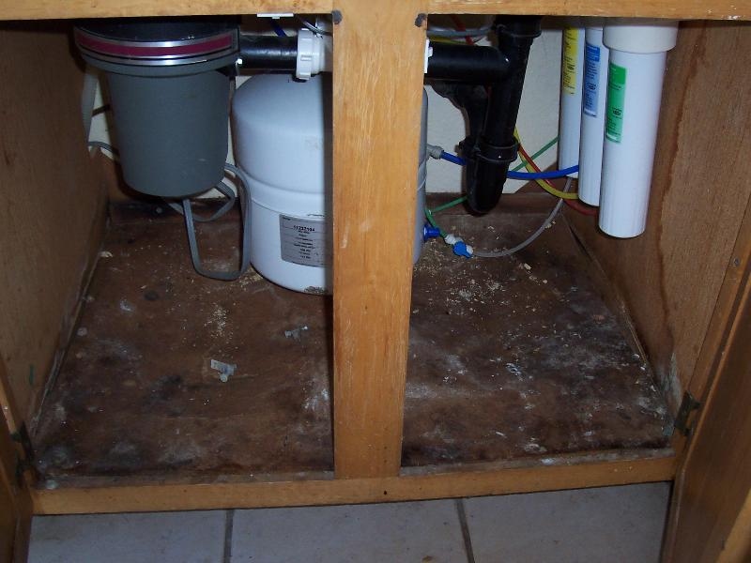
“Mary”
Connect Mary with a legal services organization
Notes:
Using Aunt Bertha, you connect Mary to a community legal services organization that provides free legal advice. She meets with a lawyer, and they discuss her options regarding bankruptcy. Before declaring bankruptcy, the lawyer connects Mary to a county program that assists with debt consolidation. After consolidating her debt, Mary discovers that her payments are more manageable, thereby reducing her stress and giving her an adequate buffer.
During this process, the legal services lawyer visits Mary at her house and conducts a screen for additional legal needs. Mary tells the lawyer about a pipe that had ruptured a couple of years ago. Her landlord fixed the leak but never addressed the sequelae of the water damage which ultimately resulted in mold. Mary wrote letters to the landlord and the county department responsible for code violations without success. With the help of the lawyer, Mary terminated her lease without penalty, obtained a housing voucher to assist with rent payments, and was able to have a new apartment inspected for mold. Following the move, her son had no further hospitalizations.

Slide 54
Using patient-reported data to inform community interventions
2
Asking patients about housing insecurity
Mapping addresses of patients with housing insecurity
Developing interventions at the community-level, targeting communities with housing insecure patients
Notes:
Path two is using patient-reported data to inform a community intervention. An example would be asking patients like Mary about housing insecurity. Then, you could map addresses of patients with housing insecurity. Finally, you would partner with other organizations to develop an intervention at the community-level, targeting communities with housing insecure patients.

Slide 55
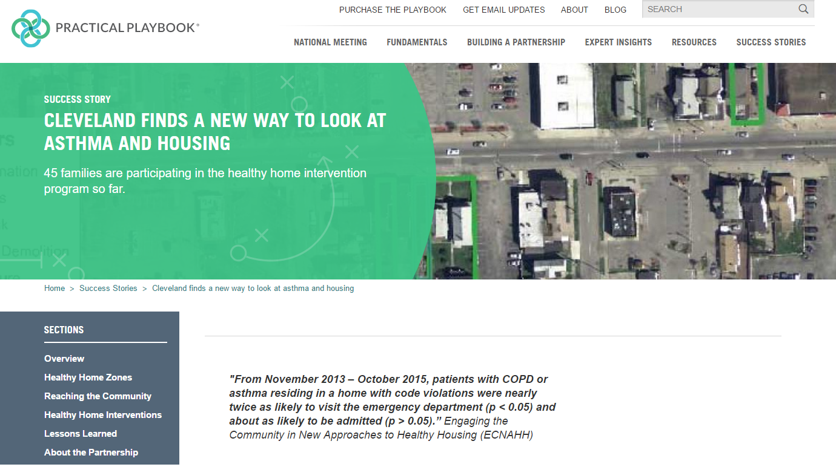
Using patient-reported data to inform community interventions
2
Notes:
The Practical Playbook has a similar case study related to housing. In this example, they collected data about patients with asthma and COPD and developed community level interventions to address poor housing conditions.

Slide 56
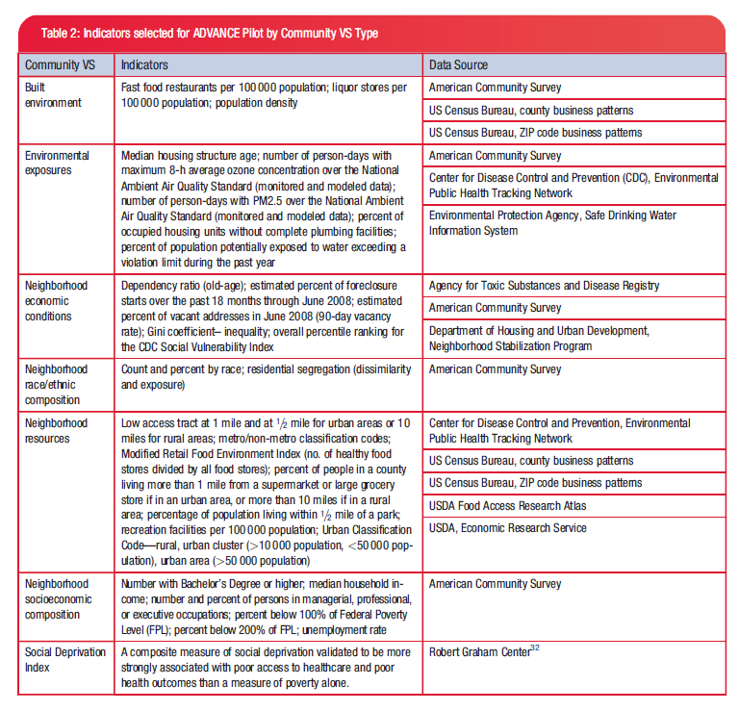
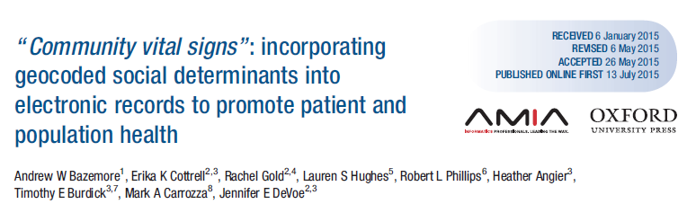
Using community vital signs data at the point of care
3
Notes:
Path three is using community-level data at the point of care. Community vital signs are aggregated community-level information about the individual’s neighborhood. OCHIN and its ADVANCE Clinical Data Research Network are incorporating these community vital sign measures into community health center electronic health records.

Slide 57
COMMUNITY VITAL SIGN DASHBOARD
PATIENT: MARY
3
90th
%
85th
%
Poverty
Education
94th
%
87th
%
WORST QUARTILE
BEST QUARTILE
Walkability
Social deprivation
Notes:
This is Mary’s community vital signs dashboard. To orient you, there are four dimensions in this dashboard example: poverty, education, walkabaility, and the social deprivation index. This refers to the census tract where Mary lives. To create this dashboard, the practice geocodes patient addresses and then attaches community metrics to each census tract. For instance, the practice can calculate the percentage of the census tract earning less than 200% of the federal poverty level or with less than a high school education. Looking at the distribution of these measures across the patients’ census tracts, the practice can identify those census tracts in the worst and best quartiles. Mary’s census tract is in the worst quartiles for poverty, education, and composite social deprivation. Fortunately, her census tract is in the best quartile for walkability.

Slide 58
Using community data to inform community interventions
4
Assessing housing insecurity at the census tract level
Developing a community-level intervention to address housing insecurity
Notes:
Path four is using community data to inform community interventions, much like public health has done for decades. An example would be using community data to assess housing insecurity and developing an intervention at the community-level.

Slide 59

Using community data to inform community interventions
4
Notes:
Here, the Practical Playbook describes an intervention where a nonprofit looked at community data about obesity and developed a community-level intervention

Slide 60
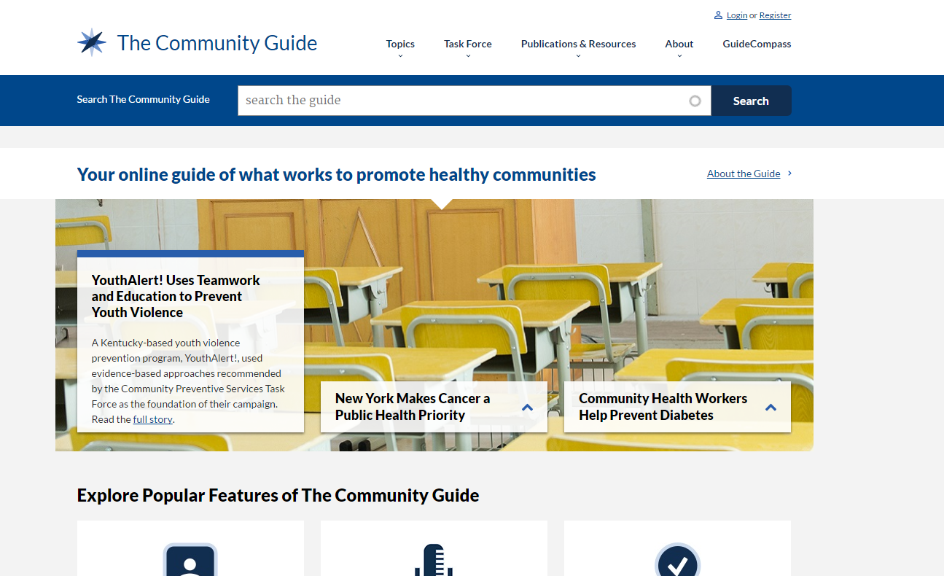
Using community data to inform community interventions
4
Notes:
Another resource is the Community Guide, which is a guideline making body that evaluates the effectiveness of community interventions. It is analogous to the US Preventive Services Task Force but specifically for community interventions.

Slide 61
2
4
DeVoe JE, Bazemore AW, Cottrell EK, et al. Perspectives in Primary Care: A Conceptual Framework and Path for Integrating Social Determinants of Health Into Primary Care Practice. Ann Fam Med. 2016;14(2):104-108. doi:10.1370/afm.1903.
Notes:
If you are like me, then paths 2 and 4 are the most difficult. They involve developing community interventions. You may be thinking, “This is not my responsibility” or “I’m not trained to do this work”. But remember, you are not meant to do this work alone. There are countless organizations in your communities already doing this work and ready to partner with you. Resources like the AHRQ Innovations Exchange and the Practical Playbook can show you what others are doing. The Community Guide and SIREN can help you assess the evidence supporting specific interventions. Finally, the Community Tool Box and COPC provide frameworks for partnering with community organizations.

Slide 62
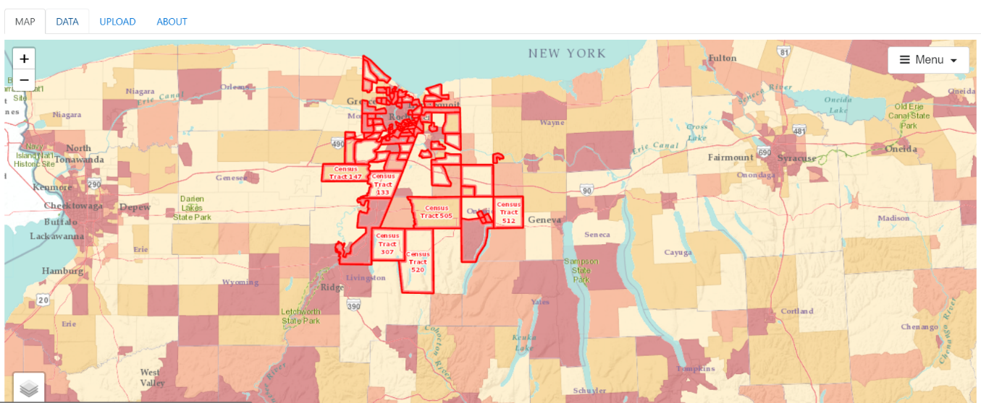
The Population Health Assessment Engine (PHATE) provides you with community data relevant to your practice through an interface with the PRIME Registry (http://primenavigator.org/).
Notes:
Until now, it has been difficult to link community and practice data. The Population Health Assessment Engine integrates community and electronic health record data through the PRIME Registry.

Slide 63
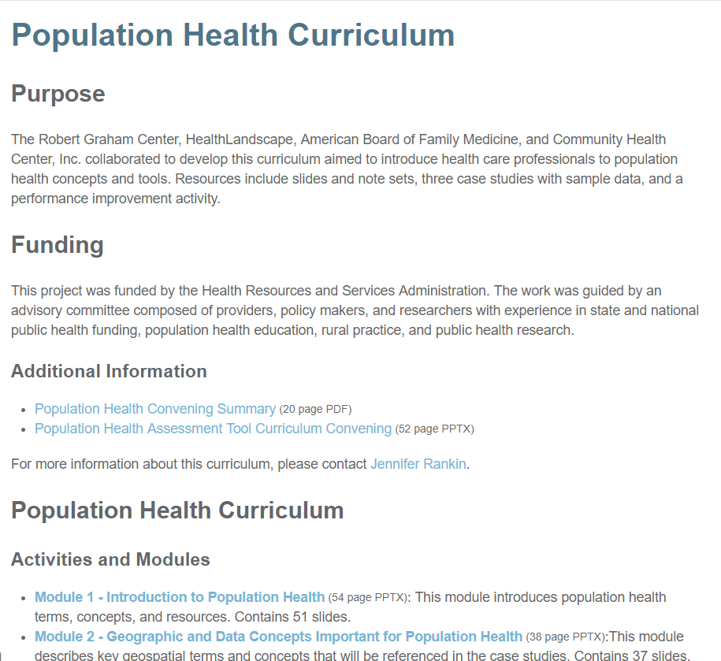
What can you do if your practice is not linked to the PRIME Registry?
CASE STUDIES
01: Exploring Community
02: Mapping Clinical Data and
Community Resources
03: Engaging Community
DIABETES PERFORMANCE IMPROVEMENT ACTIVITY
PHATE: My Community Tool
http://www.graham-center.org/rgc/maps-data-tools/tools/pop-health.html
Notes:
If your practice is not linked to the PRIME Registry, you can still use our population health curriculum materials. Check out the Graham Center website for additional activities. Furthermore, you can use the My Community Tool within PHATE without PRIME registration.

Slide 64
“Mary”
How do we screen Mary for ongoing problems?
How do we identify other people like Mary?
How do we use community data to screen for and address the problems that Mary has?
What community interventions can address these problems?
Notes:
Let’s go back to Mary for the last time.
After addressing her debt, her depression and stress have improved, but you still wonder how the system can better address her needs and the needs of those like her.
If you are by yourself, write down your response to these questions. If you are in a group, turn to the person next to you, and answer these questions.

Slide 65
What Can You Do? | Pop Health Curriculum Materials | Other Resources
Learn about your community | Case Study 1 | HealthLandscape.org 500 Cities Project Mapping Tool by Census Tract UDS Mapper
Assess individual needs |  | National Academy of Medicine measures PRAPARE: Protocol for Responding to and Assessing Patients’ Assets, Risks, and Experiences
Map clinical data | Case Study 2 Pop Health Performance Improvement Activity
Map community resources | Case Study 2 Pop Health Performance Improvement Activity | Community Health Resource Navigator Aunt Bertha

Slide 66
What Can You Do? | Pop Health Curriculum Materials | Other Resources
Identify community interventions |  | Practical Playbook The Community Guide SIREN: Social Interventions Research & Evaluation Network Agency for Healthcare Research and Quality Innovations Exchange
Engage community organizations | Case Study 3 | Community Tool Box Community Oriented Primary Care Curriculum
Geocode your electronic health record data Incorporate community vital signs into encounters |  | Partner with an organization like HealthLandscape to geocode addresses

Slide 67
Take home points
The contribution of social determinants to health is substantial
Addressing social determinants of health is an important strategy to improving population health although more research is needed to clarify effective pathways

Slide 68
Background 01: Introduction to Population Health
Learning Objectives
List two social determinants of health
Describe the impact of social determinants on health
Define community-oriented primary care
Define hotspotting and coldspotting
List two ways that individual and community social determinants of health data can be used to improve health
Notes:
By the end of this module, we hope that you will be able to:
List two social determinants of health
Describe the impact of social determinants on health
Define community-oriented primary care
Define hotspotting and coldspotting
List two ways that individual and community social needs data can be used to improve health

Slide 69
Relevant family medicine milestones
Notes:
After completing this module, we hope that family medicine residents will be able to meet these milestones.
https://www.acgme.org/Portals/0/PDFs/Milestones/FamilyMedicineMilestones.pdf

Slide 70
Relevant nurse practitioner competencies
Notes:
After completing this module, we hope that nurse practitioner trainees will be able to address these competencies.
http://www.aacn.nche.edu/dnp/Essentials.pdf
https://c.ymcdn.com/sites/nonpf.site-ym.com/resource/resmgr/Competencies/NPCoreCompsContentFinalNov20.pdf

