Slide 1

Population Health Assessment Engine

Slide 2
Population Health Assessment Engine Curriculum
01
02
BACKGROUND
Introduction to
Population Health
Introduction to
Geospatial Concepts
BEGINNER
03
04
05
Introduction to the Population Health Assessment Engine
How to use My Community
How to use Community HotSpots
06
07
ADVANCED
Getting the Most out of My Community
Getting the Most out of Community Hotspots
Notes:
This curriculum consists of 2 background modules that will introduce you to population health and geospatial concepts. The next three modules will describe how to use the Population Health Assessment Engine (PHATE) and the two tools embedded within PHATE: My Community and Community HotSpots. The final two modules will help you learn how to integrate PHATE into your clinic.

Slide 3
Overall goal for the PHATE Curriculum
To integrate community data, clinical data, and community resources in order to address social determinants of health and improve the health of patients and populations.
Notes:
Through the modules, case studies, and performance improvement activity, we hope that you will be able to integrate community data, clinical data, and community resources in order to address social determinants of health and improve the health of patients and populations.

Slide 4
Target audience
Anyone interested in learning about improving the health of populations
  Providers
  Staff
  Learners
    Residents
    Medical students

Slide 5
Abbreviations
PHATE: Population Health Assessment Engine

Slide 6
INTRODUCTION TO THE POPULATION HEALTH ASSESSMENT ENGINE
BEGINNER 03

Slide 7
Nuts and Bolts 03: Introduction to the Population Health Assessment Engine
Learning Objectives
List two activities that can be done using the PHATE
Demonstrate competency in navigating the PHATE

Slide 8
Relevant family medicine milestones
Notes:
After completing this module, we hope that family medicine residents will be able to meet these milestones.
https://www.acgme.org/Portals/0/PDFs/Milestones/FamilyMedicineMilestones.pdf

Slide 9
Relevant nurse practitioner competencies
Notes:
After completing this module, we hope that nurse practitioner trainees will be able to address these competencies.
http://www.aacn.nche.edu/dnp/Essentials.pdf
https://c.ymcdn.com/sites/nonpf.site-ym.com/resource/resmgr/Competencies/NPCoreCompsContentFinalNov20.pdf

Slide 10
Nuts and Bolts 03: Introduction to the Population Health Assessment Engine
Outline
PHATE Overview
Guide to Navigating PHATE

Slide 11
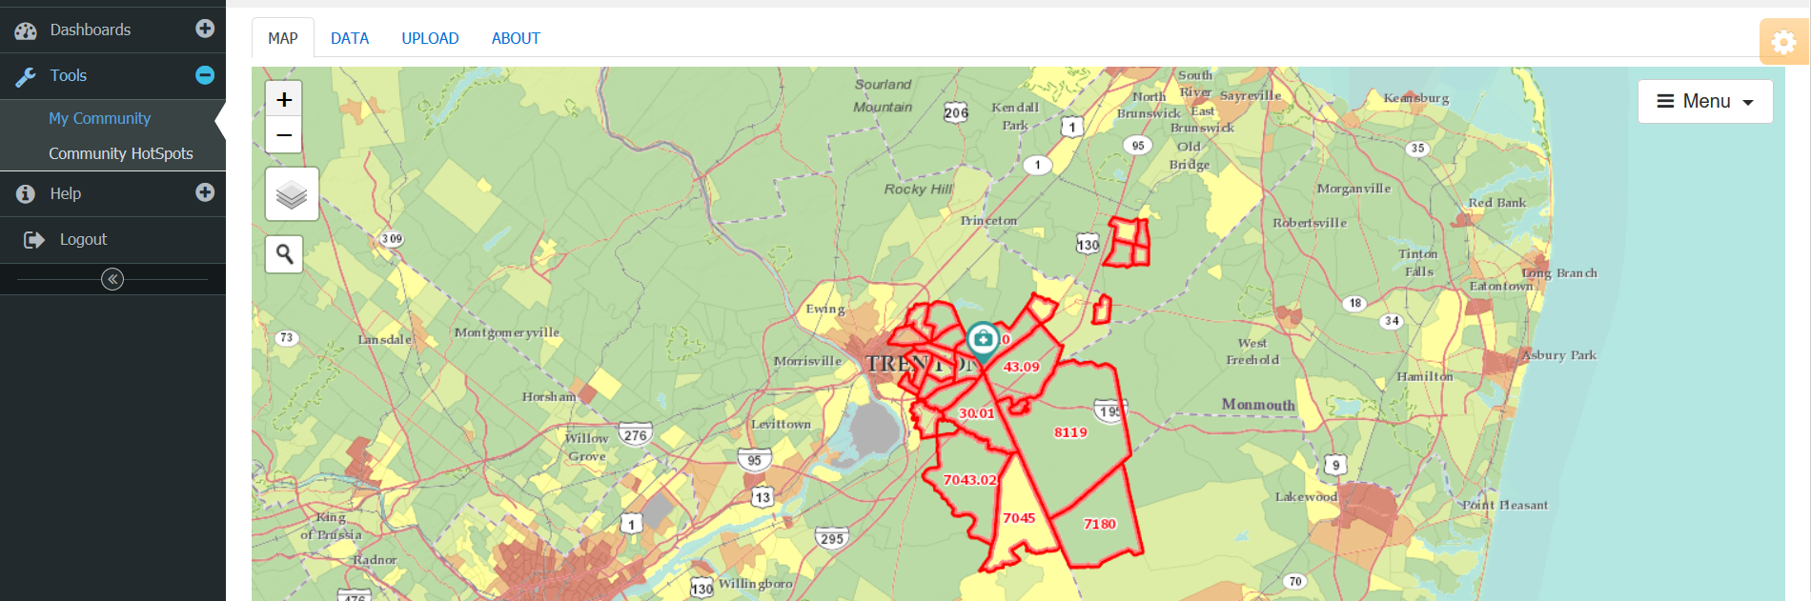
PHATE Overview: Two Tools in One
My Community
Community HotSpots
Notes:
PHATE consists of two tools:
My Community
Community HotSpots

Slide 12
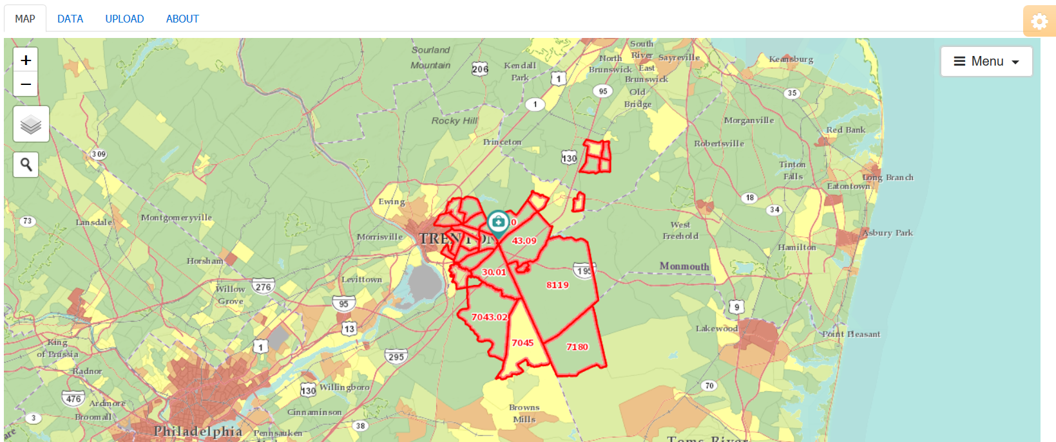
My Community
What you can do using My Community:
View community characteristics
View your clinic’s service area
View how your clinic’s service area relates to community characteristics
Download community characteristics

Slide 13
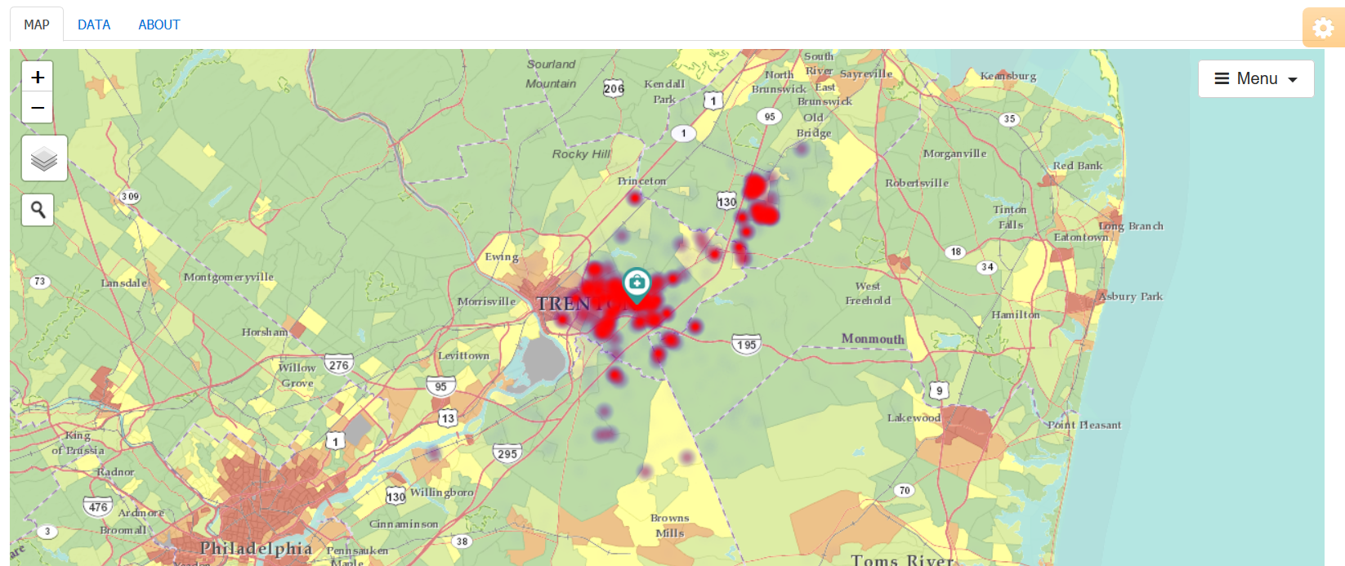
Community HotSpots
What you can do using Community HotSpots:
View community characteristics
View hot spots (clusters of poor disease control or gaps in quality) from your electronic health record data
View how hot spots relate to community characteristics
Download community characteristics

Slide 14
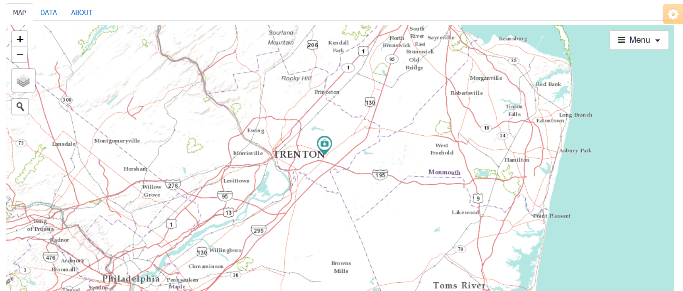
Navigation
ZOOM
MENU
MAP LAYER
SEARCH FOR AN ADDRESS
Notes:
Notice the four PHATE navigation tools.
The zoom function allows you to zoom in and out.
The map layer icon allows you to view different base maps.
The menu allows you to adjust the data selected and displayed on the map.
The search function allows you to search for a specific address on a maps

Slide 15
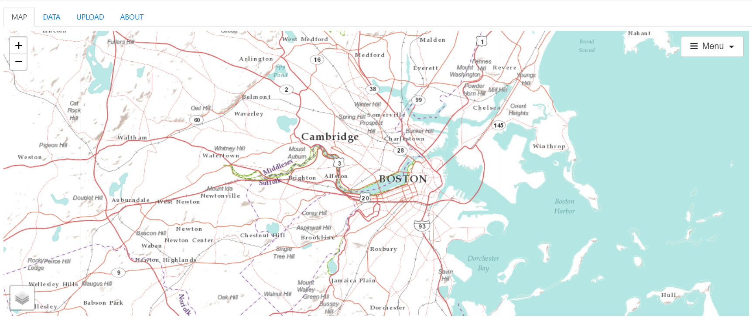
Tabs
Notes:
Notice that there are also three tabs.
The data tab provides the data underlying the maps in a table.
The upload tab allows you to upload your own data. This is relevant to displaying your own clinic’s service area.
The about tab provides additional information about the data sources.
NEXT: Each button and tab in greater detail

Slide 16
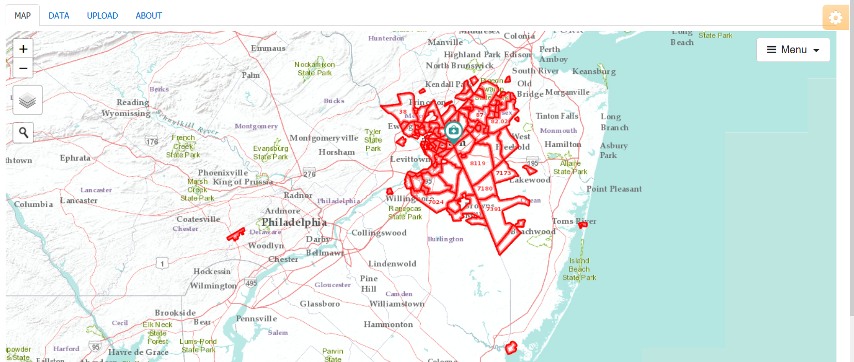
Zoom
Notes:
Zooming in and out allows you to navigate PHATE and identify the scale most appropriate for answering your question or telling your story. Double-clicking on the map also allows you to zoom in. Here, we have zoomed out in order to view more of the clinic’s service area. The green clinic icon is the clinic’s address

Slide 17
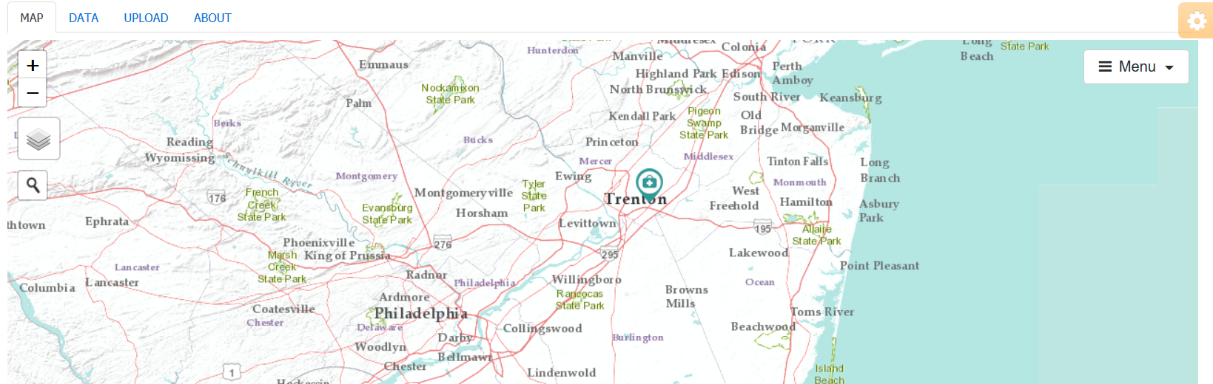
Map Layer
MAP LAYER
Notes:
Hovering over the map icon allows you to choose from two base maps. With neither option selected, the base map labels cities, towns, and major roads.

Slide 18
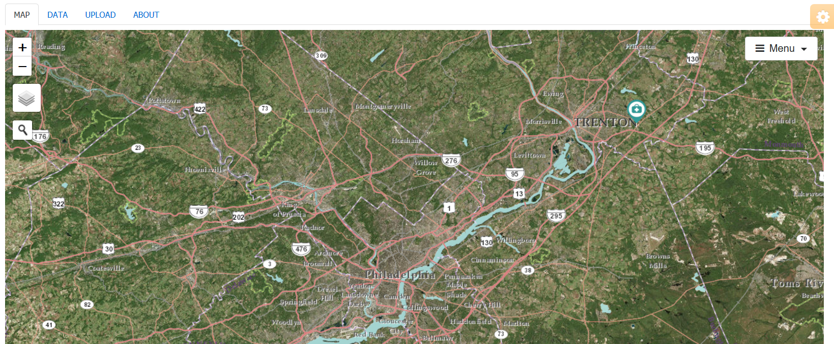
Map Layer - Imagery
Notes:
Selecting “imagery” yields satellite images.

Slide 19
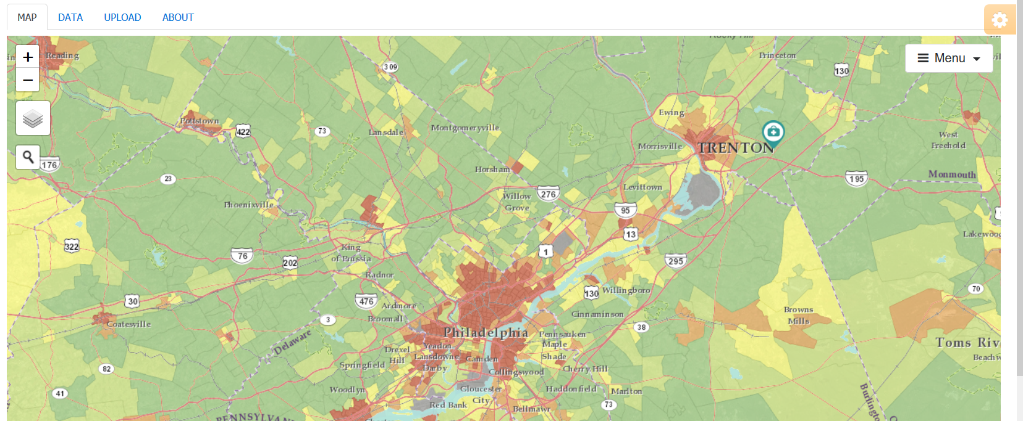
Map Layer – Social Determinant
Notes:
Selecting “Community Vital Sign” yields social determinant data by census tract.

Slide 20
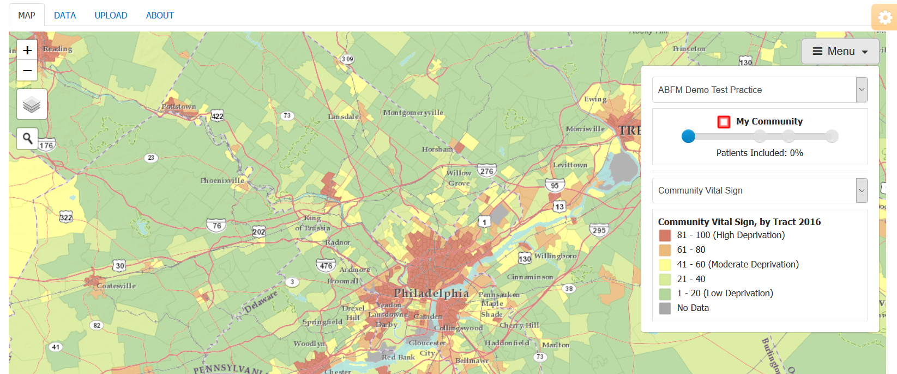
Menu
Notes:
If you click on Menu, a drop down menu appears.
The Menu allows you to modify the map based on the tool being used (My Community or Community HotSpots).
The next modules will demonstrate how to use these tools.

Slide 21
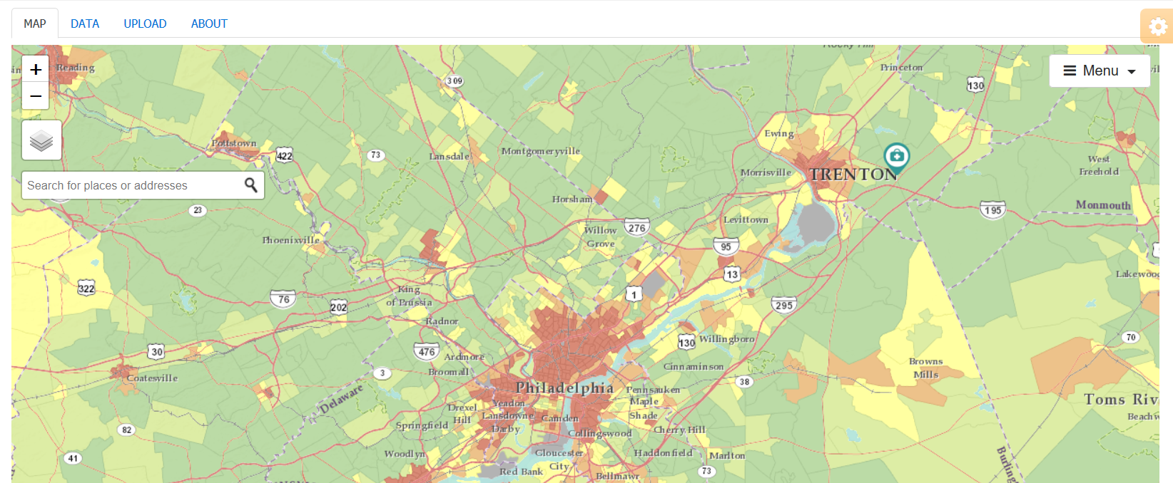
Search
725 W State St, Trenton, NJ 08618
Notes:
Clicking on the magnifying glass icon allows you to search for an address

Slide 22
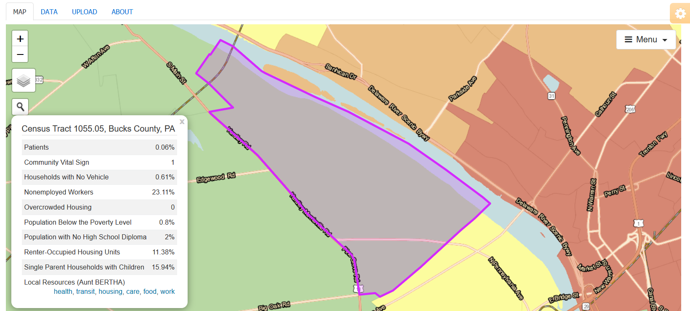
Search
725 W State St, Trenton, NJ 08618
Notes:
Once you have entered the address, PHATE brings you to the census tract where that address is located.

Slide 23
Take home points
PHATE can be used to:
  Learn about your community
  View your service area
  Identify hot spots of poor disease control or gaps in quality

Slide 24
Nuts and Bolts 03: Introduction to the Population Health Assessment Engine
Learning Objectives
List two activities that can be done using the PHATE
Demonstrate competency in navigating the PHATE

Slide 25
Relevant family medicine milestones
Notes:
After completing this module, we hope that family medicine residents will be able to meet these milestones.
https://www.acgme.org/Portals/0/PDFs/Milestones/FamilyMedicineMilestones.pdf

Slide 26
Relevant nurse practitioner competencies
Notes:
After completing this module, we hope that nurse practitioner trainees will be able to address these competencies.
http://www.aacn.nche.edu/dnp/Essentials.pdf
https://c.ymcdn.com/sites/nonpf.site-ym.com/resource/resmgr/Competencies/NPCoreCompsContentFinalNov20.pdf

