Slide 1

Population Health Assessment Engine

Slide 2
Population Health Assessment Engine Curriculum
01
02
BACKGROUND
Introduction to
Population Health
Introduction to
Geospatial Concepts
BEGINNER
03
04
05
Introduction to the Population Health Assessment Engine
How to use My Community
How to use Community HotSpots
06
07
ADVANCED
Getting the Most out of My Community
Getting the Most out of Community Hotspots
Notes:
This curriculum consists of 2 background modules that will introduce you to population health and geospatial concepts. The next three modules will describe how to use the Population Health Assessment Engine (PHATE) and the two tools embedded within PHATE: My Community and Community HotSpots. The final two modules will help you learn how to integrate PHATE into your clinic.

Slide 3
Overall goal for the PHATE Curriculum
To integrate community data, clinical data, and community resources in order to address social determinants of health and improve the health of patients and populations.
Notes:
Through the modules, case studies, and performance improvement activity, we hope that you will be able to integrate community data, clinical data, and community resources in order to address social determinants of health and improve the health of patients and populations.

Slide 4
Target audience
Anyone interested in learning about improving the health of populations
  Providers
  Staff
  Learners
    Residents
    Medical students

Slide 5
Abbreviations
PHATE: Population Health Assessment Engine

Slide 6
HOW TO USE COMMUNITY HOTSPOTS
BEGINNER 05

Slide 7
Nuts and Bolts 05: How to use Community HotSpots
Learning Objectives
Define hot spot
Define heat map
Demonstrate competency in navigating the Community HotSpots tool
List two types of community resources that can be identified using the Community HotSpots tool

Slide 8
Relevant family medicine milestones
Notes:
After completing this module, we hope that family medicine residents will be able to meet these milestones.
https://www.acgme.org/Portals/0/PDFs/Milestones/FamilyMedicineMilestones.pdf

Slide 9
Relevant nurse practitioner competencies
Notes:
After completing this module, we hope that nurse practitioner trainees will be able to address these competencies.
http://www.aacn.nche.edu/dnp/Essentials.pdf
https://c.ymcdn.com/sites/nonpf.site-ym.com/resource/resmgr/Competencies/NPCoreCompsContentFinalNov20.pdf

Slide 10
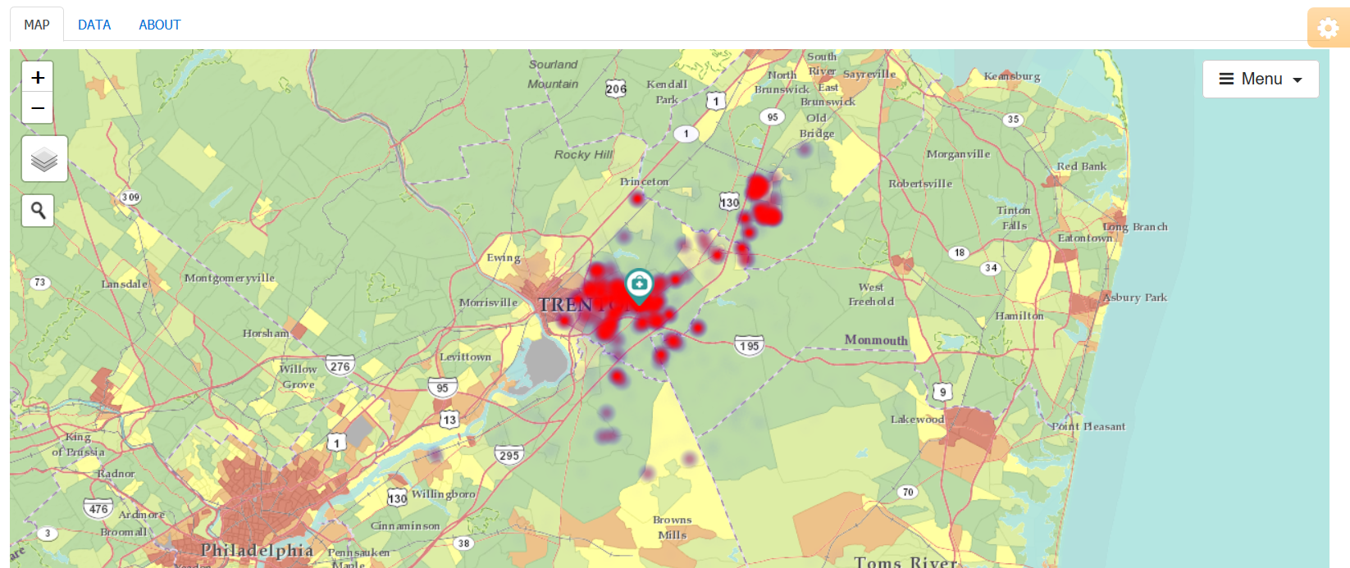
Community HotSpots
What you can do using Community HotSpots:
View community characteristics
View hot spots (clusters of poor disease control or gaps in quality) from your electronic health record data
View how hot spots relate to community characteristics
Download community characteristics

Slide 11

Hotspotting
The use of data to reallocate resources to a small subset of high-need, high-cost patients
Notes:
Today, innovators have experimented with new ways of linking health to place and have, in the process, added new terms to the population health lexicon. As recalled in the 2011 Atul Gawande New Yorker article, Jeffrey Brenner, a family physician, pioneered the hotspotting playbook. Serving as a citizen member of a Camden police reform commission, Brenner learned about community policing. One strategy was crime hotspotting, or the process of mapping crime and focusing resources on high crime neighborhoods. He applied similar techniques using health care data, identifying and treating patients and buildings responsible for significant costs. Check out the Brenner’s Camden Coalition website for more information about hotspotting.

Slide 12
What is a Hot Spot?
Merriam-Webster: a place of more than usual activity
Brenner: high-utilizing, high-spending patients
Can look across a multitude of measures:
  Crime
  Pollution
  Disparities
  PHATE: poor disease control and gaps in quality
https://www.merriam-webster.com/dictionary/hot%20spot
Notes:
The Merriam-Webster dictionary defines a hot spot as a place of more than usual activity. With respect to health care, Dr. Brenner defines hot spots as those addresses or buildings where high-utilizing, high-spending patients live. Hot spots can refer to a wide variety of measures, including crime, pollution, and disparities. In PHATE, hot spots refer to clusters of poor disease control or gaps in quality.

Slide 13
What is a Heat Map?
A heat map is a representation of data in which values are represented as colors and is a method for visualizing hot spots
The Community HotSpots tool uses different colors to represent differences in densities or clusters of activity.
For this tool, hot spots are clusters of individuals with poor disease control or gaps in quality.
Notes:
A heat map is a representation of data in which values are represented as colors and is a method for visualizing hot spots. The Community HotSpots tool uses different colors to represent differences in densities or clusters of activity.

Slide 14
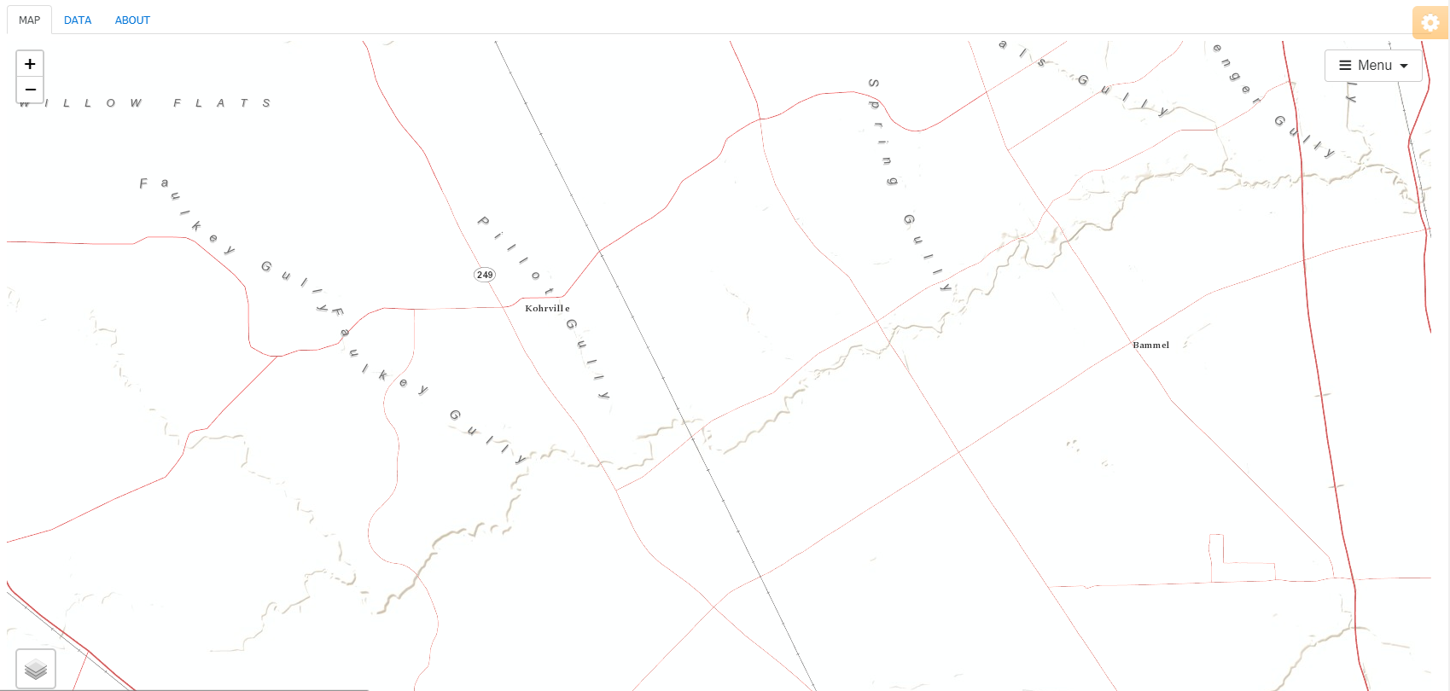
What is a Hot Spot?
Hemoglobin A1c > 9%
1 kilometer radius
Notes:
The Community HotSpot tool maps the addresses of all of the patients who have poor disease control or gaps in quality.
Any clusters involving 3 patients or more that are within a 1 km will appear as a red circle.

Slide 15
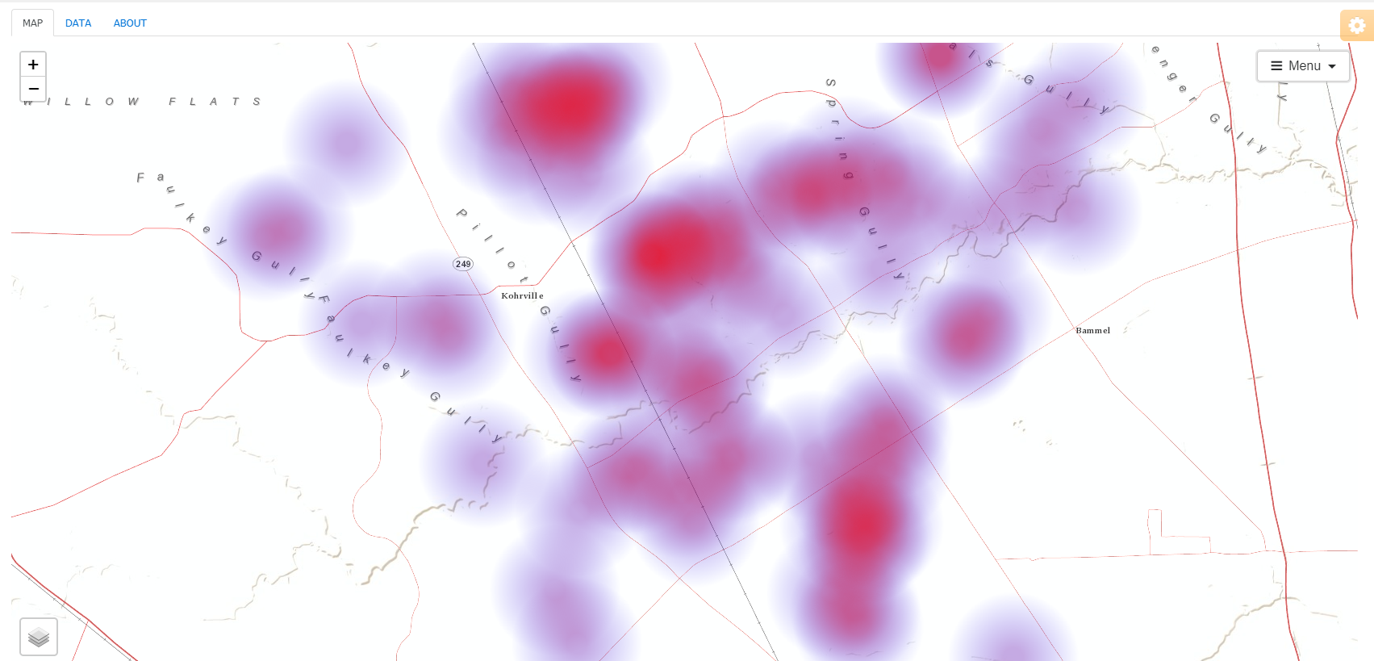
What is a Hot Spot?
Notes:
Here is the actual heat map and the same cluster of patients

Slide 16
Community HotSpots
Red = 3 patients or more are within a 1 kilometer radius distance
Only includes patients that live within the 70% service area
Notes:
For Community HotSpots, red circles indicate that there are 3 patients with poor disease control or gaps in quality within the same 1 kilometer radius distance.
This tool only maps those patients living within the 70% service area.

Slide 17
Community HotSpots
Measures
  Include measures from the National Quality Forum and Centers for Medicare & Medicaid Services
  Prevention: such as immunizations and weight counseling
  Acute: such as otitis externa, pharyngitis, sinusitis
  Chronic: such as diabetes, heart failure, asthma, heart disease
Notes:
The PRIME Registry consists of measures from the National Quality Forum and the Centers for Medicare & Medicaid Services.
These measures span:
Prevention: such as immunizations and weight counseling
Acute conditions: such as otitis externa, pharyngitis, and sinusitis
Chronic conditions: such as diabetes, heart failure, asthma, and heart disease

Slide 18
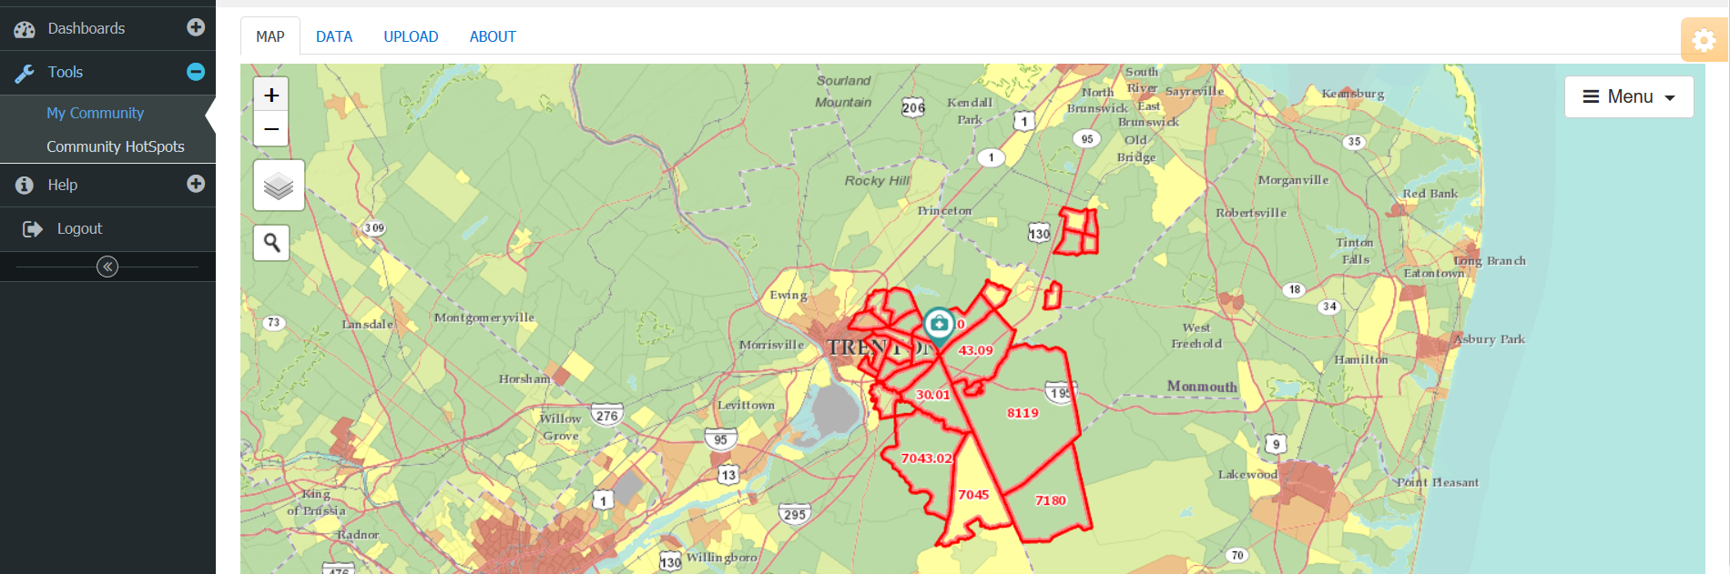
Community HotSpots
Notes:
To access Community HotSpots, select the option on the navigation menu on the left side of the screen.

Slide 19
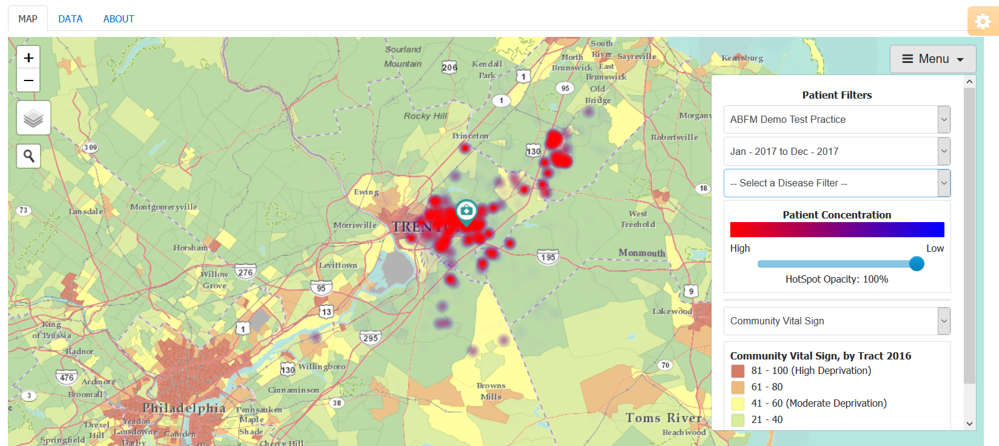
Community HotSpots
DIFFERENT
SAME
Notes:
Whereas the My Community tool allows you to visualize the census tracts served by your clinic, the Community HotSpots tool allows you to map the distribution of individual data within the EHR.
The individual data are represented as a heat map. Red indicates a greater number of individuals with the condition in that geography. If no measures are selected, then the distribution of all patients is mapped.
Notice how the menu is different. The bottom section is the same as in “My Community” while the top has new options.

Slide 20
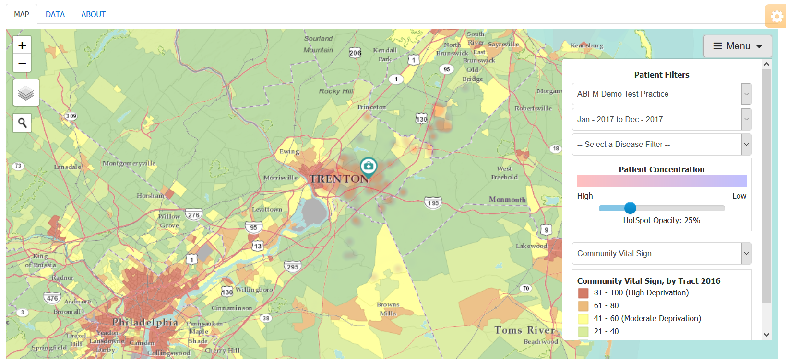
Community HotSpots
Notes:
The heat map can either be very light (low HotSpot opacity) or…

Slide 21
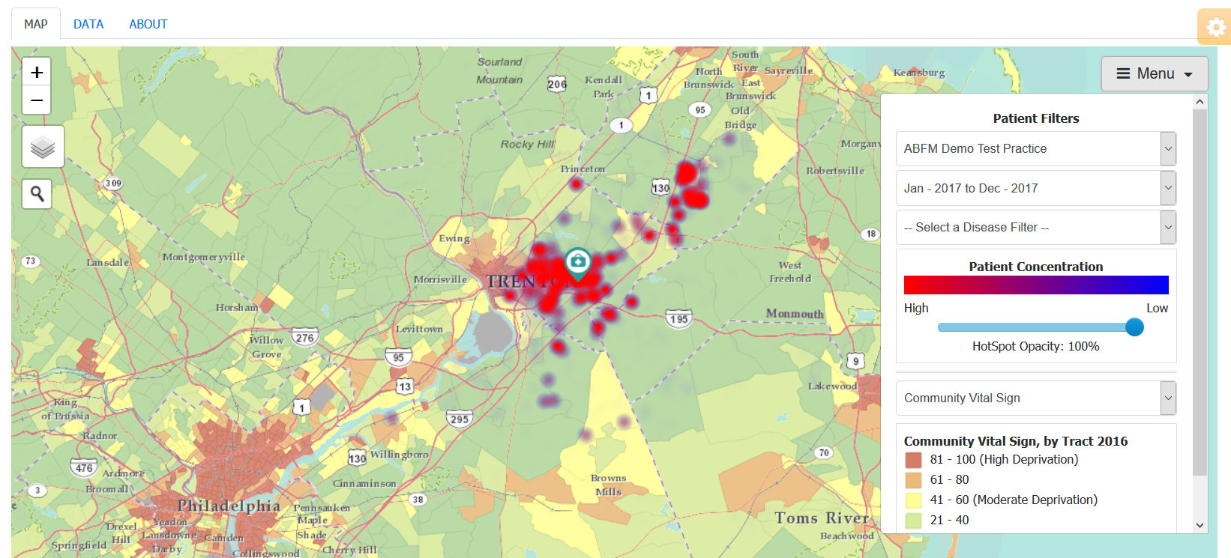
Community HotSpots
Notes:
Very dark (high HotSpot opacity) depending on whether you want to be able to see the heat map, community data, or both.

Slide 22
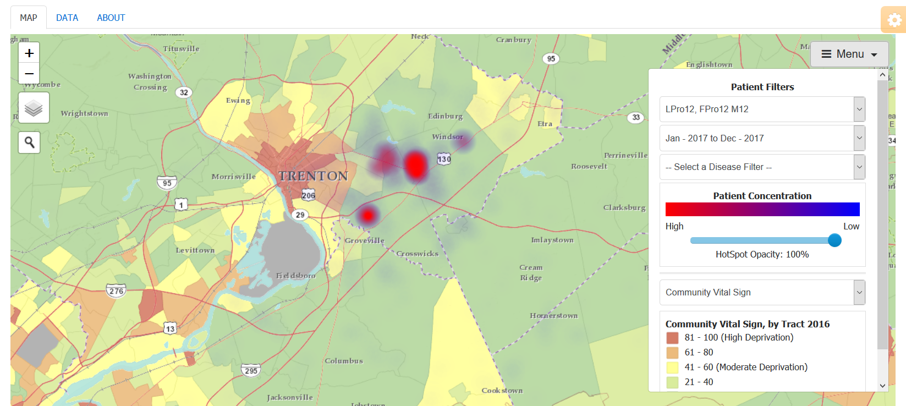
Community HotSpots
Notes:
Under the “Patient Filters” section of the menu, you can adjust the individuals included in the heat map, by selecting the clinicians, time frame, and conditions. Here, we have selected one of the clinicians in the group. Therefore, we are only seeing the patients assigned to him or her.

Slide 23
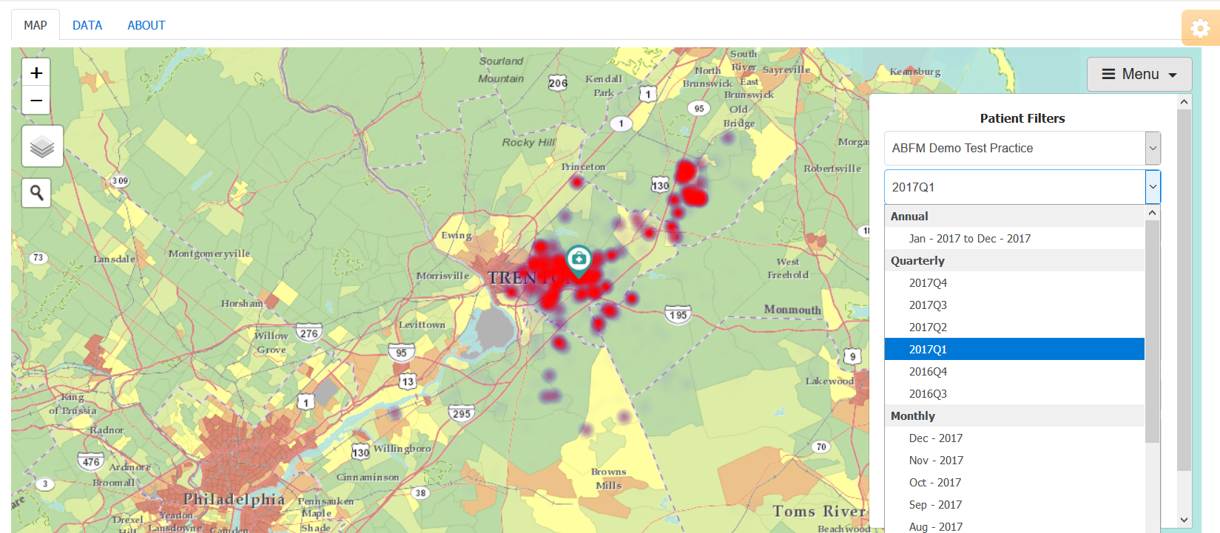
Community HotSpots
Notes:
You can select the time frame included by selecting the desired year, quarter, or month. This selects the patients seen at the clinic during the year, quarter, or month of interest.

Slide 24
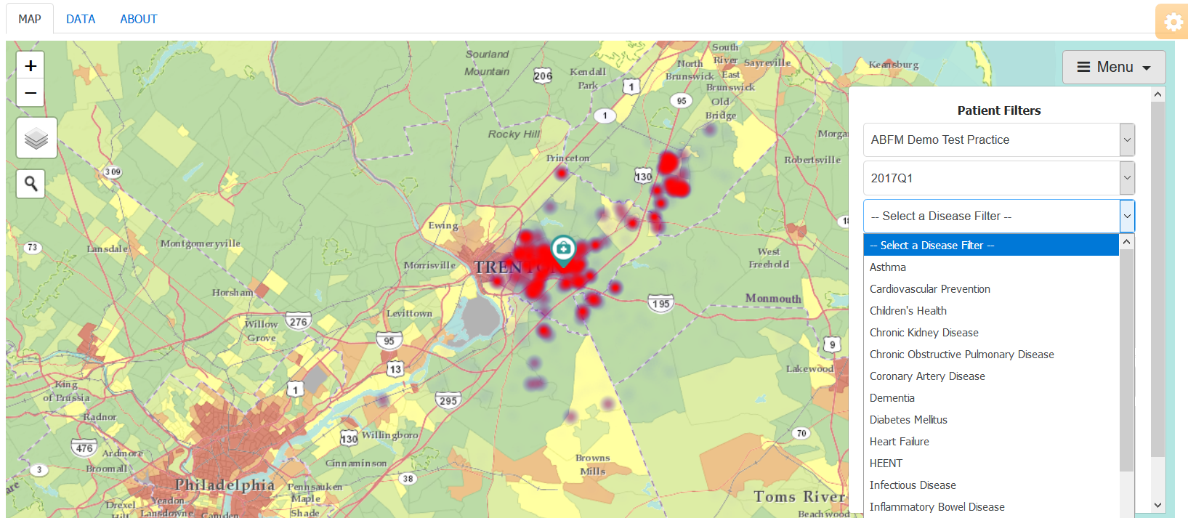
Community HotSpots
Notes:
Finally, you can select the disease group and quality measure included.

Slide 25
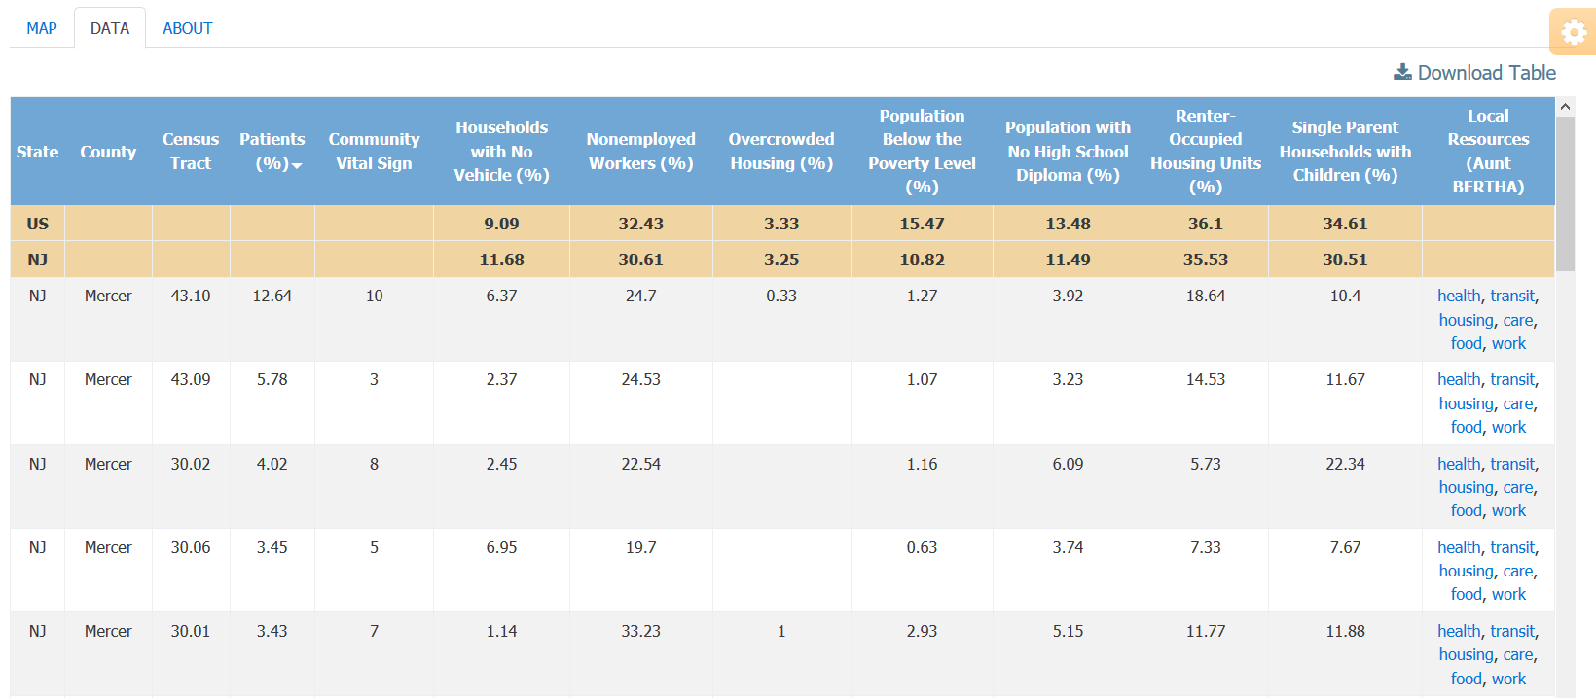
Community HotSpots
Notes:
As with the My Community tool, you can view the underlying data by clicking on the “Data” tab.
The census tracts visible are those included in the practice’s 70% service area.

Slide 26
Community Resources
Notes:
Under Local Resources, PHATE provides links to Aunt Bertha, a website that collates community resources in your community.
PHATE links the census tract to its commensurate zip code and allows you to search across six domains (health, transit, housing, care, food, and work). Clicking on the links takes you the Aunt Bertha page for that zip code and domain.

Slide 27
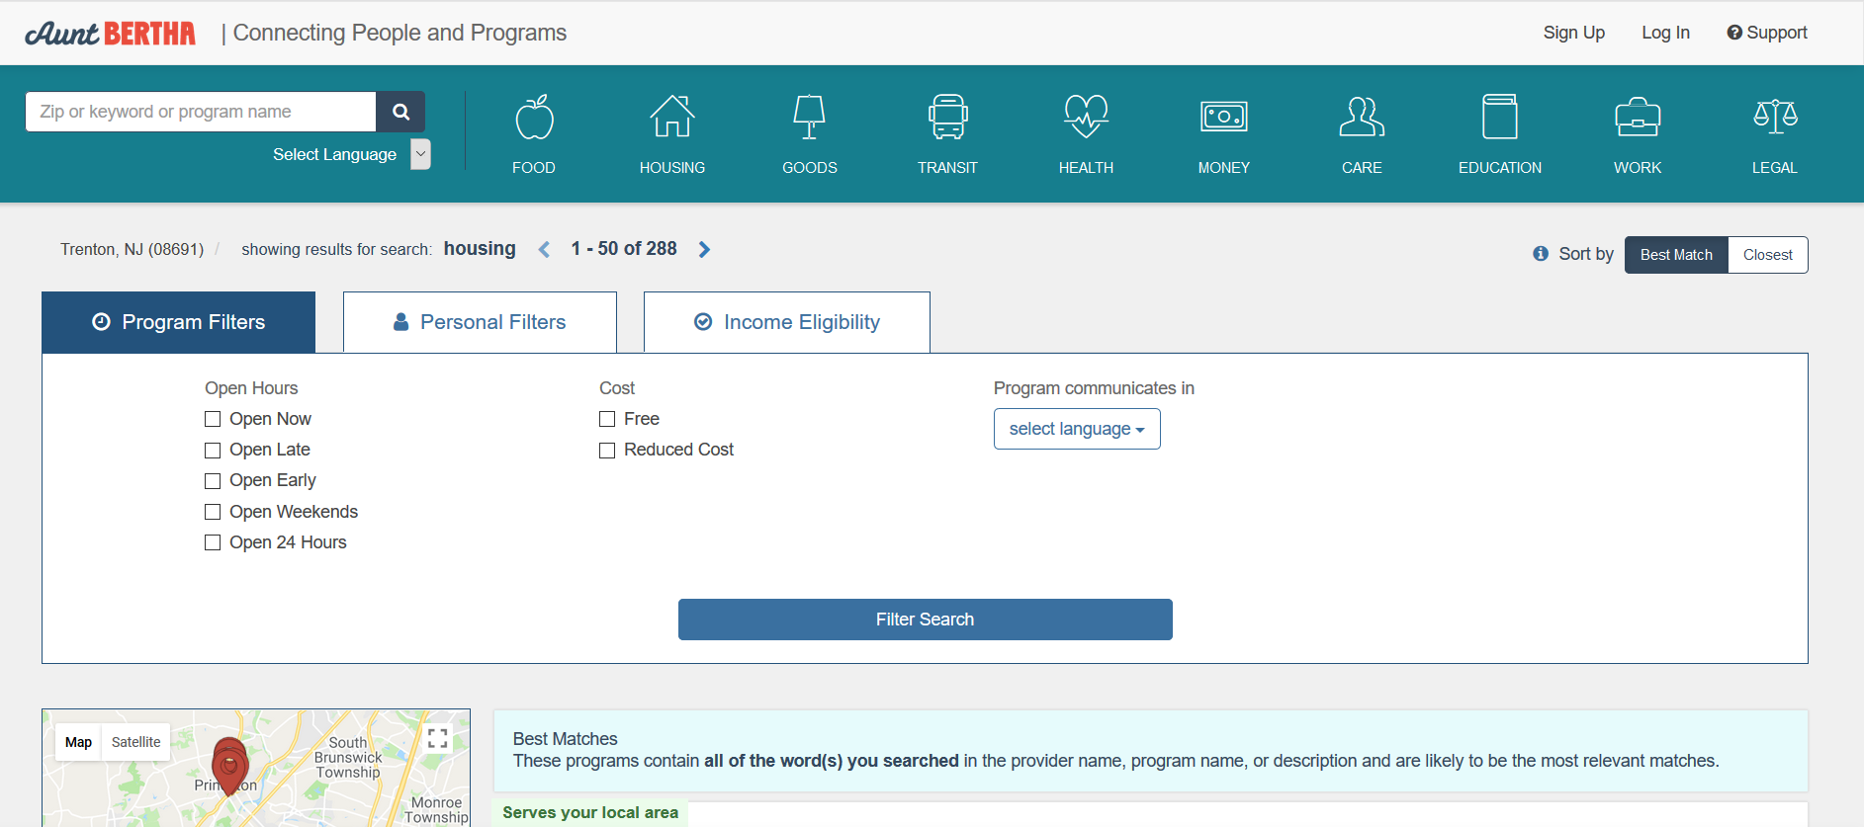
Community Resources
Notes:
Clicking on “housing” for census tract 43.10 in Mercer County takes you to this Aunt Bertha page which provides information for housing resources in this zip code.

Slide 28
Take Home Points
Hot spots are clusters of individuals with poor disease control or gaps in quality
Community HotSpots can be used to
  View hot spots a wide variety of diseases and quality measures
  Connect to community resources

Slide 29
Nuts and Bolts 05: How to use Community HotSpots
Learning Objectives
Define hot spot
Define heat map
Demonstrate competency in navigating the Community HotSpots tool
List two types of community resources that can be identified using the Community HotSpots tool

Slide 30
Relevant family medicine milestones
Notes:
After completing this module, we hope that family medicine residents will be able to meet these milestones.
https://www.acgme.org/Portals/0/PDFs/Milestones/FamilyMedicineMilestones.pdf

Slide 31
Relevant nurse practitioner competencies
Notes:
After completing this module, we hope that nurse practitioner trainees will be able to address these competencies.
http://www.aacn.nche.edu/dnp/Essentials.pdf
https://c.ymcdn.com/sites/nonpf.site-ym.com/resource/resmgr/Competencies/NPCoreCompsContentFinalNov20.pdf

