Slide 1
GEOGRAPHIC AND DATA CONCEPTS IMPORTANT FOR POPULATION HEALTH
MODULE 2

Slide 2
Module 2 Learning Objectives
Describe how geography interacts with population health
Explain geographic terms like thematic mapping and geocoding
Demonstrate how to use online population health tools

Slide 3
Population Health
In order to practice population health you must be able to define who your population is and measure “health” within that population
Easiest way to define population is your existing patient base
You could just stop there:
  Defined population: my patient panel
  Measurement: only those data points captured in clinical setting
Notes:
There is often some sort of geography involved in population definition, even if not explicitly stated, and even if obscure

Slide 4
Determinants of Health
Annals of the New York Academy of Sciences
Volume 896, Issue 1, pages 281-293, 6 FEB 2006 DOI: 10.1111/j.1749-6632.1999.tb08123.x
http://onlinelibrary.wiley.com/doi/10.1111/j.1749-6632.1999.tb08123.x/full#f1
Notes:
As we learned in module one these are the things that we might want to measure

Slide 5



Capturing Social and Behavioral Domains and Measures in Electronic Health Records
Suggested citation: IOM (Institute of Medicine). 2014. Capturing Social and Behavioral Domains and Measures in Electronic Health Records: Phase 1 or Phase 2. Washington, DC: The National Academies Press.
Notes:
Recognizing the important role that SDoH play, the Institute of Medicine in 2014 recommended adding social and behavioral domains into EHRs. They recommended 17 domains including neighborhood/ community compositional characteristics, but looking at the other 16, many of them have a dataset already available at various geographic levels

Slide 6
Capturing Social and Behavioral Domains and Measures in Electronic Health Records
Domains include:
Sexual Orientation
Race/ Ethnicity
Country of Origin
Education
Employment
Financial Resource Strain (Food and Housing Insecurity)
Health Literacy
Stress
Negative Mood and Affect (Depression and Anxiety)
Psychological Assets
Dietary Patterns
Physical Activity
Tobacco Use and Exposure
Alcohol Use
Social Connections and Social Isolation
Exposure to Violence
Neighborhoods/ Community Compositional Characteristics
Notes:
Recognizing the important role that SDoH play, the Institute of Medicine in 2014 recommended adding social and behavioral domains into EHRs. They recommended 17 domains including neighborhood/ community compositional characteristics, but looking at the other 16, many of them have a dataset already available at various geographic levels

Slide 7
Thinking about Patient Panels in a
Non-Clinical Context
Service area = Where patients who come to see me live
  Generic = neighborhood, city, county or state name
  Examples:
Notes:
So if we want to take advantage of these SDoH datasets we need to start thinking about our patient panel in geographic terms. You could generically say that your service area is this neighborhood. Or this city. Or this county. But if we want to compare our service area to the SDoH data we need to be more specific

Slide 8
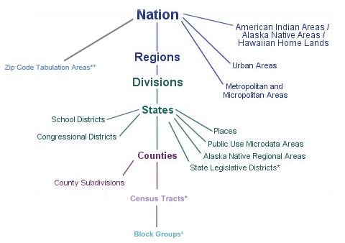
Census Geography
Primary uses: apportioning congressional seats/ reporting to federal government
  Therefore, must nest within nation, state
States collect data primarily to report to governors/ legislatures/ state government so usually collect data at county level
Notes:
This is the core geographic hierarchy of the US Census Bureau which is the provider of most SDoH data. These data and additional datasets are available at the national, state and county levels; some are available at the census tract level. These geographies are primarily used to apportion congressional seats and federal reporting; states take advantage of them to collect and report data to state legislatures and governors. Because of the availability of data at these geographies we should consider using them to define our service area. Counties are typically too large to see neighborhood variation so census tracts are the ideal geography.

Slide 9
Census Geography
Census Tracts
  Primary purpose is to provide a stable set of geographic units for the presentation of statistical data
  Population size between 1,200 and 8,000 people, with an optimum size of 4,000 people
  Usually covers a contiguous area, but area varies widely
  Boundaries are delineated with the intention of being maintained over a long time so that longitudinal comparisons can be made
  Occasionally are split due to population growth or merged as a result of substantial population decline
  Boundaries generally follow visible and identifiable features
Notes:
Just some highlights about census tracts: they are stable, designed with the intent of maintaining them over a long time. Also their boundaries generally follow visible and identifiable features.
BUT if I asked, “Hey Winston, what census tract do you live in?” Do you think he could answer accurately? Could you? In fact, few if any of us would be able to. Census tracts are not relatable and not routinely collected or available.
Then if I asked, “Hey Winston, what ZIP Code do you live in?” I bet he and everyone of you could answer that question accurately.

Slide 10
ZIP Codes
But what is the area?
  Since not published by Postal Service, any ZIP Code boundaries you see are created by various entities and may not align with each other
What happens in growth areas?
  ZIP Codes are split when needed, at any time
A ZIP Code is a route- instructions to drive/ walk and put mail in mail boxes on the street or on the building- even if that route crosses county or state lines
Notes:
ZIP Codes are not perfect though. First, a ZIP Code is a route, not an area. To create service area, we need areas. Since USPS does not publish areas, anything you see that depicts a ZIP Code as an area is not official and therefore data collected at that level may not align with other attempts to create those areas. Also, while census tracts are stable, ZIP Codes can change any time the USPS needs them to.

Slide 11

Notes about ZIP Codes
Can change at any time
No attempts to contain homogenous population
Huge size variation (in land mass and population size)
Not truly an “area” so data are not always comparable
“Easy” to get from EHR
Use
Don’t Use
Notes:
ZIP Codes are fairly easy to get in a clinical setting because patient home address is routinely collected, most likely. Therefore despite their flaws, they are often used in service area definition.

Slide 12
ZIP Code vs ZCTA
ZIP Code Tabulation Areas (ZCTAs) are generalized areal representations of United States Postal Service (USPS) ZIP Code service areas
ZCTA (ZIP Code Tabulation Area) are more stable than ZIP Codes because they only change every 10 years
ZCTA is built from Census Blocks so one can report demographic/ SDoH data at the ZCTA level
Notes:
But if you’ll recall, most of the SDoH data are available using census geographies. So how can we reconcile? ZIP Code Tabulation Areas are one compromise. A ZCTA is a generalized representation of ZIP Codes, they are stable over 10 years and many census-bureau provided demographic SDoH data are available at this geographic level.

Slide 13
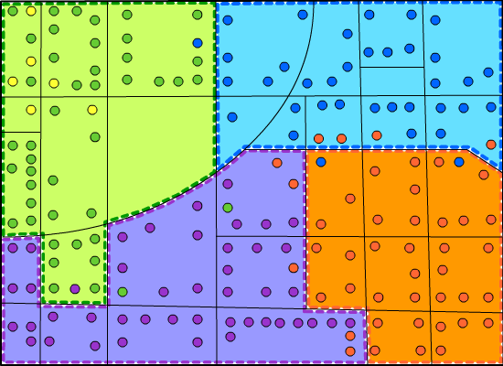
ZIP Code vs ZCTA
Dots are addresses
Color of dot represents ZIP Codes
Black lines represent Census Blocks
Colored areas represent ZCTAs
Notes:
This is a representation of how ZCTAs are made. We see several dots which represent addresses. The color of the dot represents the ZIP Code for the address. Within each census block (those are the black lines), for the most part the ZCTA number that is assigned to the census block is the majority ZIP Code in the ZCTA, then all the blocks with the same ZCTA number are grouped to form the ZCTA. ZCTAs are therefore a workable compromise between patient data and SDoH data.

Slide 14
Census Geography Hierarchy
Notes:
If we open up the rest of the census geographic hierarchy, we see ZCTAs off to the side. They do not nest within census tracts or counties or even states and therefore may not be our ideal geography, but we have to use something.
So let’s recap what we have learned so far: If wanting to define service area based on patients’ home address (geographic retrofitting), we need to take patient address out of EHR. If want to compare to census demographic info and governmental collected SDoH data we should used one of their geographies. Census Tracts provide small areas that nest within larger relevant geographies. Census Tracts are not available in EHR on routine basis. Easier to define service areas based on ZIP Code but ZIP Codes are not standard, stable geography. So maybe we should use ZCTAs? But ZCTAs are not perfect either…

Slide 15
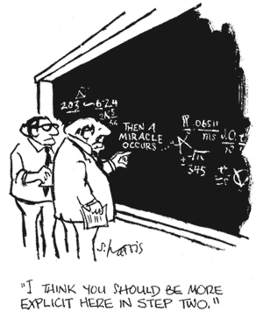
Deriving Service Area from Patient Data
Notes:
Now that I’ve explained the geography, we need to think about getting your patient data to compare to the SDoH data. I’ve always loved this cartoon. From what I gather about extracting data from EHRs, the joke seems to that endeavor as well. In the slides that follow, I’m going to have to assume that your miracle occurred and you were able to get the data you need out of the EHR.

Slide 16
Deriving Service Area from Patient Data (Geographic Retrofitting)
There are two ways to use patient data to define service area
  Option 1: Use the address to get census tracts (or other geography)
  Option 2: Use ZIP Codes and convert to ZCTAs
No matter which one you pick, you will then aggregate your data so that you have a compiled list of areas to create your service area
Notes:
When we use existing patient data to create a service area, that is called geographic retrofitting. There are two basic ways of doing this. Option one is to start with the full patient address and based on that address, learn the location of your patients by census tract, ZIP Code, ZCTA, or whatever geography is of interest to you. The second option is to start with just patient ZIP Codes and use those directly or convert them to ZCTAs then use them. No matter which option you choose, the next step is always the same- compile a list of areas to aggregate to form your service areas

Slide 17
Option 1: Geocoding Patient Addresses
Geocoding is the process of comparing address information to a standard database to assign longitude and latitude for that location
Once geocoded, you can verify the different geographies that location is in, including Census Tract
1100 S Ocean Blvd x = -80.036066 ct: 12099003504
Palm Beach, FL 33480 y = 26.677778 ZCTA: 33480
Cong. Dist.: FL-21
etc.
Notes:
In option 1, we will begin with a list of addresses and geocode them. Geocoding converts address information into longitude and latitude, allowing you to place a dot on a map to represent that location. Once you have a dot, you can see what geography or geographies the dot falls into.
In this example we see an address in Palm Beach, FL, when geocoded, we get this latitude and longitude and from that we can determine census tract, ZCTA, and others.
Bonus- which is longitude- x or y?

Slide 18
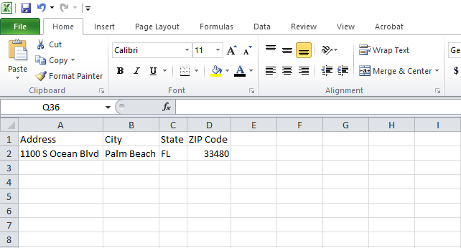
Geocoding
Notes:
When geocoding US addresses, typically your dataset will have an address, city, state, and ZIP Code. In most geocoding systems these will be in different fields (not all smashed together.)

Slide 19
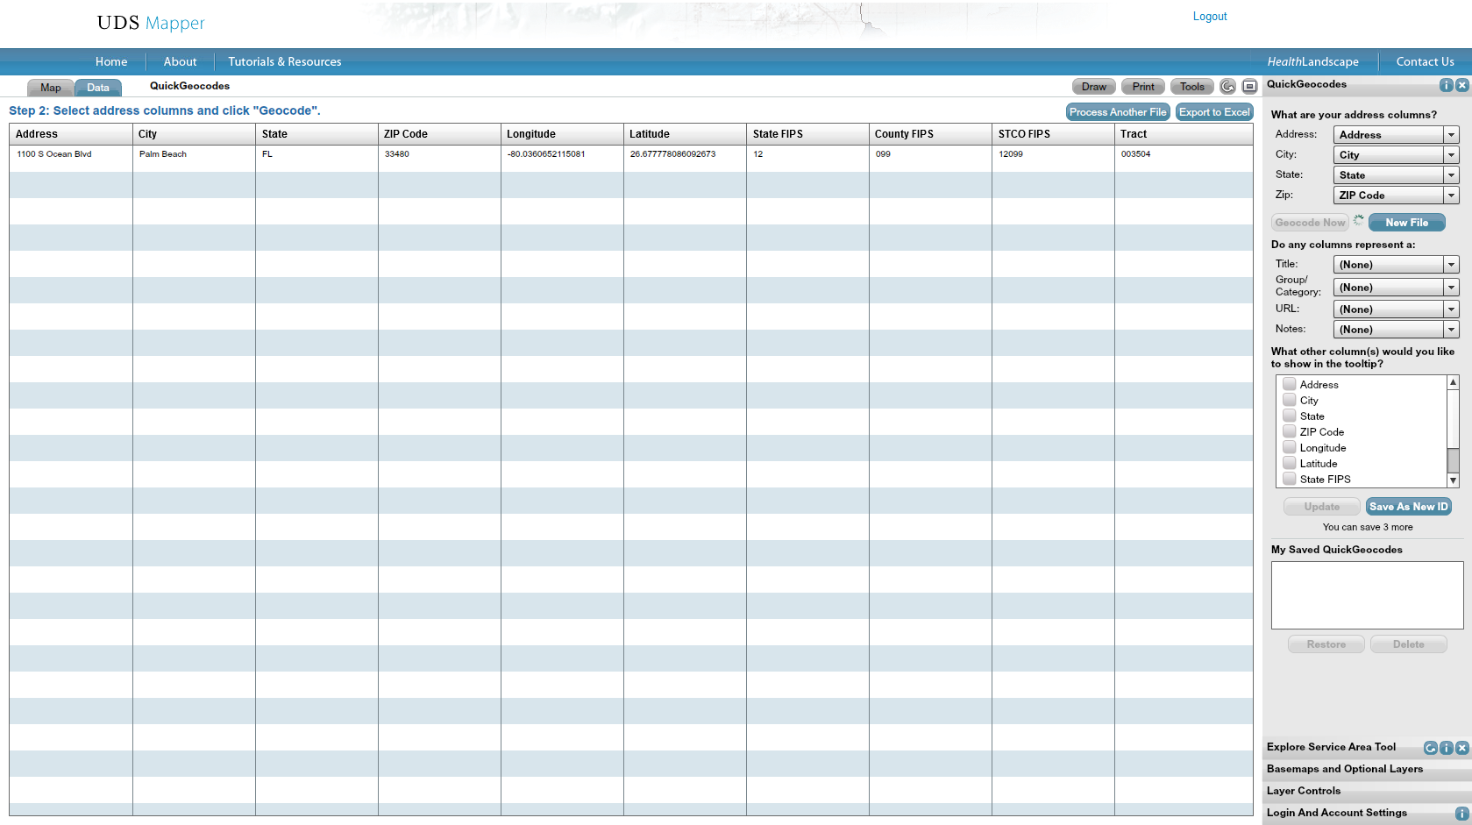
Geocoding
Notes:
I’m now showing a free utility within the UDS Mapper, a free, online mapping tool. It allows you to copy your addresses from your spreadsheet and paste them in to the system, then geocode it in order to see the point on the map. I will be covering the mechanics of this functionality next month in our advanced webinar.

Slide 20
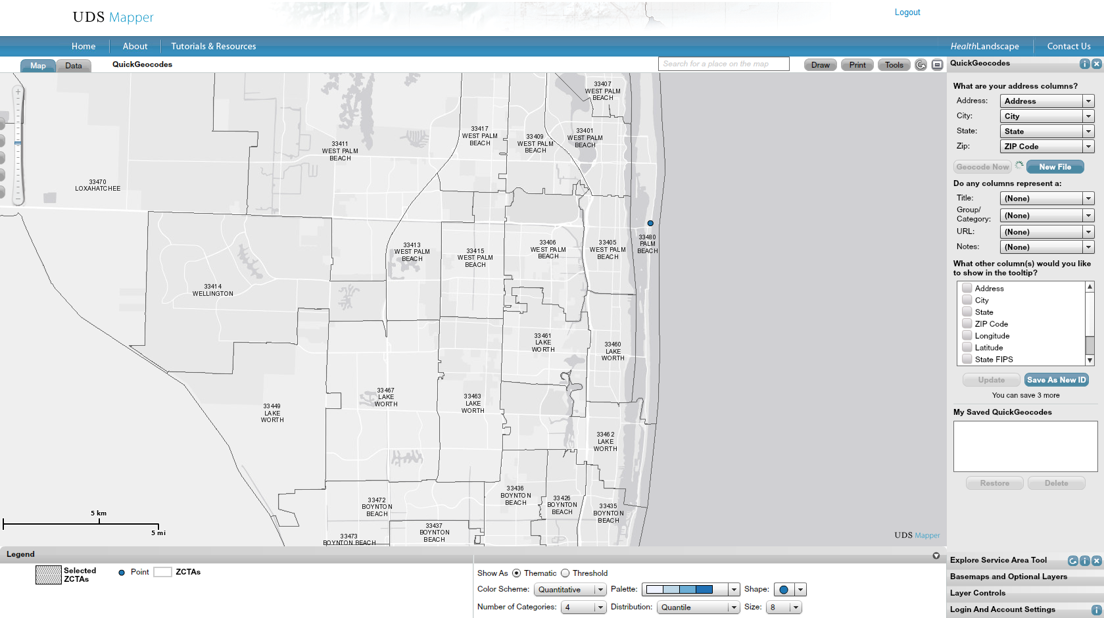
Geocoding
Notes:
Finally here we see the point on the map. I can see which ZCTA it falls into and I could also add other boundaries to find congressional district or county or census tract- whatever geography was relevant for my analysis.

Slide 21
Geocoding Caveats
HIPAA- Address is PHI
Patients with PO Boxes will not be placed in correct location
In rural locations where streets/ mapping not fully developed, patients may be placed incorrectly
HIPAA- Address is PHI
Notes:
BUT! We have to remember HIPAA. Address is considered to be PHI so you need to be sure that you only geocode in a HIPAA compliant environment. The UDS Mapper and other HealthLandscape tools that include the geocoding utility I showed are not currently HIPAA compliant. So please keep that in mind- I’m showing concepts here more so that how you should actually do this.
Also keep in mind that not all addresses lend themselves to geocoding.

Slide 22
Option 2: Using Existing Patient Address Data
Since ZIP Code is in the EHR, you can extract the data
Then convert it to ZCTA (most ZCTA numbers are the same five-digit ZIP Code) but if you don’t convert before using, you will lose data from ZIP Codes that do not have a direct ZCTA match
You can use the ZIP Code to ZCTA Crosswalk (https://www.udsmapper.org/zcta-crosswalk.cfm) to convert your data with no loss of data
Notes:
As I said before, since ZIP Code is routinely collected in most health centers, extracting that may be the easier route, until you can find a way to geocode your data in a HIPAA compliant manner. If you want to convert it to ZCTA in order to be able to accurately compare your patient data to the SDOH data, the UDS Mapper has a crosswalk that you can use. If you don’t do this, you will lose patient data from ZIP Codes that do not have a direct ZCTA match.

Slide 23
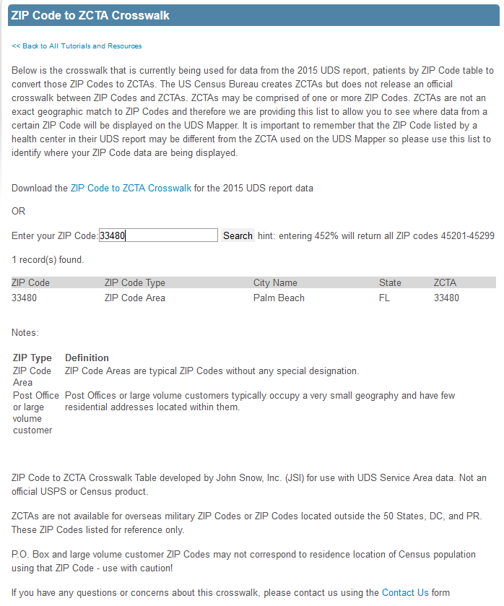
www.udsmapper.org/zcta-crosswalk.cfm
Enter a ZIP Code into the box and “Search”
You will get a single entry back showing information about that ZIP Code and then the correct ZCTA number
Notes:
This is the ZIP Code to ZCTA crosswalk that is in the UDS Mapper. Since ZIP Codes change all the time, this crosswalk is redone every year for comparison to the relevant UDS data. Keep that in mind if you are using historic data and request an older one from us via email. On the webpage, simply enter the ZIP Code of interest and click search. The results will show information about that ZIP Code and most importantly, which ZCTA best matches that location.

Slide 24
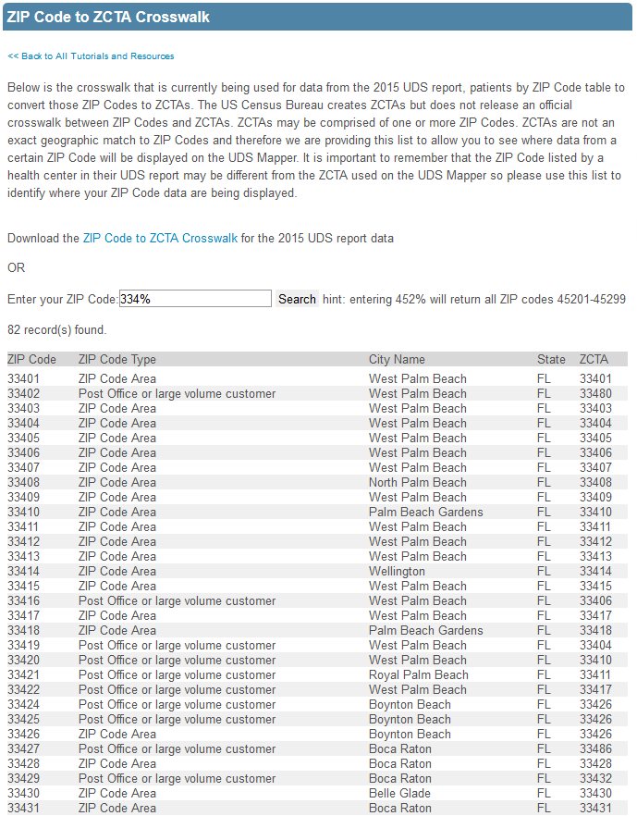
Crosswalk Many at the Same Time
If you would like to do many ZIP Codes at the same time and they all have a similar start- like the same first, first two or first three digits, enter those and then a % sign
Alternately, download the entire crosswalk
Notes:
If you are converting many ZIP Codes at the same time, there are a couple of options. First of your list of ZIP Codes has common starting digits, enter as many of those digits as you want- one, two or three, most likely, and then a percent sign. When you click search you will get a list of all 5 digit ZCTAs that start with the digits you entered. Here in the Palm Beach area, we can see that ZIP Code 33402 data should be put into ZCTA 33480.
Alternately you can download the entire crosswalk in an Excel spreadsheet.

Slide 25
Compile and (maybe) Aggregate!
After either option 1 or option 2 you will end up with a list of ZIP Codes, ZCTAs, Census Tracts- whatever that you can aggregate into a service area
OR
You can consolidate the data into counts of patients in each area
Notes:
Once you have your data geocoded and assigned to a geography as we discussed for option one, or converted to ZCTA as in option two you will need to either compile a list of the areas to use to create a service area or weight each area by number of patients, aggregating them into counts of patients by area.

Slide 26
Converting Patient Data to
Service Area
Area | # pts
A | 432
V | 89
L | 167
D | 312
FF | 0
F | 263
W | 0
H | 233
I | 208
M | 146
K | 181
Area | # pts
C | 349
J | 199
N | 135
O | 120
P | 0
AA | 27
R | 99
S | 96
T | 90
U | 0
B | 380
Area | # pts
G | 251
X | 60
Y | 0
Z | 0
Q | 0
BB | 21
CC | 15
DD | 0
EE | 0
E | 301
Notes:
For the first way, let’s pretend these data show the areas within our county and the number of patients from each area. We can simply stop here and highlight all of the areas on a map that have any patients

Slide 27
Thinking about Patient Panels in a
Non-Clinical Context
Service area = just based on the areas where my patients live
AA
T
S
R
Q
P
BB
CC
Z
U
G
F
A
B
O
DD
Y
V
H
E
D
C
N
EE
X
W
I
J
K
L
M
FF
Notes:
That is what this map shows- so we can see that the earlier guesses of service area were not perfect- we certainly serve a larger area than just the neighborhood. We serve most parts of the city but there are some areas we do not serve. We also serve most parts of the county, but some areas we miss and we serve nothing outside of the county.

Slide 28
Converting Patient Data to
Service Area
Area | # pts | Cum. %
A | 432 | 10.3%
B | 380 | 19.5%
C | 349 | 27.8%
D | 312 | 35.3%
E | 301 | 42.5%
F | 263 | 48.8%
G | 251 | 54.8%
H | 233 | 60.4%
I | 208 | 65.4%
J | 199 | 70.1%
K | 181 | 74.5%
Area | # pts | Cum. %
L | 167 | 78.5%
M | 146 | 82.0%
N | 135 | 85.2%
O | 120 | 88.1%
P | 0 | --
Q | 0 | --
R | 99 | 90.5%
S | 96 | 92.8%
T | 90 | 94.9%
U | 0 | --
V | 89 | 97.1%
Area | # pts | Cum. %
W | 0 | --
X | 60 | 98.5%
Y | 0 | --
Z | 0 | --
AA | 27 | 99.1%
BB | 21 | 99.6%
CC | 15 | 100%
DD | 0 | --
EE | 0 | --
FF | 0 | --
TOTAL | 4,174 | 100%
Notes:
But what if we reorder those areas by number of patients? Now we can find the core areas that we are serving by focusing only on those areas that have the most patients. The business literature suggests that this core service area should include between 70-80% of your patients. The Bureau of Primary Health Care selected 75% for the UDS Mapper. In this list we can see that for a 70% service area, we would inlcude areas A-J. For an 80% service area we would also add K and L.

Slide 29
Thinking about Patient Panels in a
Non-Clinical Context
Service area = based on the number of patients per area; include the ones with the most patients first/ in core area
AA
T
S
R
Q
P
BB
CC
Z
U
G
F
A
B
O
DD
Y
V
H
E
D
C
N
EE
X
W
I
J
K
L
M
FF
Notes:
And that is what this map shows. By weighting the areas by number of patients we see that the four areas that are in the neighborhood we said we serve earlier are indeed the areas that have the most patients. Extending to a 70% service area will add the areas to the west and southwest of this neighborhood and going to 80% will add the areas to the south. This is where most of the patients are coming from and by focusing population health efforts on these neighborhoods, you will have the most impact on your patient outcomes.

Slide 30
Find SDOH Data to Better Understand Contextual Information about Patients
What is the income level in this neighborhood?
Do most of the adults in this neighborhood have a high school diploma? College education?
What is the walkability of this area? Are there sidewalks? Are the parks, if any, usable?
What is the prevalence of diabetes in the area?
Etc.
Notes:
Once you have the area pinpointed, find data to better understand what is going on there AND resources in the community that already exist to help your patients . You’ll want to find data related to income level, race/ ethnicity, edcuation level and language spoken at home. Is the area walkable? Are there safe sidewalks? Are there street lights? What is the community disease burden? You can find these data from the Census Bureau, from CDC, from state and local health departments. HealthLandscape pulls these data and adds them into our online mapping tools, including the UDS Mapper.

Slide 31
In the UDS Mapper by ZCTA
We have SDOH data from the Census Bureau/ American Community Survey
  Poverty/ Low-Income
  Race/ Ethnicity
  Income level of the uninsured
  Age
  Non-employment
  Less than HS education
  Limited English proficiency
  Estimated one- year insurance status

Slide 32
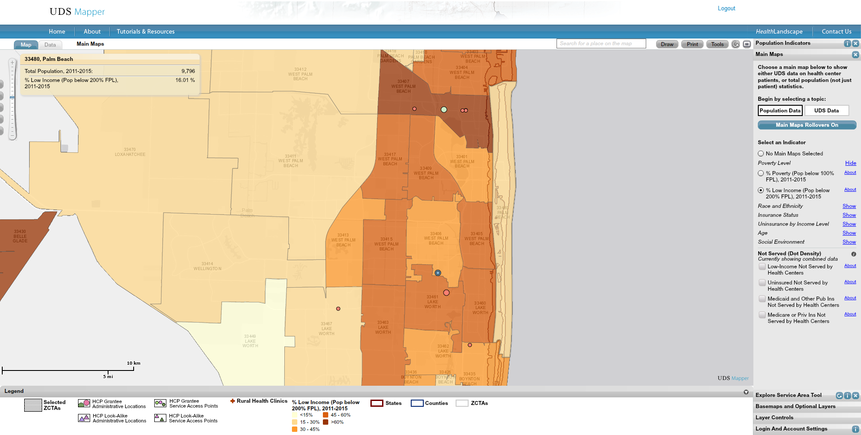
UDS Mapper- Low-Income
(Main Maps Tool)

Slide 33
In the UDS Mapper by ZCTA
Estimates based on data the HRSA Area Resource File, CDC Wonder and CDC Behavioral Risk Factor Surveillance System (BRFSS)
  Low birth weight rate
  Age-adjusted mortality
  Prevalence
    Diabetes, obesity, high blood pressure, no dental visit in past year, delayed care due to cost, no usual source o care
Notes:
In addition to these data, click the HealthLandscape link in the UDS Mapper to find other mapping tools with data at other geographic levels.

Slide 34
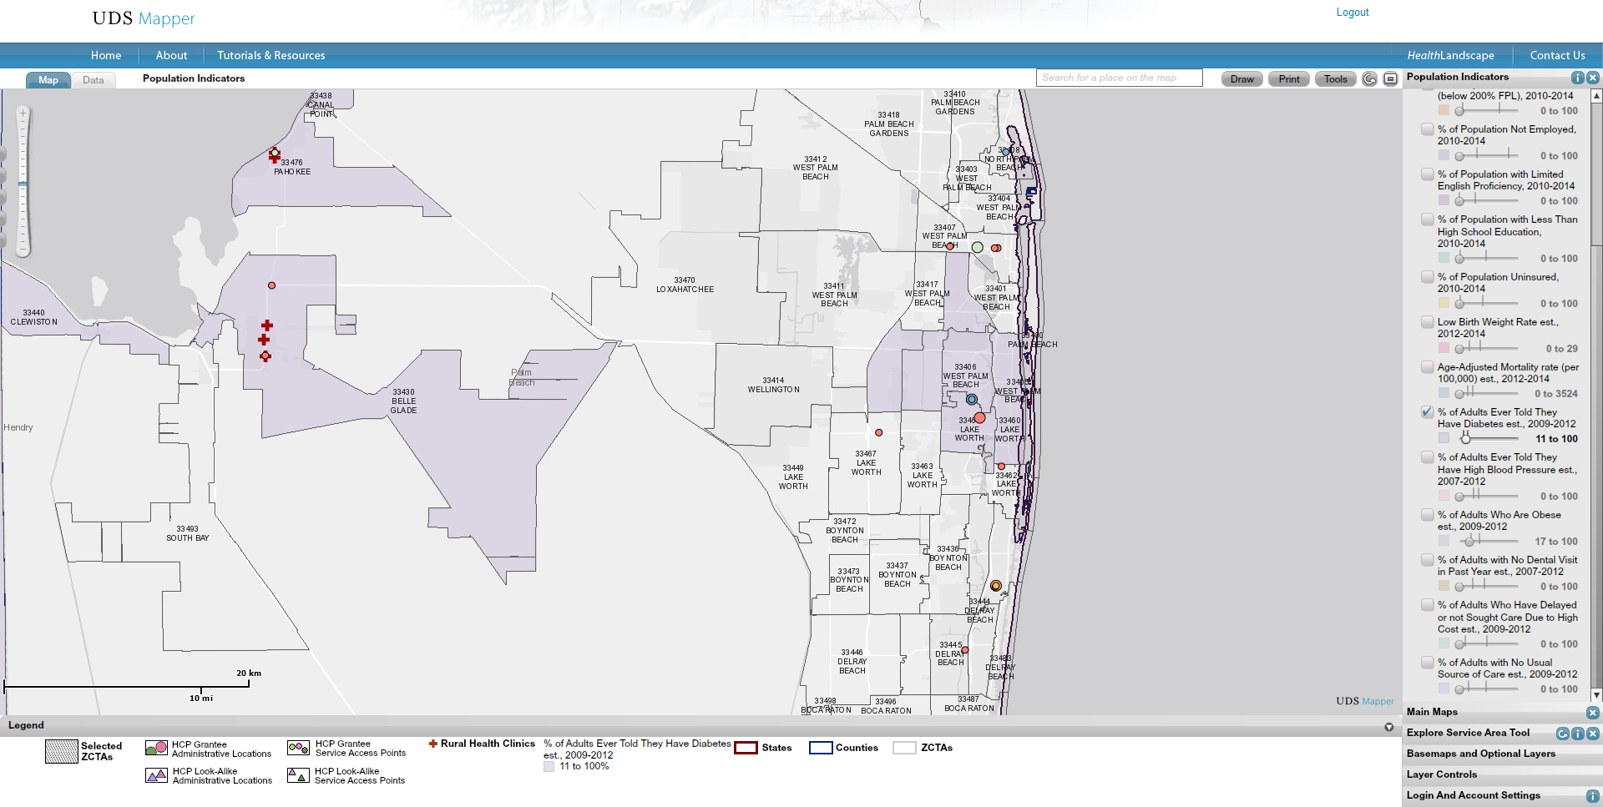
UDS Mapper- Diabetes Prevalence (Population Indicators Tool)

Slide 35
Others
Population Health Mapper by County- www.healthlandscape.org/map_PopulationHealth.cfm
Social Determinants of Health Mapper by Census Tract- www.healthlandscape.org/map_SDOH.cfm
500 Cities Project Mapping Tool by Census Tract- www.healthlandscape.org/map_Project500Cities.cfm
Community Health View by State/ County- www.healthlandscape.org or www.udsmapper.org

Slide 36
Module 2 Learning Objectives
Describe how geography interacts with population health
Explain geographic terms like thematic mapping and geocoding
Demonstrate how to use online population health tools
Notes:
As a reminder, here are the learning objectives that we hoped to accomplish by the end of this module.

Slide 37
Relevant family medicine milestones
Notes:
After completing this module, we hope that family medicine residents will be able to meet these milestones.
https://www.acgme.org/Portals/0/PDFs/Milestones/FamilyMedicineMilestones.pdf

Slide 38
Relevant nurse practitioner competencies
Notes:
After completing this module, we hope that nurse practitioner trainees will be able to address these competencies.
http://www.aacn.nche.edu/dnp/Essentials.pdf
https://c.ymcdn.com/sites/nonpf.site-ym.com/resource/resmgr/Competencies/NPCoreCompsContentFinalNov20.pdf

